Slide 1
under the sea
美麗海底城
小老師:陳寀妍

Slide 2
目錄
Warm-up
文法教學(習題練習)
Quizlet 文法句型練習
作業時間

Slide 3
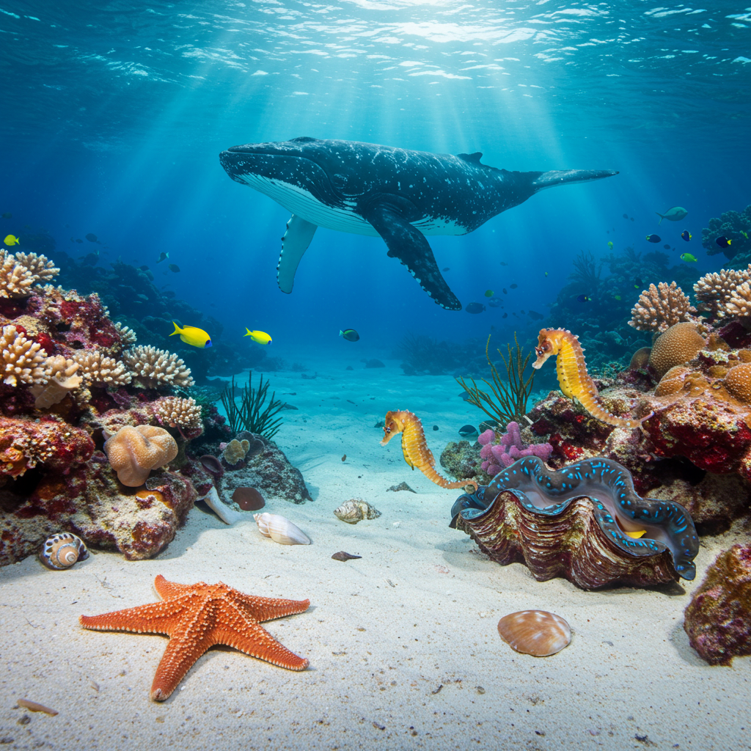
Warm-up

Slide 4
歌曲播放
https://youtu.be/AnrOI-2Dskg?si=jPikc91GANQF905m

Slide 5
請找出含有am/is/are +V-ing的句子
I'm going down, down, down, under the sea.
I'm going down, down, down, won't you come with me?
Where the whale swims...

Slide 6
more practice…
1.I am going down under the sea.
2.I go down under the sea.
3.I am going down the sea.
請問上面三個句子，哪一句是正確的呢?
The starfish ______ shining under the sea.
A. are B. is C. am

Slide 7
文法教學
用法 | 說明 | 句型 | 例句
現在進行式 | 表示正在進行或已經安排好的計畫 | S + am/is/are + V-ing | I'm going down, down, down, under the sea.
未來式 | 1.臨時決定、承諾 2.已經有計畫好的未來 | 1. S +will +原V 2. S+am/are/is +going to+原V | 1.They will help you now . 2.I am going to visit grandma.

Slide 8
句型結構
主詞 (S) | Be verb | 句型
I | am | going down under the sea.
The whale | is | swimming under the sea.
The starfish |  | shining under the sea.
The seahorse |  | jumping under the sea.

Slide 9
文法:V-ing（動詞現在分詞）變化規則
 | Example 1 | Example 2
1.直接+ing | sleep sleeping | walk walking
2.無聲字尾e 去e +ing | prepare preparing | come coming
3.短母音+子音 重複字尾+ing | swim swimming | run running
4.字尾是 -ie， 變 y 再加-ing | lie lying | die dying

Slide 10
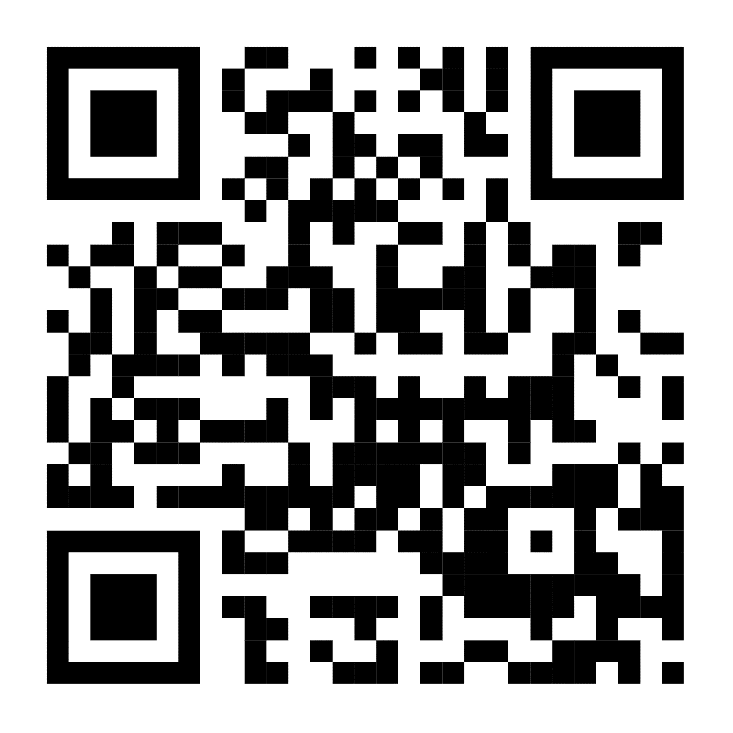
複習句型/文法: quizlet

Slide 11
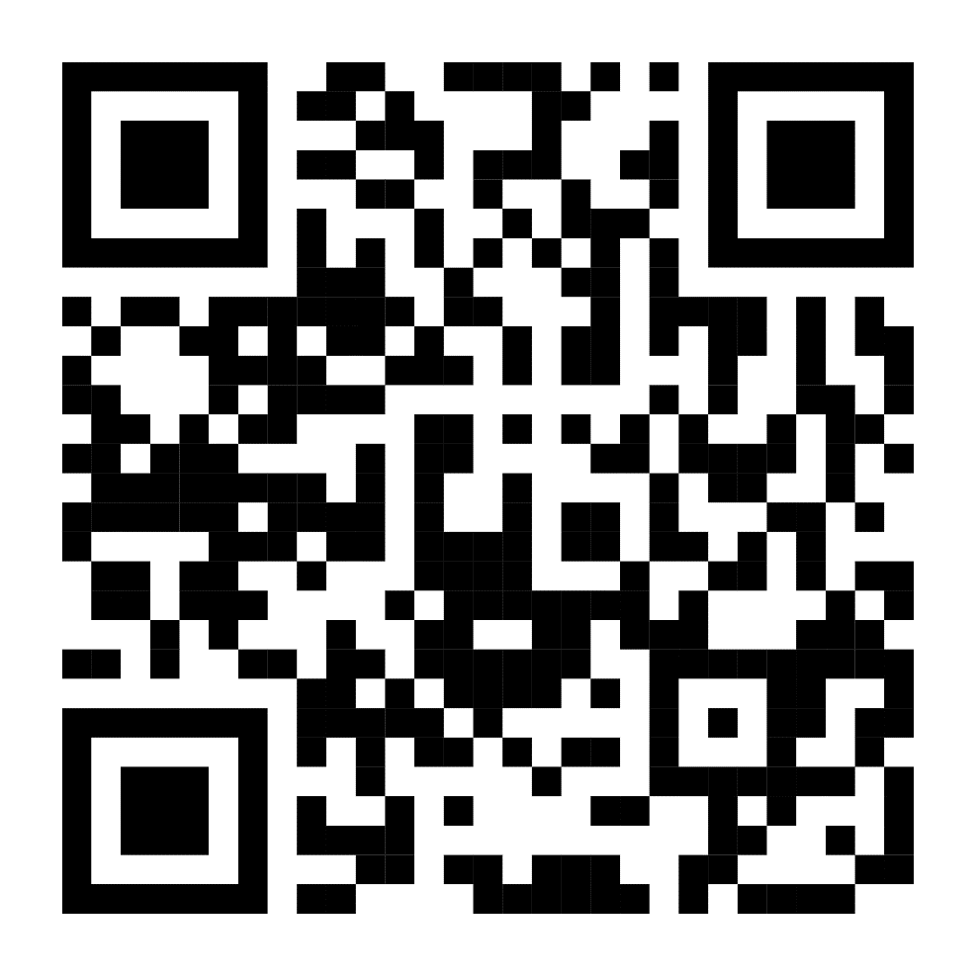
作業時間

