Slide 1











Sea Animal Friends Cleaning the Sea
海洋朋友清理污染一起來

Slide 2

Warm–up
Tra

Slide 3
Warm–up
Trash

Slide 4
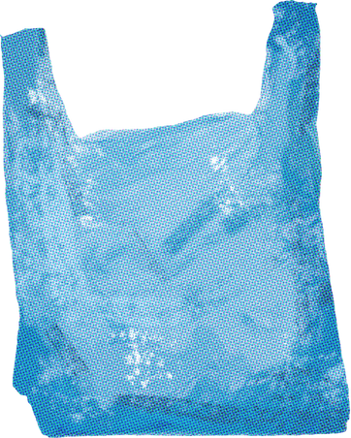

Warm–up
Pl st c

Slide 5
Warm–up
Plastic

Slide 6
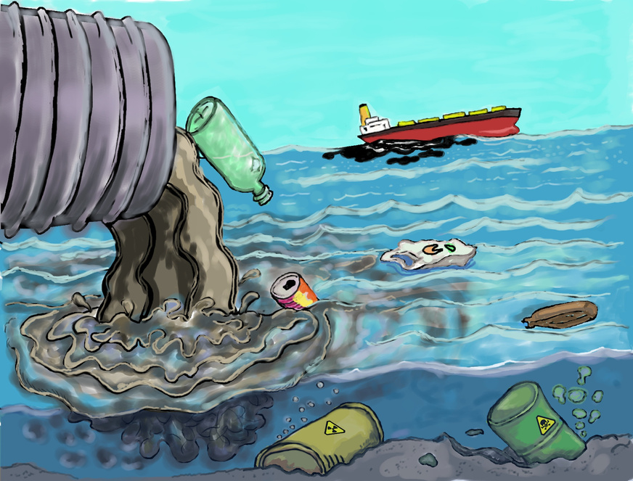
Warm–up
P ll t n

Slide 7
Warm–up
Pollution

Slide 8
Take a listen
聽聽看，在留言區寫下
你聽到的2個單字

Slide 9
Music Time
https://youtu.be/xbyV-m1Pv_I?si=eLEGtH4EYZiyNoBY

Slide 10
Song lyrics
I am swimming, I am swimming.
In the sea. In the sea.
我在游泳，我在游泳
在海裡，在海裡

Slide 11
Song lyrics
Look at all the plastic, look at all the plastic.
Surrounding me. Surrounding me.
看看這些塑膠，看看這些塑膠
圍繞著我，圍繞著我

Slide 12
Song lyrics
I am picking up, I am picking up.
With my tusk, with my tusk.
我正在撿，我正在撿
用我的象牙，用我的象牙

Slide 13
Song lyrics
All of this rubbish, all of this rubbish.
From dawn till dusk. From dawn till dusk.
這些垃圾，這些垃圾
從早到晚，從早到晚

Slide 14
Song lyrics
My home is covered,
my home is covered.
In this mess. In this mess.
我的家被覆蓋了，我的家被覆蓋了
在這片混亂中，在這片混亂中

Slide 15
Song lyrics
We need help to clean it.
We need help to clean it.
To make it less, to make it less.
我們需要幫忙清理，我們需要幫忙清理
讓它變少，讓它變少

Slide 16
Song lyrics
If you're near a beach,
if you're near a beach.
Stream or lake, stream or lake.
如果妳在海灘附近，如果妳在海灘附近
溪流或湖泊，溪流或湖泊

Slide 17
Song lyrics
You could help to clean,
you could help to clean.
For all our sake, for all our sake.
你可以幫忙清理，你可以幫忙清理
為了我們大家好，為了我們大家好

Slide 18
Song lyrics
Come on.
來吧
You wanna help?
你想幫忙嗎？
Let’s go.
我們走吧！

Slide 19
Word Types
Verb→ 動詞
Noun→ 名詞
Phrasal Verb→ 動詞片語
adjective→ 形容詞
prepositional phrase→介係詞短語

Slide 20


Vocabulary
swim / swimming (Verb)
I like to go swimming in the summer.
我喜歡在夏天去游泳

Slide 21
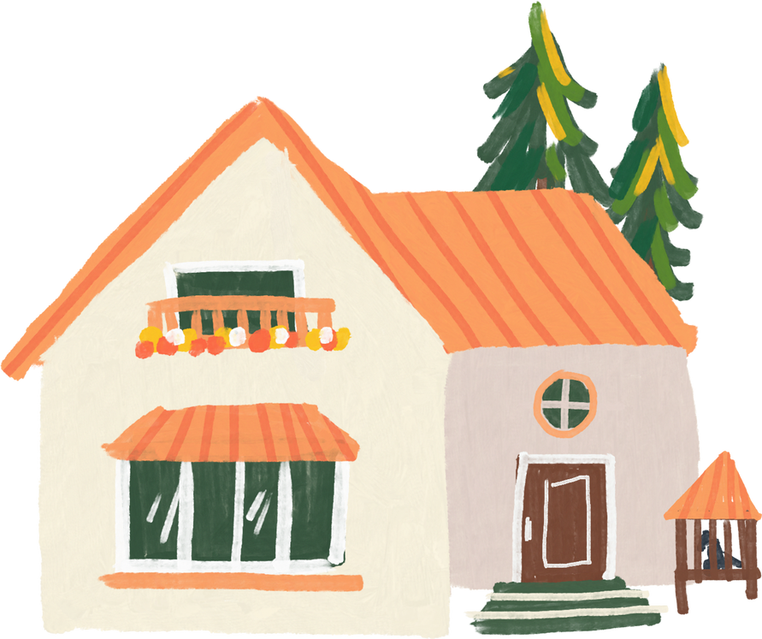


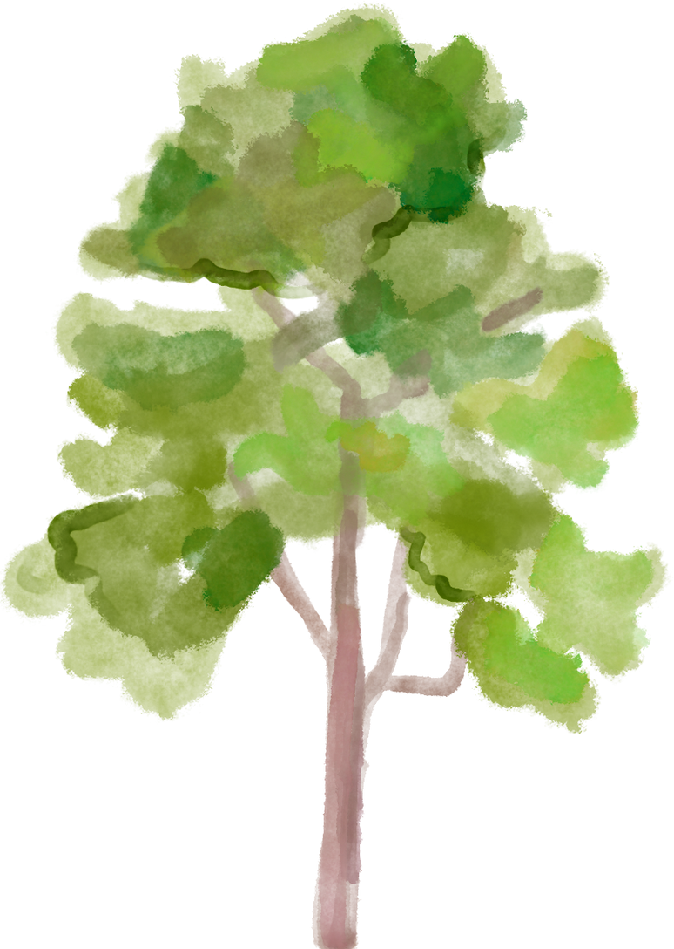

Vocabulary
surround / surrounding (Verb)
The trees are surrounding the house.
樹木圍繞著房子

Slide 22
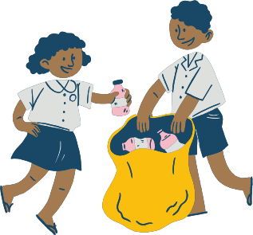

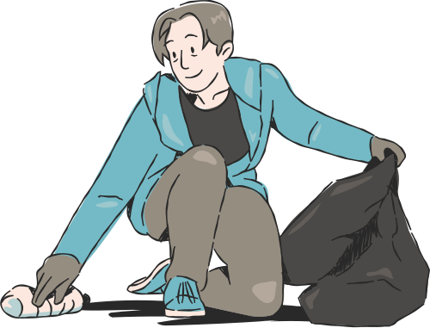
Vocabulary
pick up / picking up (phrasal verb)
I am picking up trash in the park.
我正在公園裡撿垃圾

Slide 23

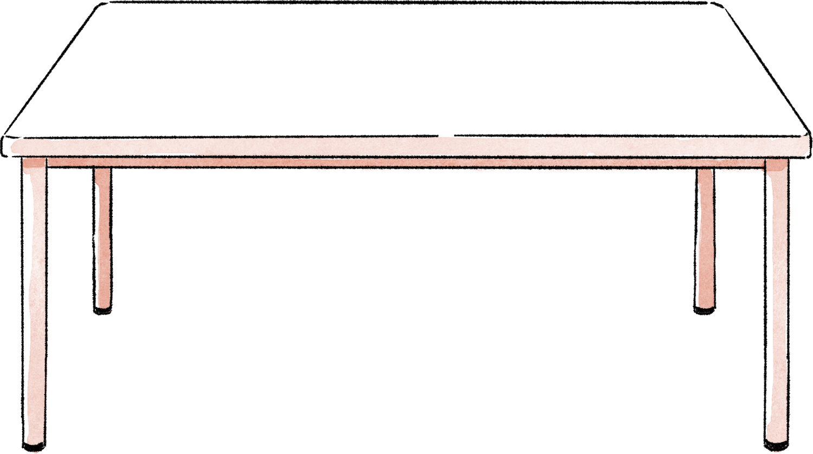
Vocabulary
cover / covered (Verb)
The table is covered with a red cloth.
桌子被紅布蓋住了

Slide 24

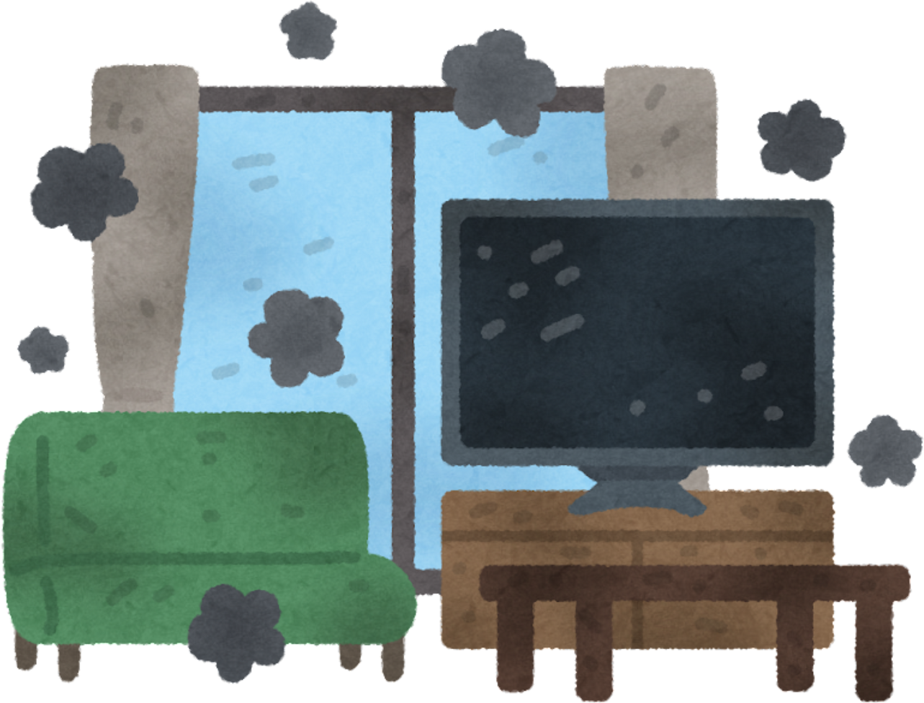
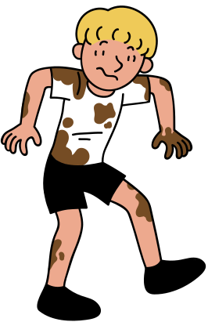
Vocabulary
mess (noun)
My room is such a mess.
我的房間很亂

Slide 25



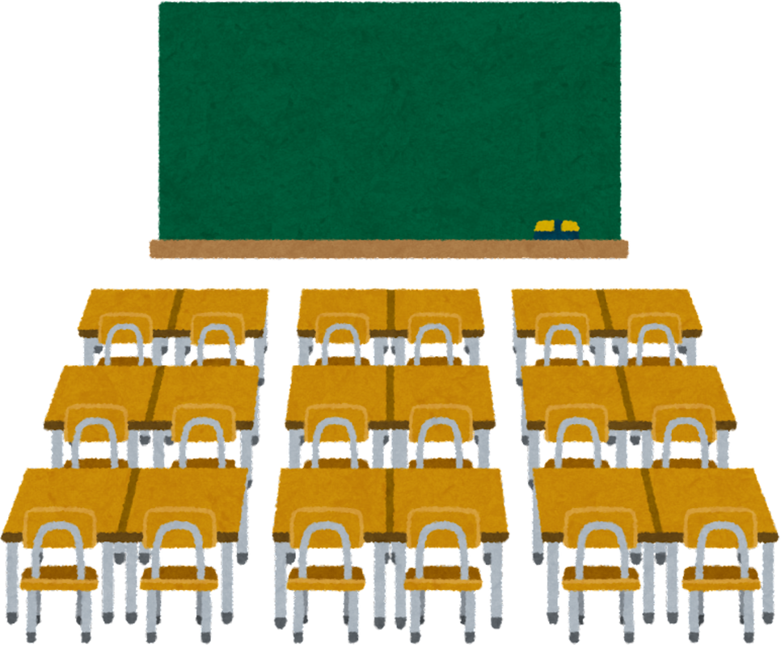

Vocabulary
clean (Verb)
Let’s clean the classroom together.
我們一起打掃教室吧

Slide 26

Vocabulary
make (Verb)
I will make a rose for my mom.
我要做一朵玫瑰花給我媽媽

Slide 27





Vocabulary
less (adjective )
There is less sugar in this juice.
這杯果汁的糖比較少

Slide 28



Vocabulary
dawn (Verb)
I wake up early at dawn.
我黎明時分就醒了

Slide 29

Vocabulary
dusk (noun)
The sky looks orange at dusk.
黃昏時天空看起來是橘色的

Slide 30
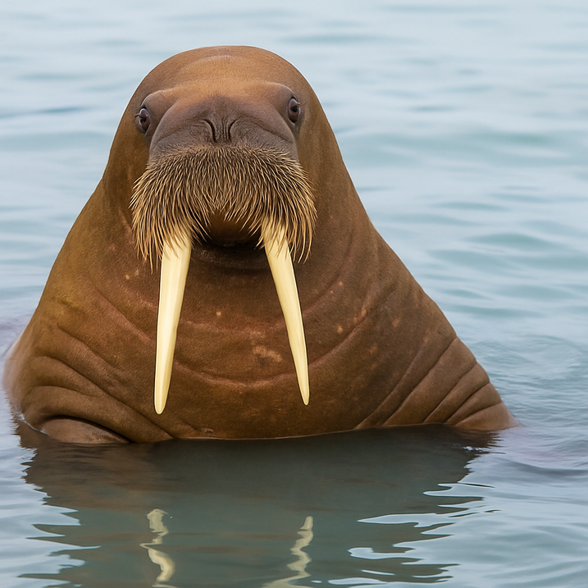


Vocabulary
tusk (noun)
The elephant has long tusks.
大象有長長的象牙

Slide 31


Vocabulary
stream (noun)
There is a small fish in the stream.
小溪裡有一條小魚

Slide 32





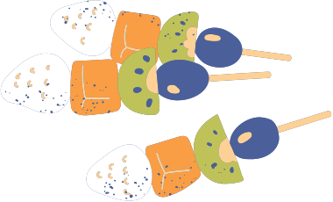
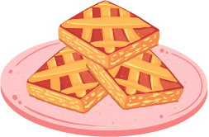
Vocabulary
lake (noun)
We had a picnic by the lake.
我們在湖邊野餐

Slide 33

Vocabulary
For all our sake (prepositional phrase)
For all our sake, we should keep the classroom clean.
為了大家好，我們應該保持教室整潔

Slide 34


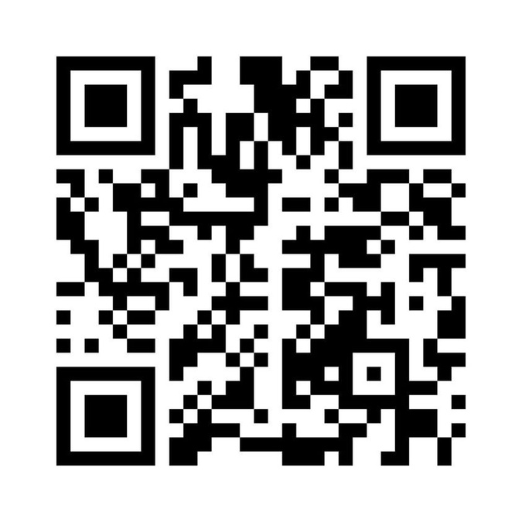




Sentence practice
♥︎

Slide 35
Grammar
現在進行式（Present Continuous Tense）
I am swimming.
I am picking up.

Slide 36
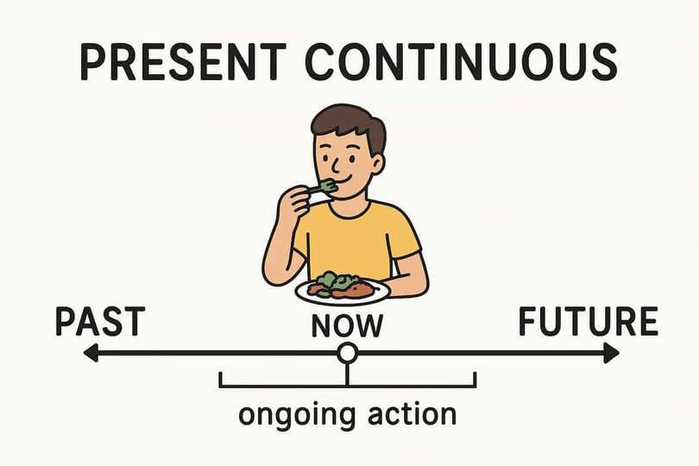
Grammar
→「主詞 + be動詞(am/are/is) + V-ing」
→ 表示正在發生的動作

Slide 37

Life application
I am eating breakfast.
我正在吃早餐
She is reading a book.
她正在看書

Slide 38

Grammar
地點副詞片語（Place Phrases）
In the sea.
With my tusk.

Slide 39



Grammar
副詞片語描述「在哪裡、用什麼方式」
in + 地點（在…裡）
on + 地點（在…上面）
with + 工具（用…工具）

Slide 40


Life application
I study in my room.
我在房間讀書
He draws with a pencil.
他用鉛筆畫畫

Slide 41
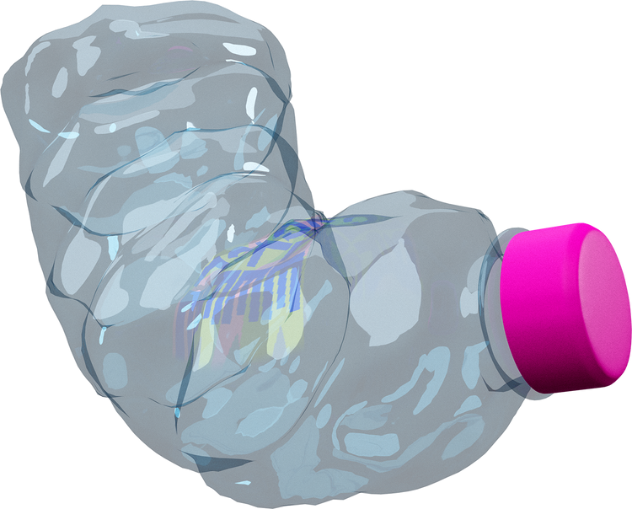


Grammar
Look at… 句型
Look at all the plastic.
看看所有的塑膠

Slide 42
Grammar
“Look at + 名詞” 表示請別人看某樣東西
→ 用在日常提醒、指示或吸引注意

Slide 43




Life application
Look at the sky!
看天空！
Look at that dog.
看那隻狗 !

Slide 44
Grammar
被動語態（Passive Voice）
My home is covered in this mess.
意思是「我的家被這些髒亂覆蓋」

Slide 45
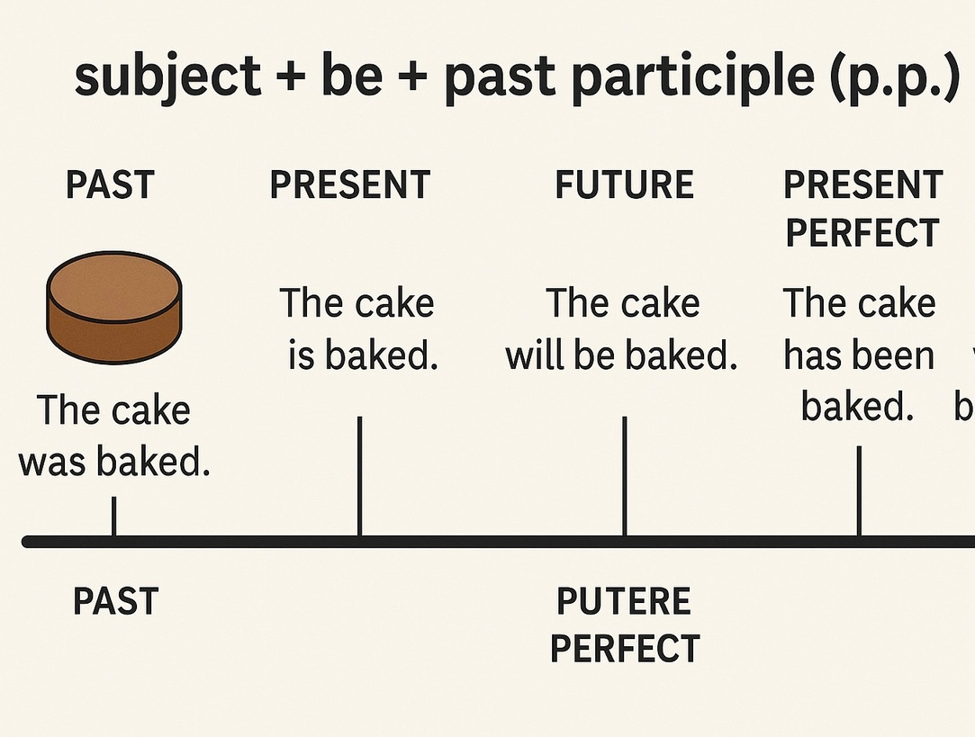
Grammar
→ 主詞+be動詞+過去分詞(P.P.)

Slide 46


Life application
The bread is eaten by Tom.
麵包被Tom吃了
The floor is cleaned every day.
地板每天都被打掃

Slide 47
Grammar
條件句型 If…
If you’re near a beach…
→ 條件句：如果…，就…

Slide 48
Grammar
If you’re near a beach, you could
help to clean.
如果妳住的靠近海邊，妳可以幫忙打掃

Slide 49



Life application
If it rains, I will stay home.
如果下雨，我會待在家
If you are hungry, eat something.
如果你餓了，就吃點東西

Slide 50
Quick Review
swim
surround
pick up
cover
mess
clean
make
less
dawn
dusk
tusk
stream
river
for all our sake

Slide 51
Quiz

Slide 52
The end

