Slide 1
Save the Sea Animals
拯救海洋生物好朋友
羅桓希 Nimin

Slide 2
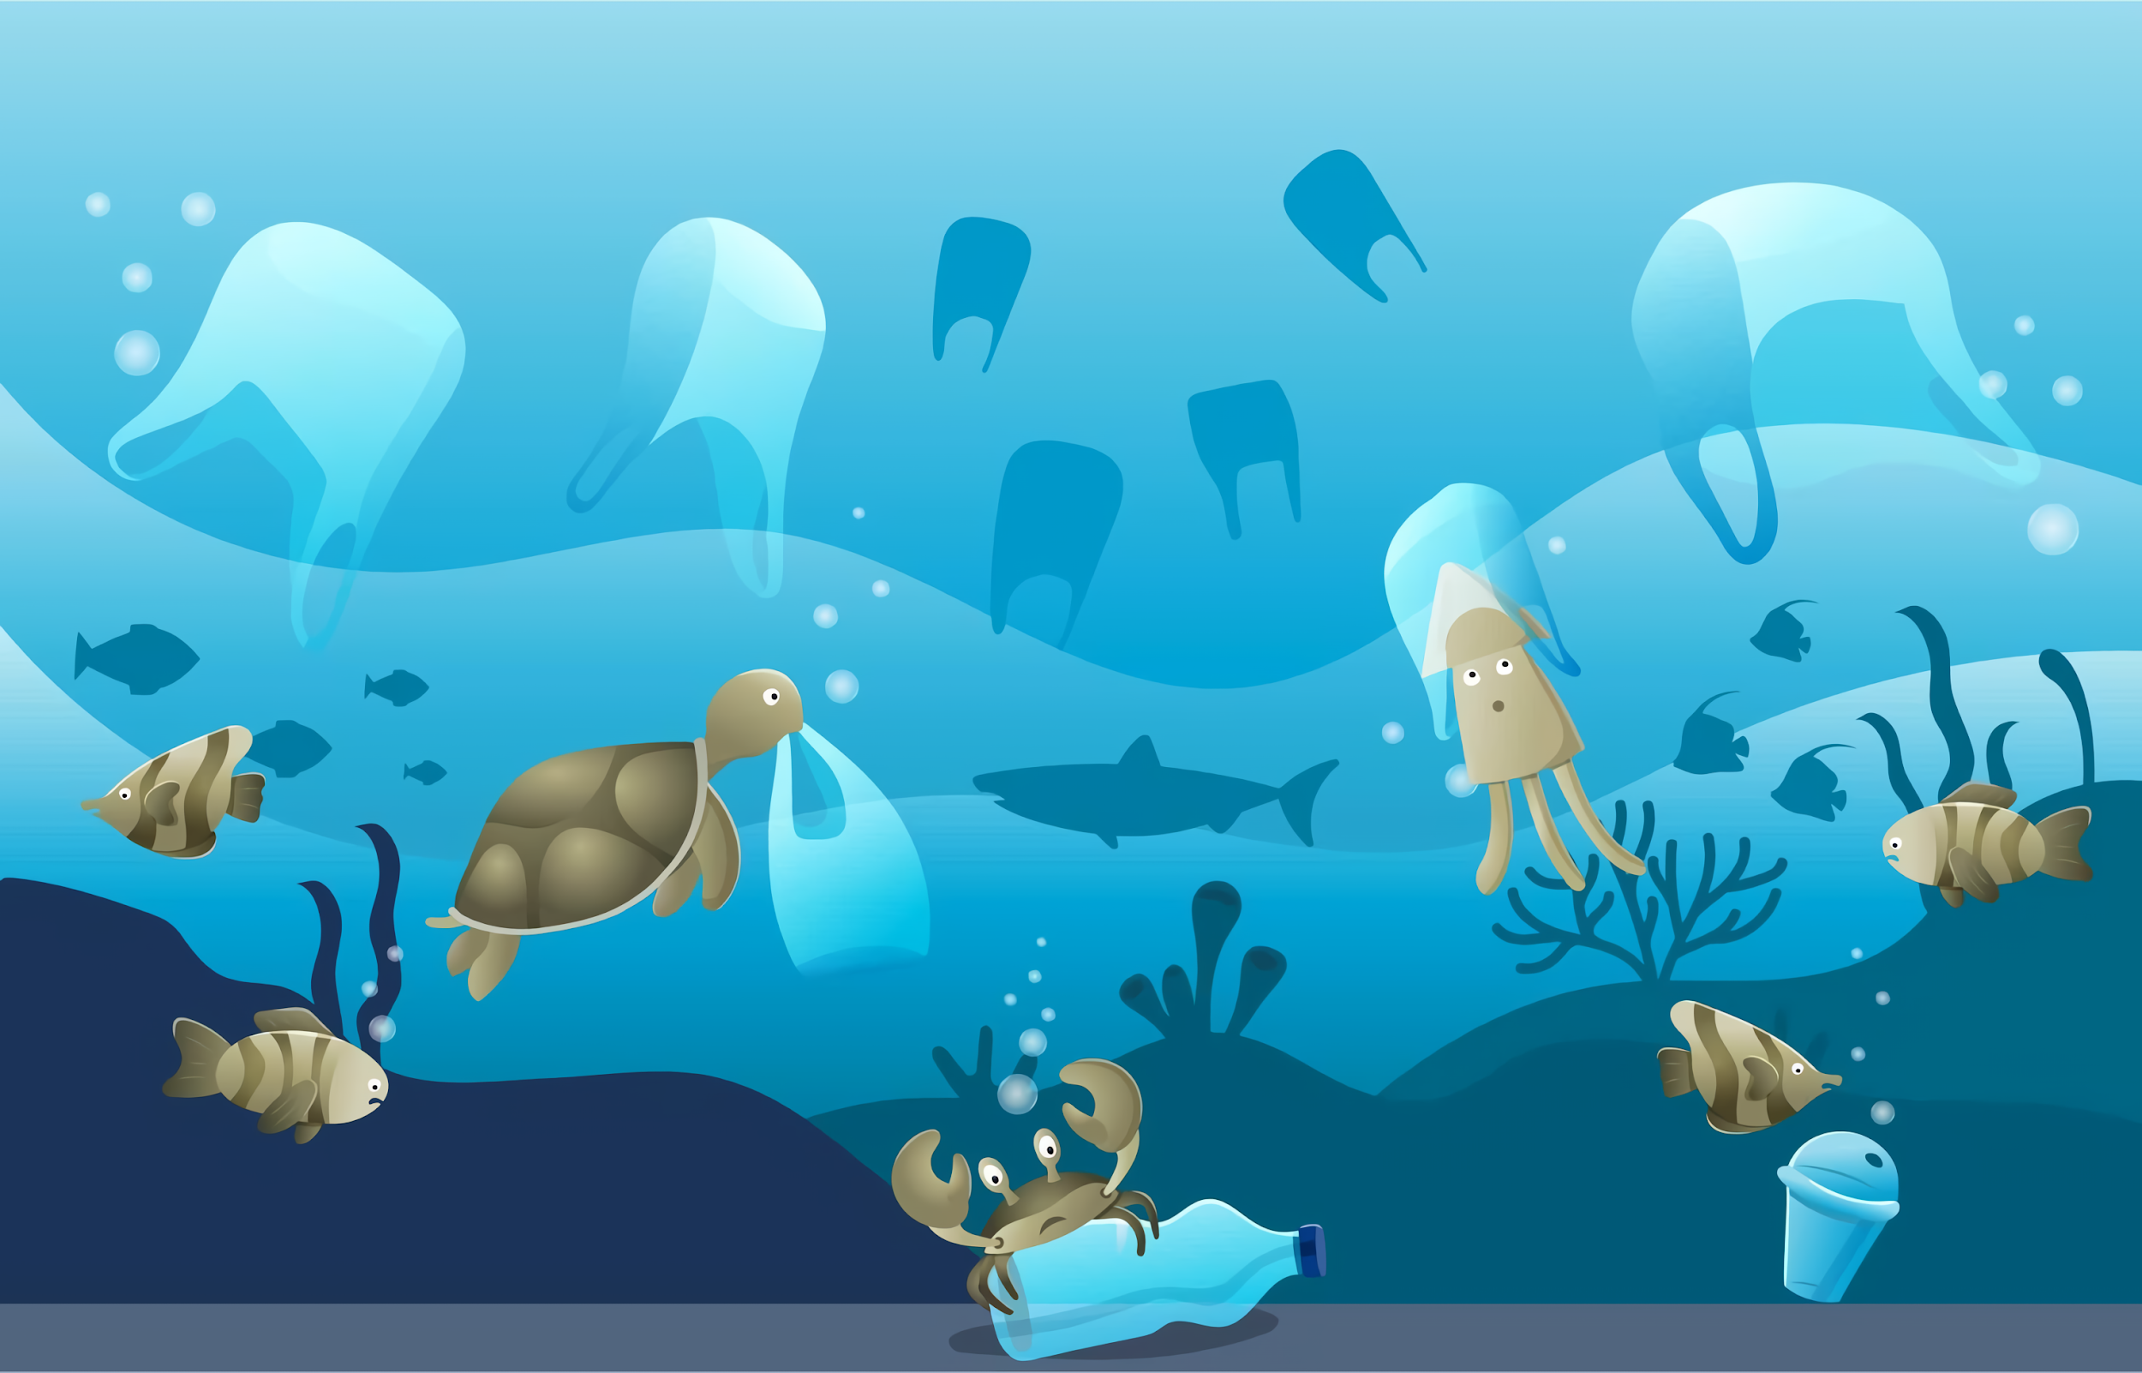
What do you see
in this picture?

Slide 3
01
Word bank

Slide 4

monster

Slide 5
A monster is in the sea.

Slide 6
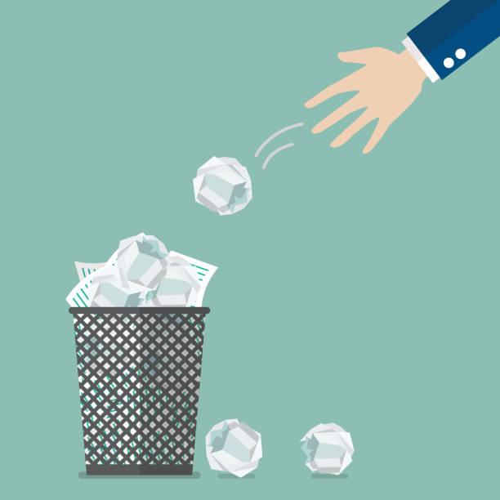
throw away

Slide 7
I throw away the trash.

Slide 8

trap

Slide 9
He puts a fish in the trap.

Slide 10
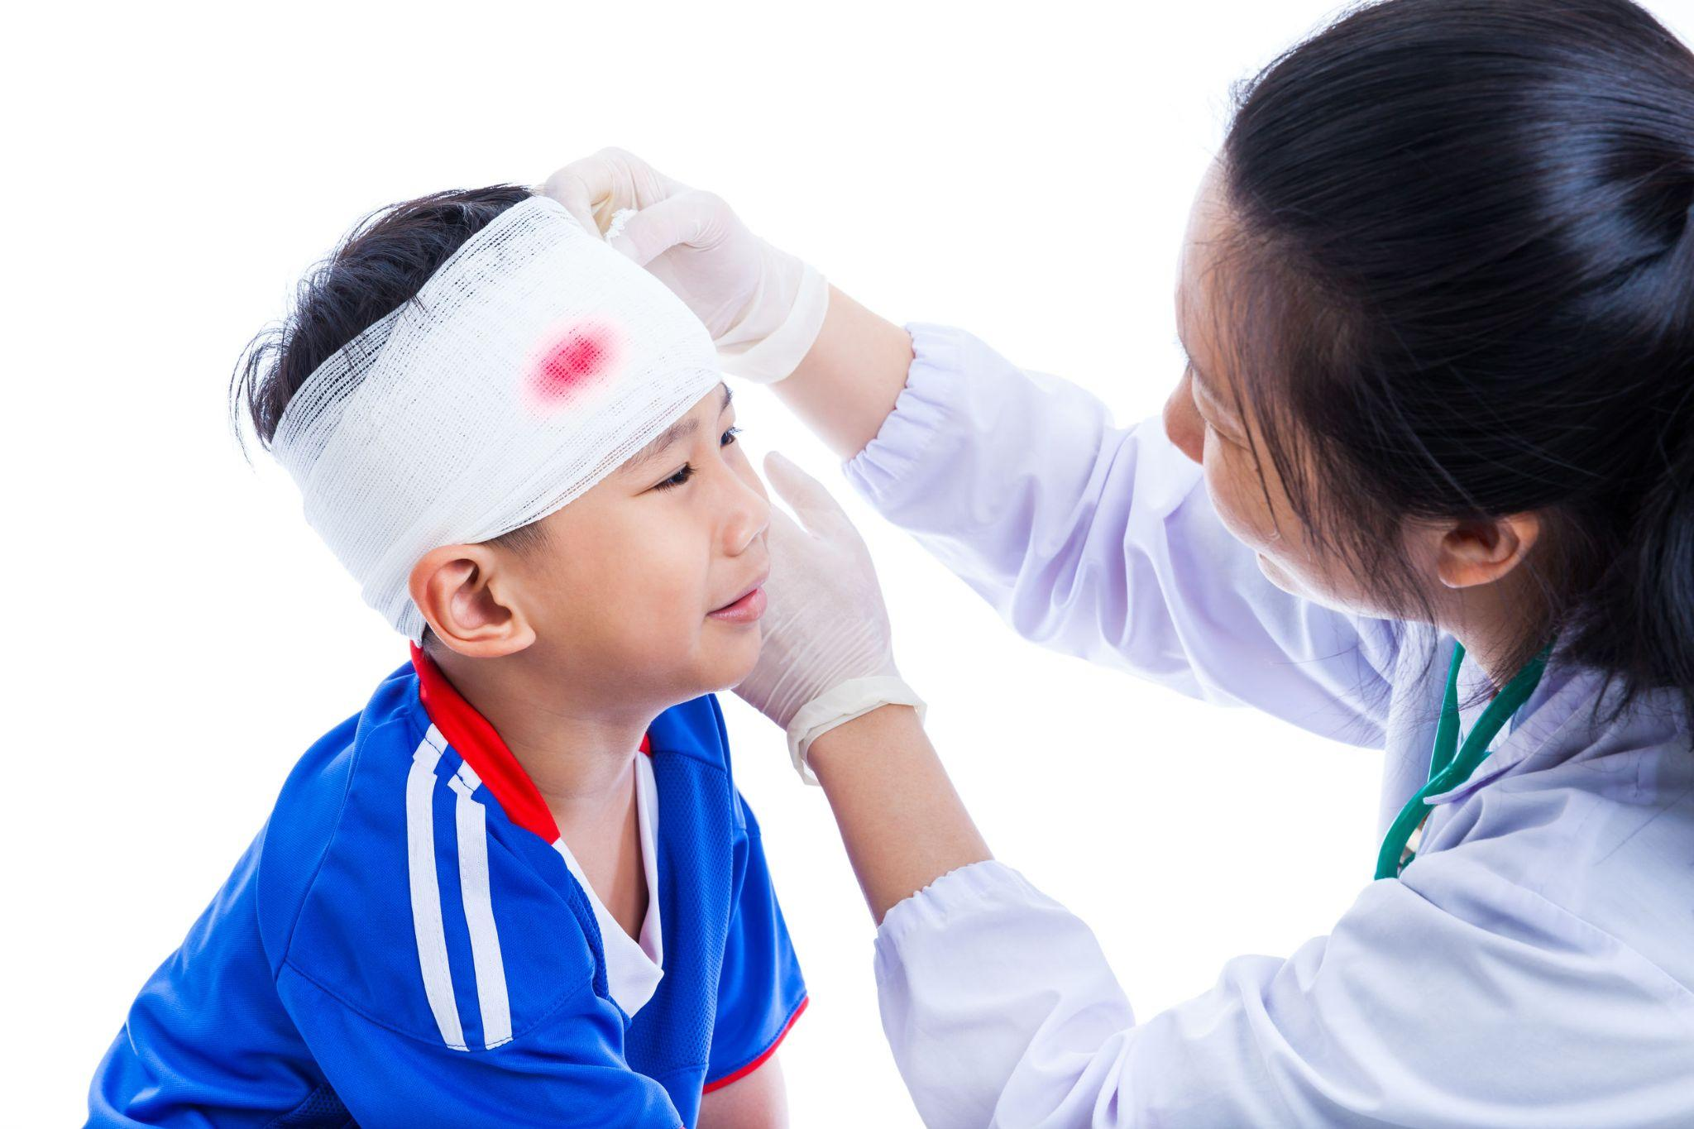
get hurt

Slide 11
I get hurt.
It is bad.

Slide 12

police

Slide 13
The police comes and helps us.

Slide 14
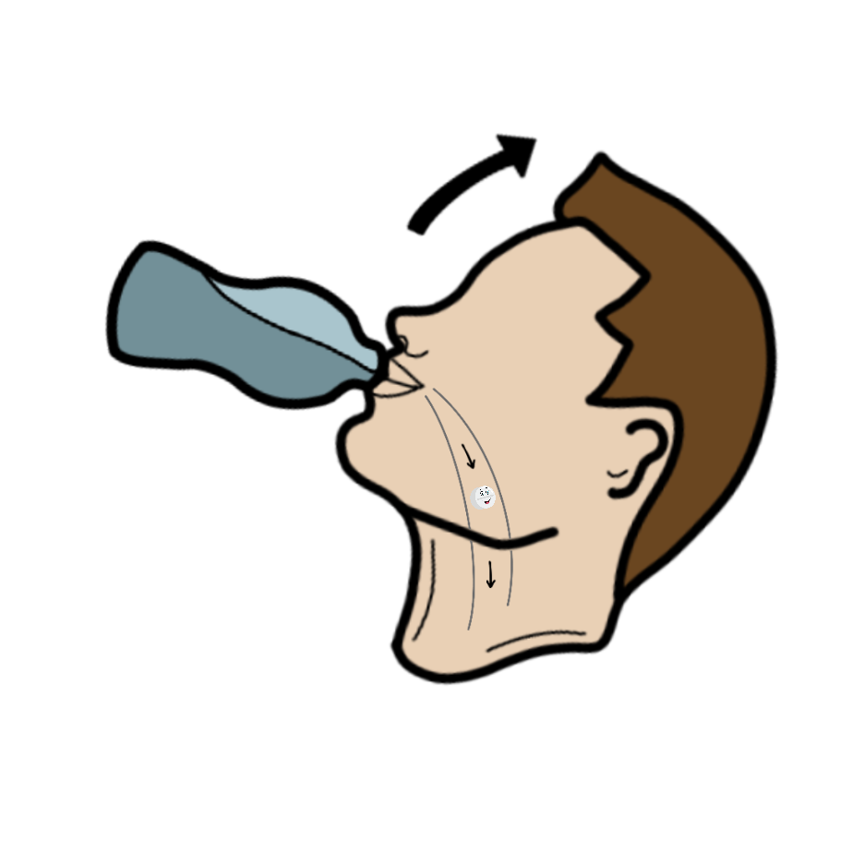
swallow

Slide 15
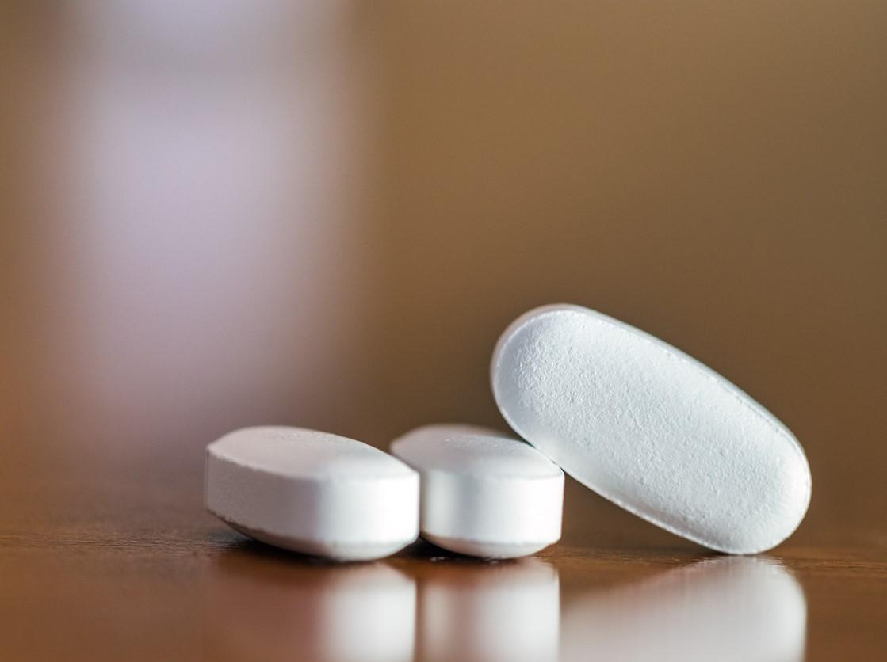
He swallows pills with water.
pill

Slide 16

fishing
net

Slide 17
He uses a fishing net to catch fish.

Slide 18
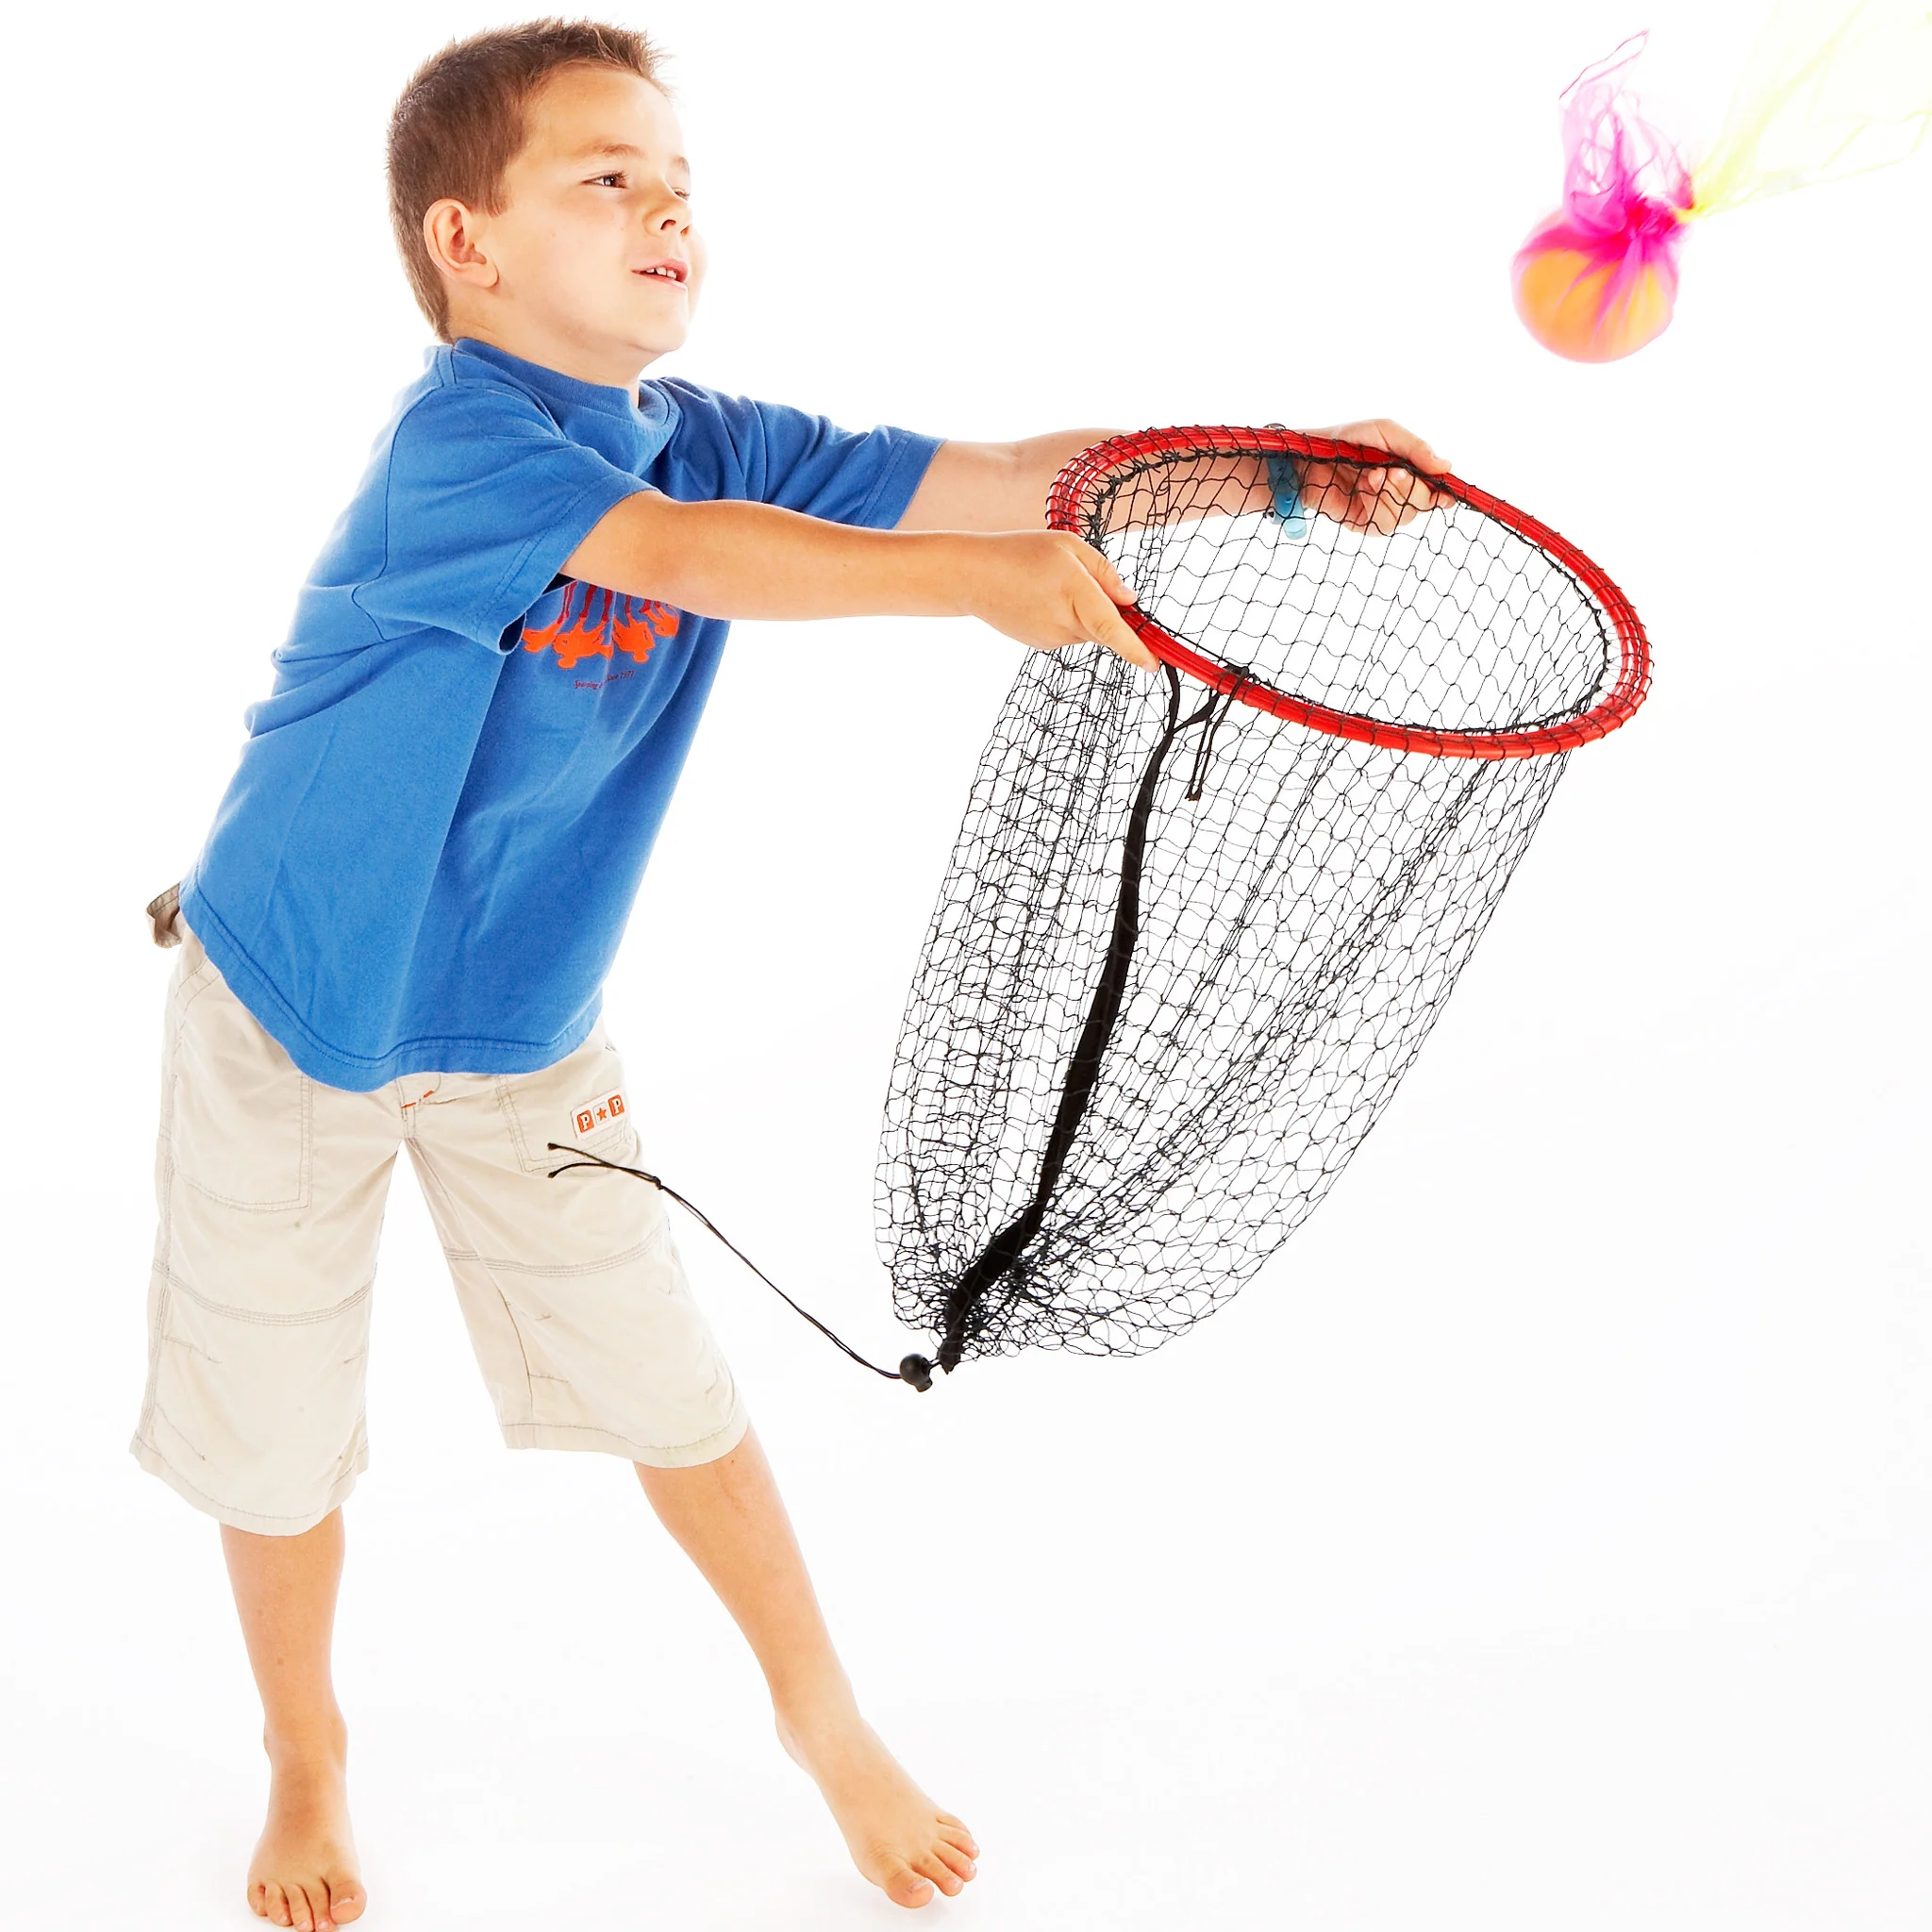
catch

Slide 19
We catch
the ball in the game.

Slide 20

dolphin

Slide 21
A dolphin jumps out of the water.

Slide 22
Practice
time

Slide 23
A m_____r is in the sea.

Slide 24
A monster is in the sea.

Slide 25
I th__w away the trash.

Slide 26
I throw away the trash.

Slide 27
He puts a fish in the t__p.

Slide 28
He puts a fish in the trap.

Slide 29
I get h__t.
It is bad.

Slide 30
I get hurt.
It is bad.

Slide 31
The p____e comes and helps us.

Slide 32
The police comes and helps us.

Slide 33
He s_____ws pills with water.

Slide 34
He swallows pills with water.
pill

Slide 35
He uses a f____ing n_t to catch fish.

Slide 36
He uses a fishing net to catch fish.

Slide 37
We c___h
the ball in the game.

Slide 38
We catch
the ball in the game.

Slide 39
A d_____n jumps out of the water.

Slide 40
A dolphin jumps out of the water.

Slide 41
Matching

Slide 42
Let’s listen:
JunyTony vs. The Ocean Trash Monsters

Slide 43
02
Quiz time

Slide 44
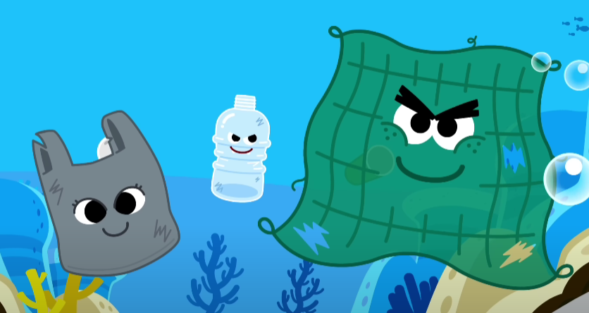
Quiz time
Q.
?
A.
①
③
②
What monsters are in the video?
(4 answers)
？

Slide 45
Quiz time
Q.
?
A.
①
③
②
What monsters are in the video?
(4 answers)
The Trash Monster
①the plastic monster
②the plastic bag monster
③the (old) fishing net monster

Slide 46
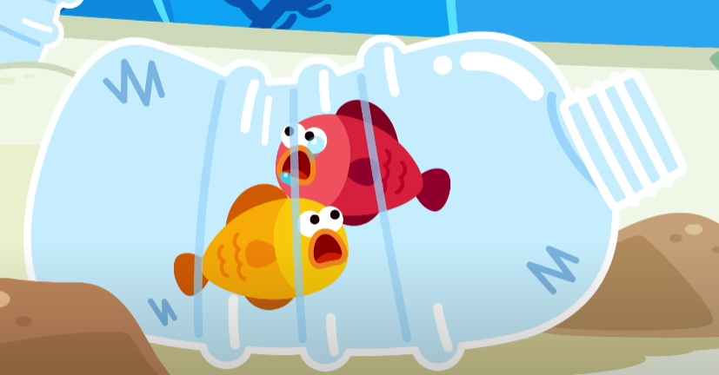
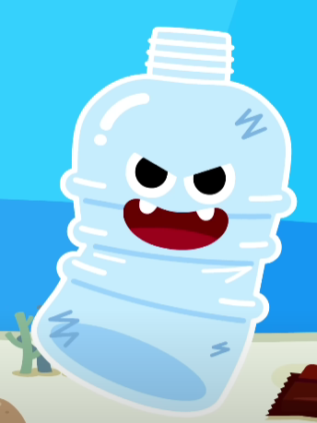
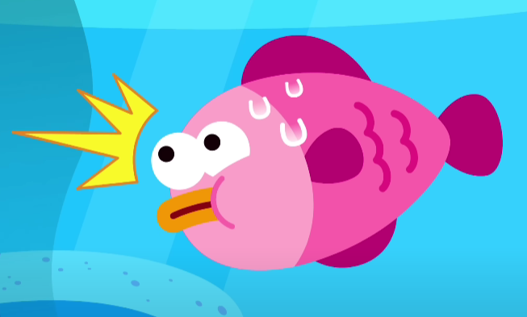
Quiz time
Q.
?
How do the plastic (bottle) monster hurt sea creatures?
I t__p fish.
Fish get h__t.

Slide 47
Quiz time
Q.
?
How do the plastic (bottle) monster hurt sea creatures?
I trap fish.
Fish get hurt.

Slide 48
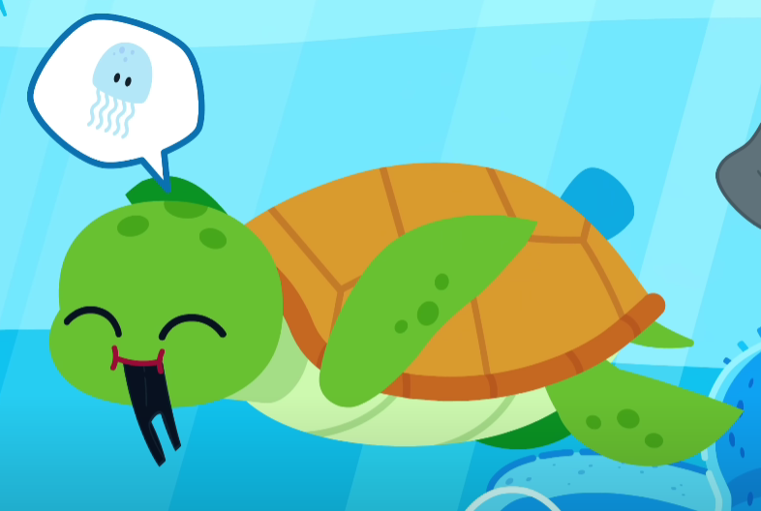
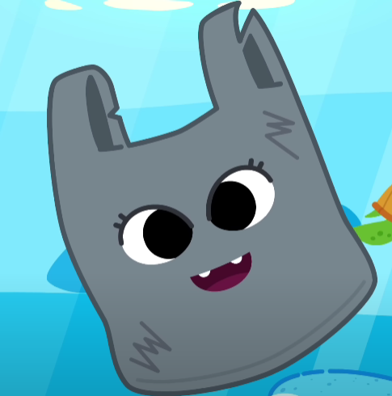
Quiz time
Q.
?
How do the plastic bag monster hurt sea creatures?
T____e s_____ws me.
T____e gets s__k.

Slide 49
Quiz time
Q.
?
How do the plastic bag monster hurt sea creatures?
Turtle swallows me.
Turtle gets sick.

Slide 50
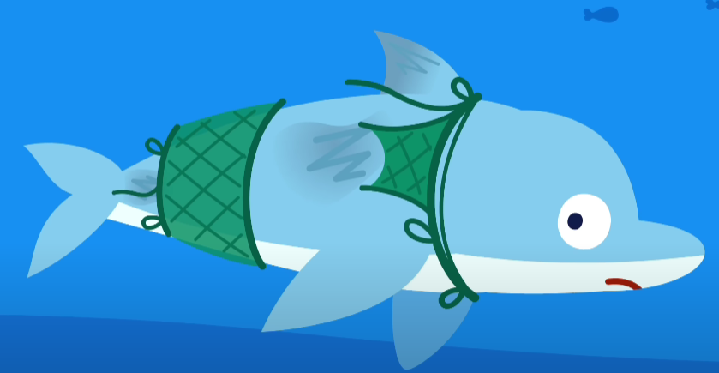
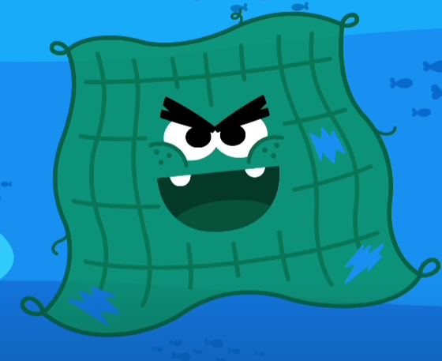
Quiz time
Q.
?
How do the (old) fishing net monster hurt sea creatures?
I c___h a dolphin.
Dolphin gets h__t.

Slide 51
Quiz time
Q.
?
How do the (old) fishing net monster hurt sea creatures?
I catch a dolphin.
Dolphin gets hurt.

Slide 52
take a break

Slide 53
03
Sentences

Slide 54
Let's+V

Slide 55
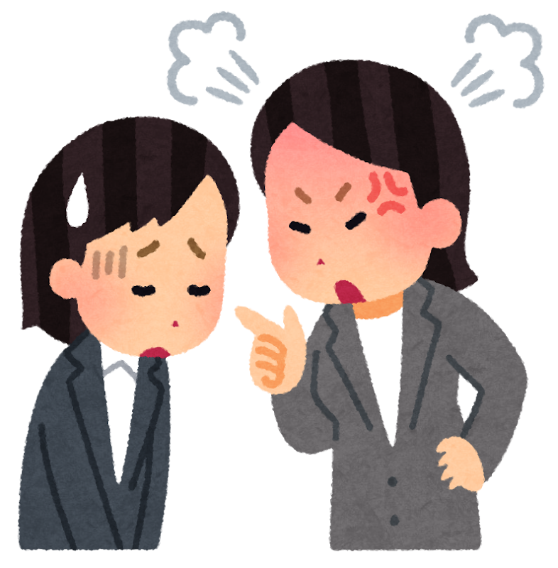
Be quiet!

Slide 56

Let's be quiet!

Slide 57
Example
How can you start helping?
Let's protect the ocean.

Slide 58

How can you start helping?
Let's
+
save the dolphins!

Slide 59

How can you start helping?
Let's save the dolphins!

Slide 60

How can you start helping?
Let's
+
stop using plastic bags.

Slide 61

How can you start helping?
Let's stop using plastic bags.

Slide 62


How can you start helping?
Let's stop using plastic bags.

Slide 63
Not only…
but also

Slide 64
not only A but also B?

Slide 65
not only A but also B?
比較強調B

Slide 66
not only A but also B?
比較強調B
A跟B的結構要相同

Slide 67
not only A but also B?
比較強調B
A跟B的結構要相同
  She is not only smart but also kind. (形容詞)
  I not only picked up the trash but also saved the turtles. (動詞)

Slide 68
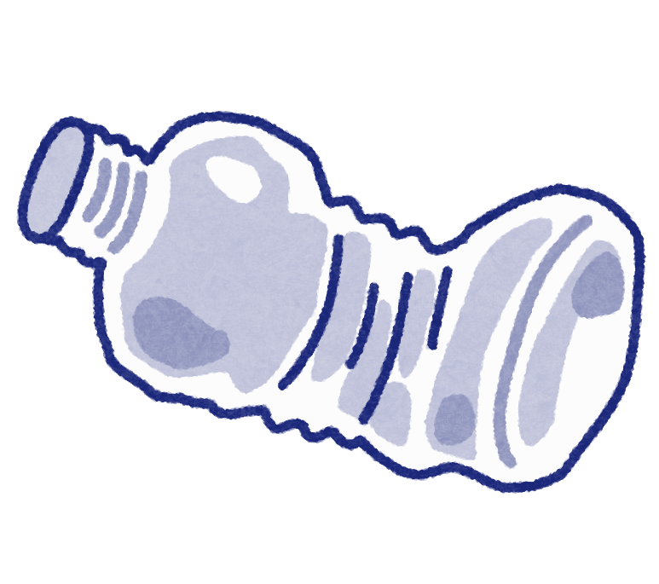


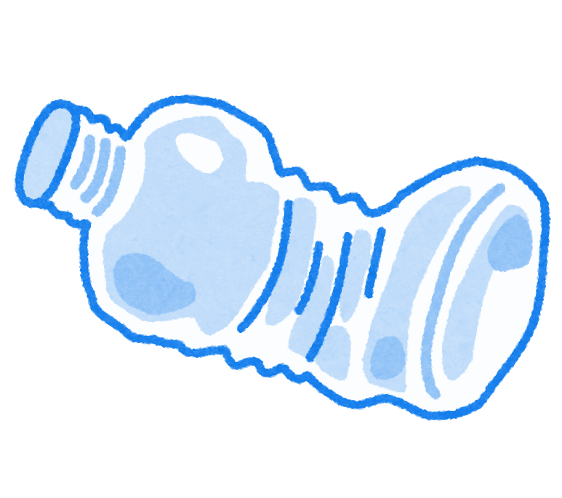



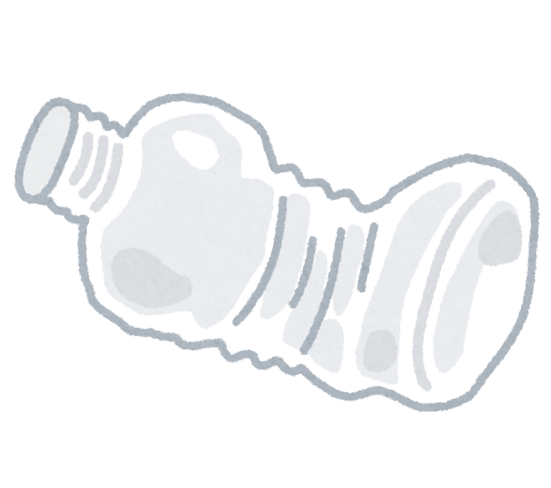

Example
Not only _______ ______
but also _______ ____
hurt sea animals.

Slide 69
Example
Not only plastic bottles
but also fishing nets
hurt sea animals.

Slide 70
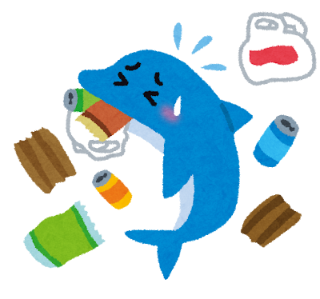
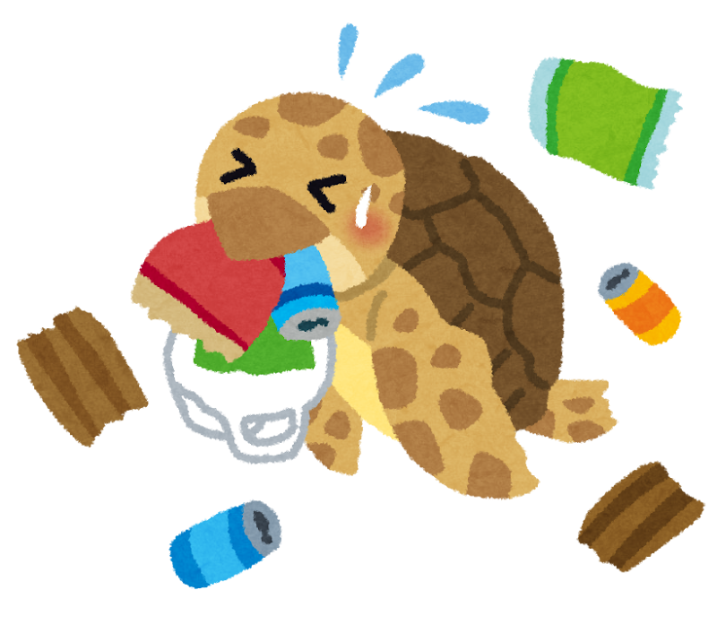
Not only _______ but also ______
get hurt.

Slide 71
Not only dolphin but also turtle
get hurt.

Slide 72
04
Wrap up

Slide 73
review test
Q.
?
A.
What can trap fish in the ocean?
？

Slide 74
review test
Q.
?
A.
What can trap fish in the ocean?
The fishing net.

Slide 75
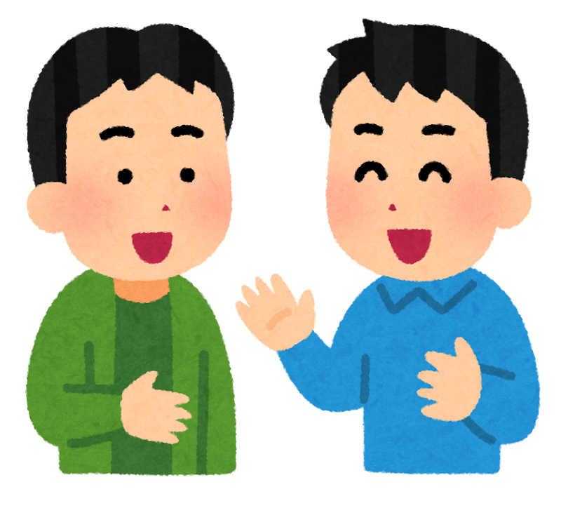
review test
Q.
?
A.
Let's _______ to protect the ocean.
？

Slide 76
review test
Q.
?
A.
Let's _______ to protect the ocean.
(a) throw away the plastic bags

Slide 77
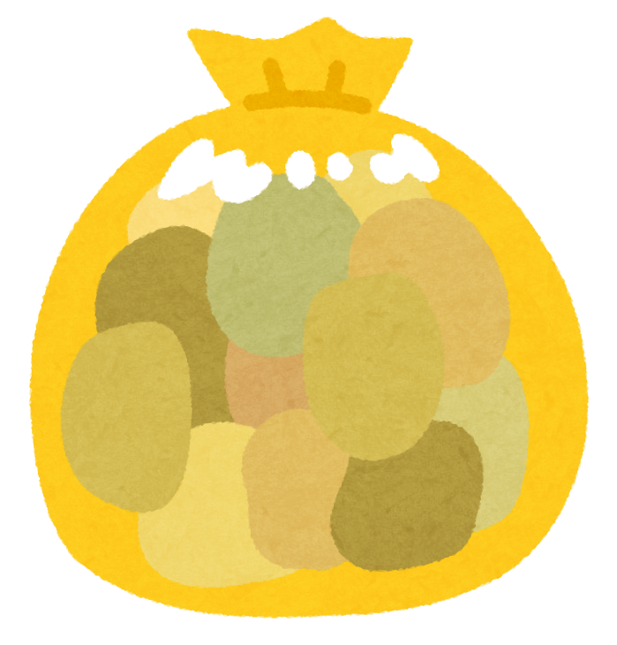
review test
Q.
?
A.
Let's _______ to protect the ocean.
(a) throw away the plastic bags
(b) catch up the trash

Slide 78

review test
Q.
?
A.
Let's _______ to protect the ocean.
(a) throw away the plastic bags
(b) catch up the trash
(c) use fishing net

Slide 79
review test
Q.
?
A.
Let's _______ to protect the ocean.
(a) throw away the plastic bags
(b) catch up the trash
(c) use fishing net

Slide 80
review test
Q.
?
A.
Not only _______, but also _______ are ocean trash.
？

Slide 81
review test
Q.
?
A.
Not only _______, but also _______ are ocean trash.
1.the plastic bottles
2.the plastic bags
3. the fishing nets

Slide 82
Let's make music!

Slide 83
How to create?

Slide 84
How to create?
歌詞素材

Slide 85
How to create?
歌詞素材
曲風

Slide 86
Let's+V
learn about ocean protection
學習海洋保護知識
reduce plastic use
減少塑料使用
protect the dolphins
保護海豚
save fish from fishing nets
拯救漁網中的魚
stop monsters from hurting marine life
阻止怪物傷害海洋生物
3

Slide 87
Not only plastic bottles but also plastic bags hurt sea animals.
不只有塑膠瓶，還有塑膠袋也會傷害海洋動物。
Not only adults but also children can be ocean police.
不只是大人，還有小孩也可以當海洋警察。
Not only today but also every day we must protect our ocean.
不只有今天，還有每一天我們都必須保護我們的海洋。
1
not only A but also B

Slide 88
Feedback

