Slide 1
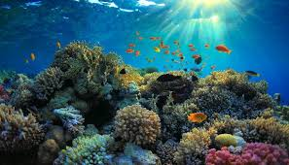
Sea Animal Friends Cleaning the Sea
海洋朋友清理污染一起來
小老師：陳寀妍

Slide 2
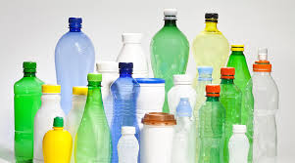
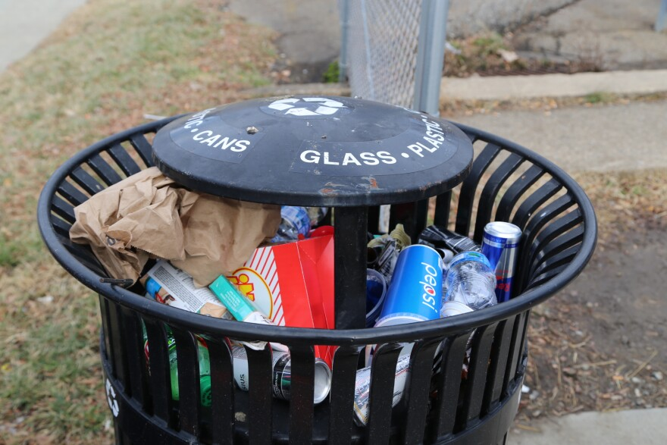
Warm-up
Q：What are you looking at?
A：We are looking at all the trash.
Q：What are these?
A:These are plastic bottles.

Slide 3
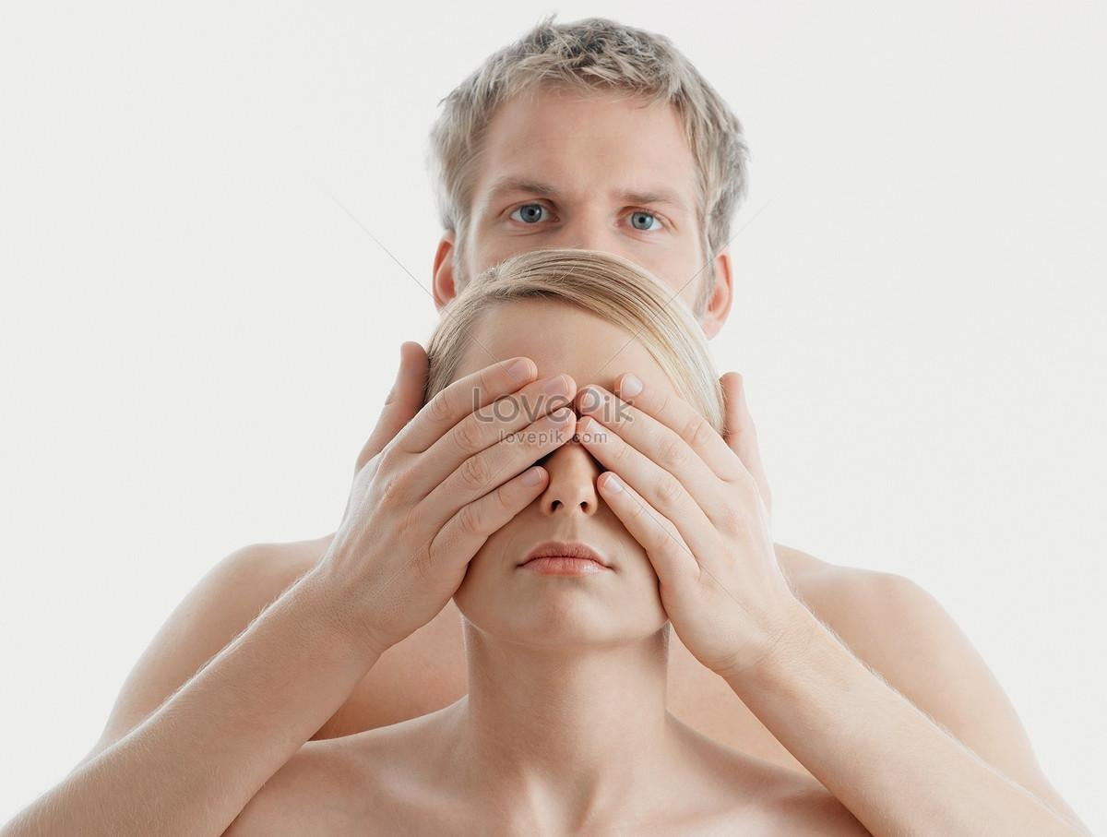
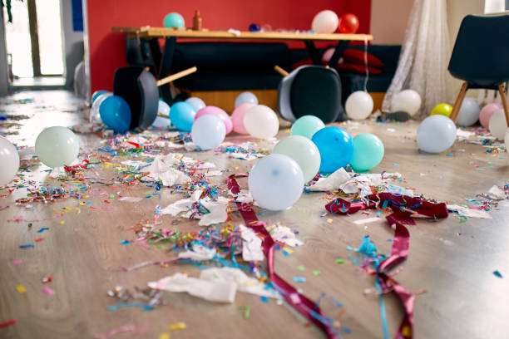
Warm-up
Q：What is he doing?
A：He is covering his eyes.
Q：How is this room?
A：This room is a mess (messy).

Slide 4
請找出現在進行式的句子
1. I am swimming.
2. I am picking up the trash.
3. We need help to clean it.

Slide 5
文法：現在進行式(複習)
用法 | 說明 | 句型 | 例句
現在進行式 | 表示正在進行或已經安排好的計畫 | S + am/is/are + V-ing | I'm seeing a swimming fish in the deep blue sea.

Slide 6
複習文法:V-ing（現在分詞）變化規則
 | Example 1 | Example 2
1. 直接+ing | sleep sleeping | walk walking
2. 無聲字尾e 去e +ing | prepare preparing | come coming
3. 短母音+子音 重複字尾+ing | swim swimming | run running
4. 字尾是 -ie， 變 y 再加-ing | lie lying | die dying

Slide 7
More practice…
1. I am swimming in the sea.
2. I swim in the sea.
3. I am go swim in the sea.
請問上面三個句子，哪一句是正確的呢?

Slide 8
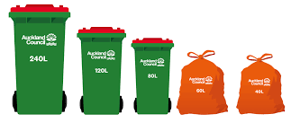
複習Be+Ving 疑問句/簡答
Q：Are you picking up all the rubbishes in the sea?
A：Yes, we are.

Slide 9
複習Be+Ving 疑問句/簡答
Q：Are you picking up all the rubbishes in the sea?
A：No, we are not (aren′t).

Slide 10

Are you swimming?

Slide 11

Are you listening to music?

Slide 12
複習Be+Ving 的否定句
We′re(are) picking up all the rubbishes in the sea.
We are not (aren′t) picking up all the rubbishes in the sea.
You′re(are) picking up all the rubbishes in the sea.
You are not (aren′t) picking up all the rubbishes in the sea.
⮊
⮊

Slide 13
複習Be+Ving 的否定句
They′re (are) picking up all the rubbishes in the sea.
⮊They are not (aren′t) picking up all the rubbishes in the sea.
I′m(am) picking up all the rubbishes in the sea.
⮊I′m(am) not picking up all the rubbishes in the sea.

Slide 14
複習Be+Ving 的否定句
She′s (is) picking up all the rubbishes in the sea.
⮊She is not (isn′t) picking up all the rubbishes in the sea.
He′s (is) picking up all the rubbishes in the sea.
⮊He is not (isn′t) picking up all the rubbishes in the sea.

Slide 15
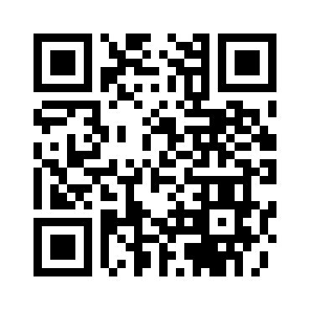
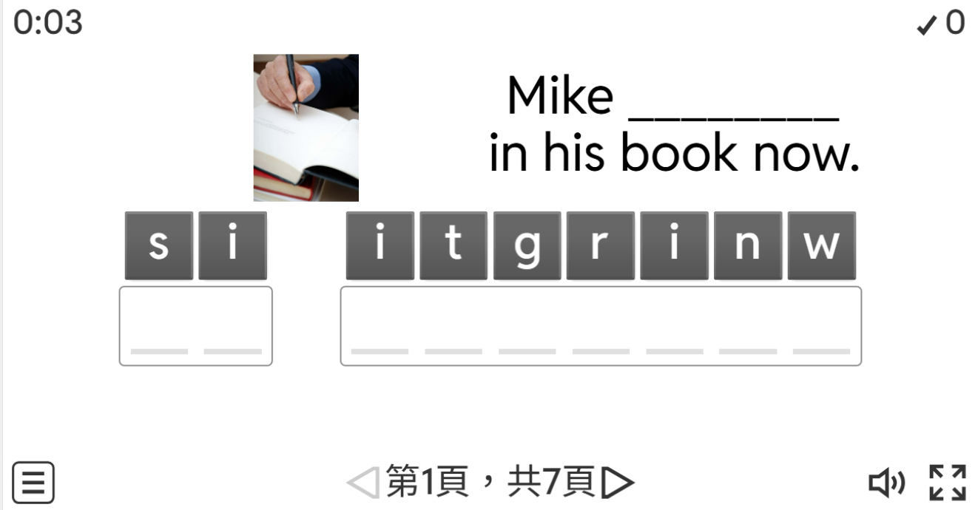
wordwall 遊戲
wordwall.net/tc/resource/34388025

Slide 16
課堂作業
The puppy_______ in the box. Be careful. Don't let it come out.
A：move
B：moves
C：is moving
答案：C

Slide 17
課堂作業
It is 18:00 now. Tom ___________TV in the living room.
A： watch
B：watches
C：is watching
答案：C

Slide 18
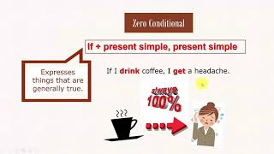

Slide 19
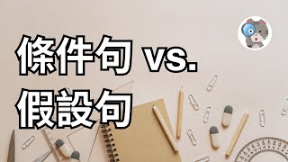

Slide 20
四種條件句類型的 If 用法
(1)If 零條件句： what actually happens 實際發生
(2) If 第一條件：what could happen 未來可能會發生的
(3) If 第二條件：what we wish would happen 希望發生的
(4)If 第三條件：what might have happened 過去可能發生的

Slide 21
假設語氣1、在無條件下，[ If + 現在簡單, 現在簡單 ]
用於談論習慣、事實、真相，無法爭辯的事實。也就是談論一件無論過去、現在，還是未來，都會這樣的事。
If I get sick, I go to the doctor.
如果我生病了，我會去看醫生。
上述例句意思是從以前、過去到現在，只要生病我就會去看醫生，零條件句談論的是習慣、一直以來都這樣的事
If you put ice in your drink, it melts.
如果在飲料中加冰，冰就會融化。

Slide 22
假設語氣2、第一條件 (1st Conditional)
[ If + 現在簡單, will (will / Shall / Can / May) + 不定式動詞 ]
表示在未來可能發生的情況。我們用它來談論將來可能發生的事情（是真實的），並且很有可能發生！
If I get sick, I will go to the doctor.
如果我生病了，我就要去看醫生。
If it’s hot tomorrow, I’ll go for a swim at the beach.
如果明天很熱，我就要去海灘游泳。

Slide 23
假設語氣2、第一條件 (1st Conditional)
[ If + 現在簡單, will (will / Shall / Can / May) + 不定式動詞 ]
If they lose the game, they won’t go to the finals.
如果他們輸了比賽，就不會進入決賽。
if 第一條件句的後半句助動詞，除了 Will 之外，還可以用 Shall、Can 跟 May 唷!

Slide 24
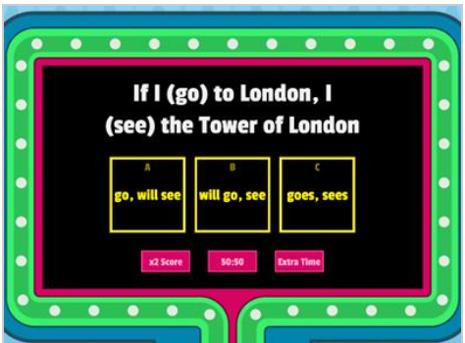
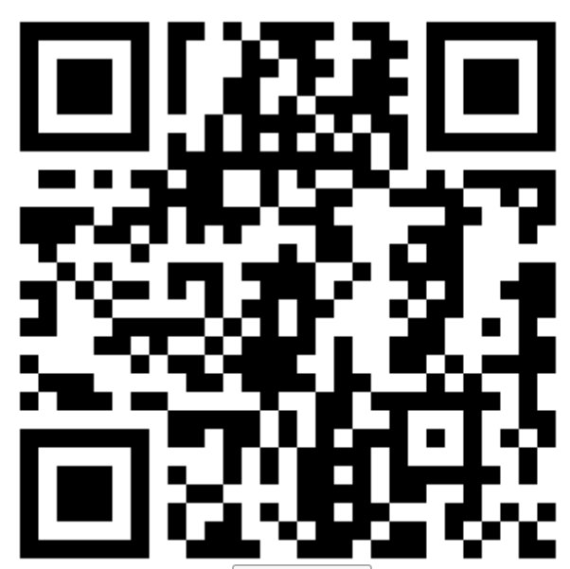
https://wordwall.net/resource/4055300

Slide 25
Do not edit
How to change the design
Audience Q&A
The Slido app must be installed on every computer you’re presenting from

