Slide 1

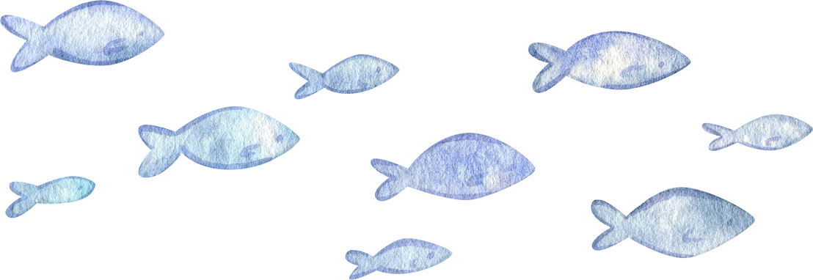
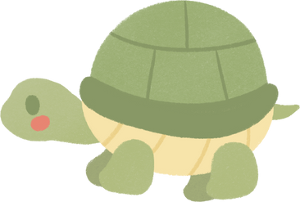
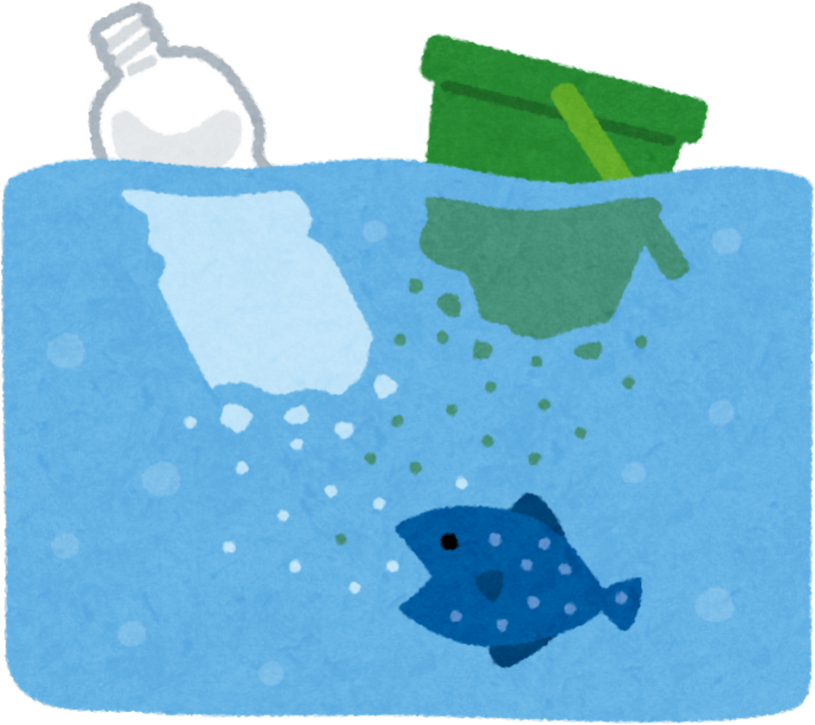
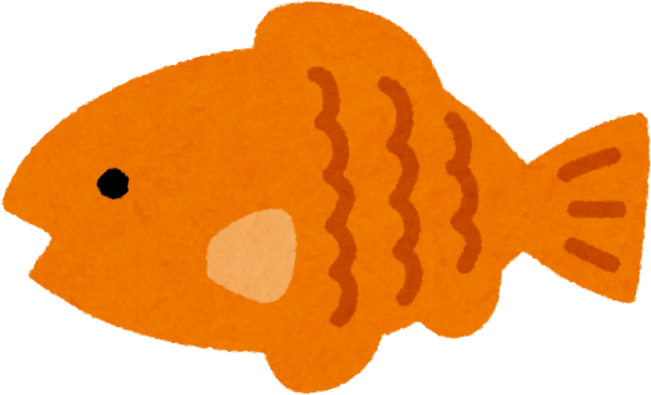

Reuse重複使用, Reduce減少使用, Recycle再生利用
減塑環保，拯救海洋 Save our ocean
2025.5.7(三)
15:00-16:00

Slide 2
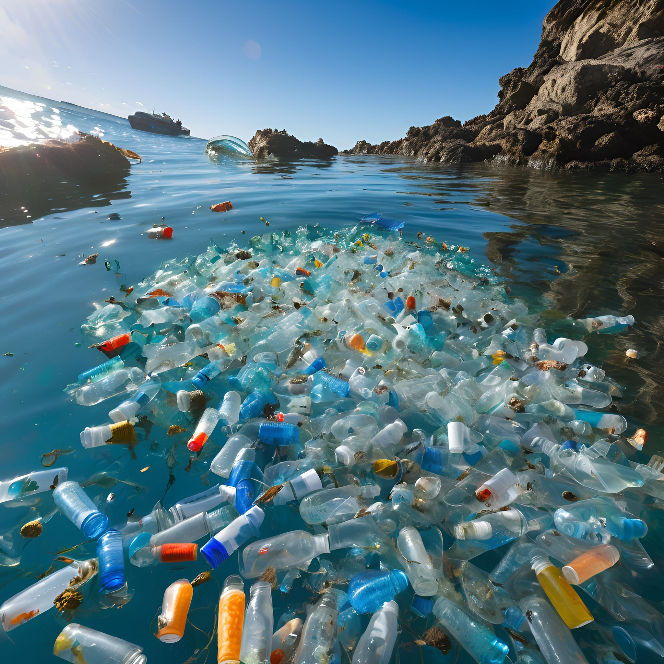

What happened?
  What do you see?
  How do you feel?

Slide 3
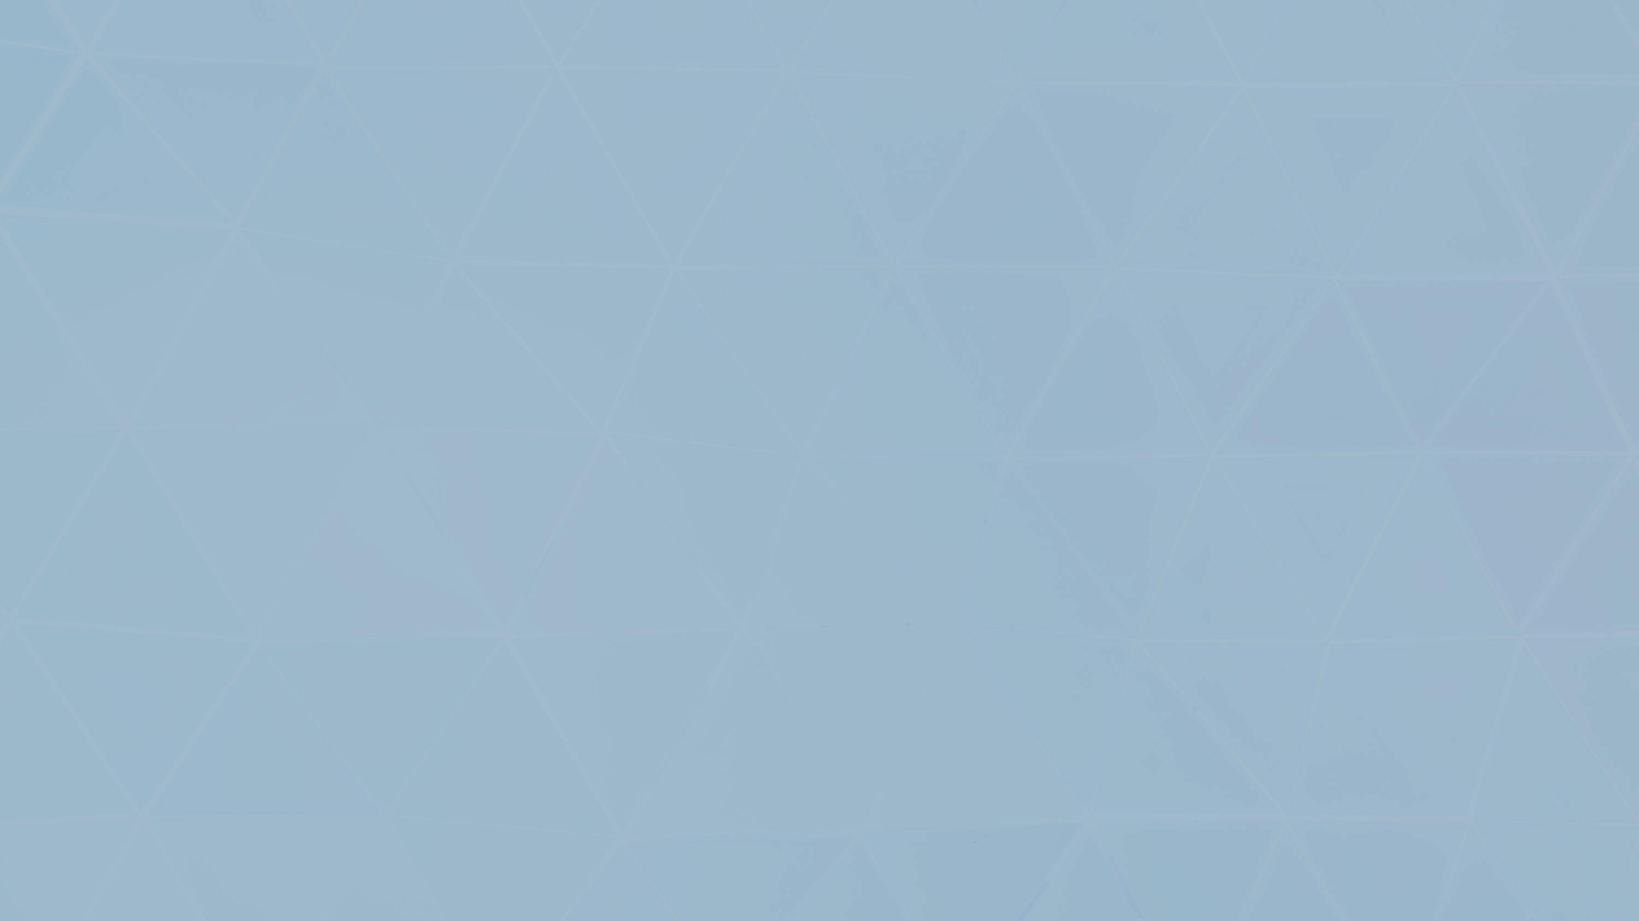
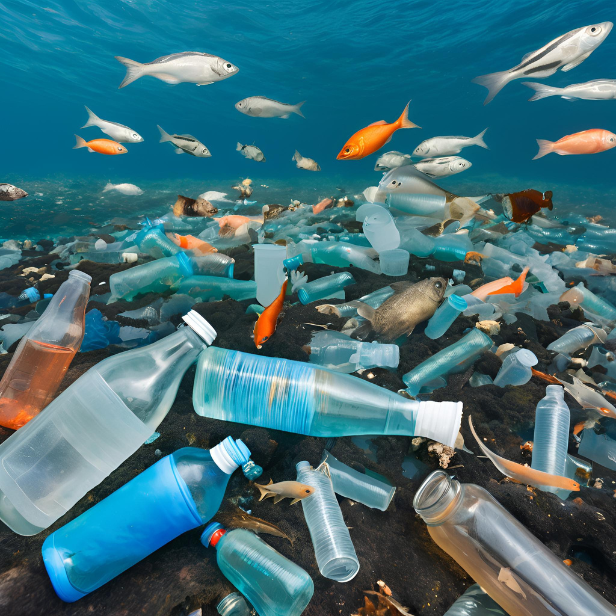
1.Too many bottles.
2.No place to live for fish.

Slide 4

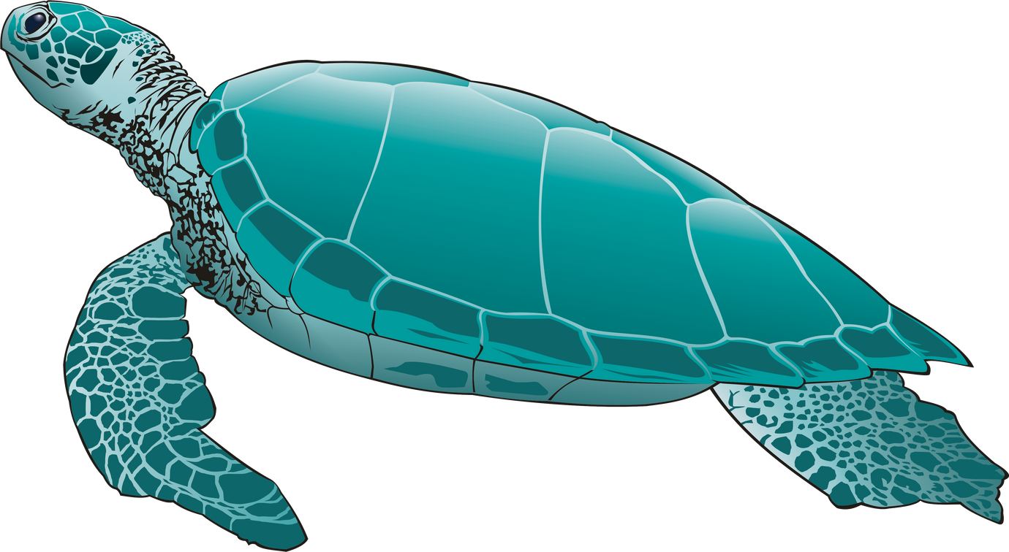
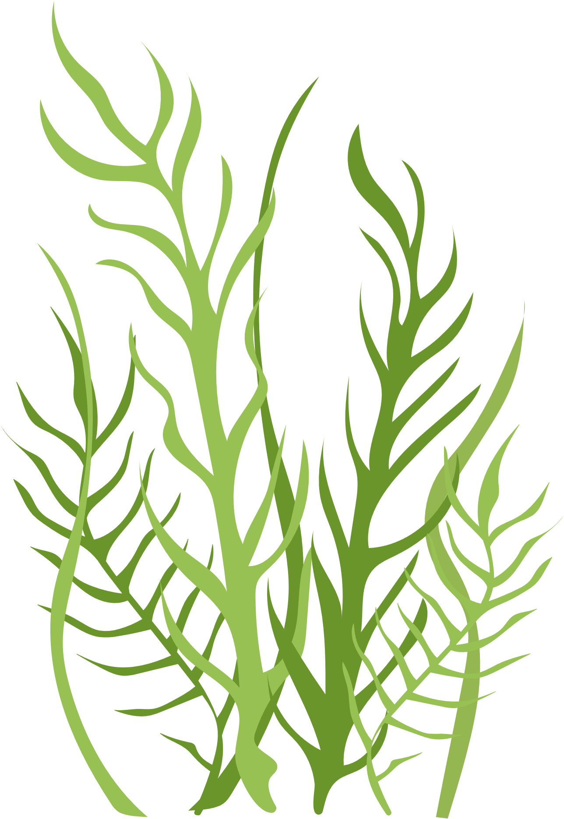
Vocabulary

Slide 5
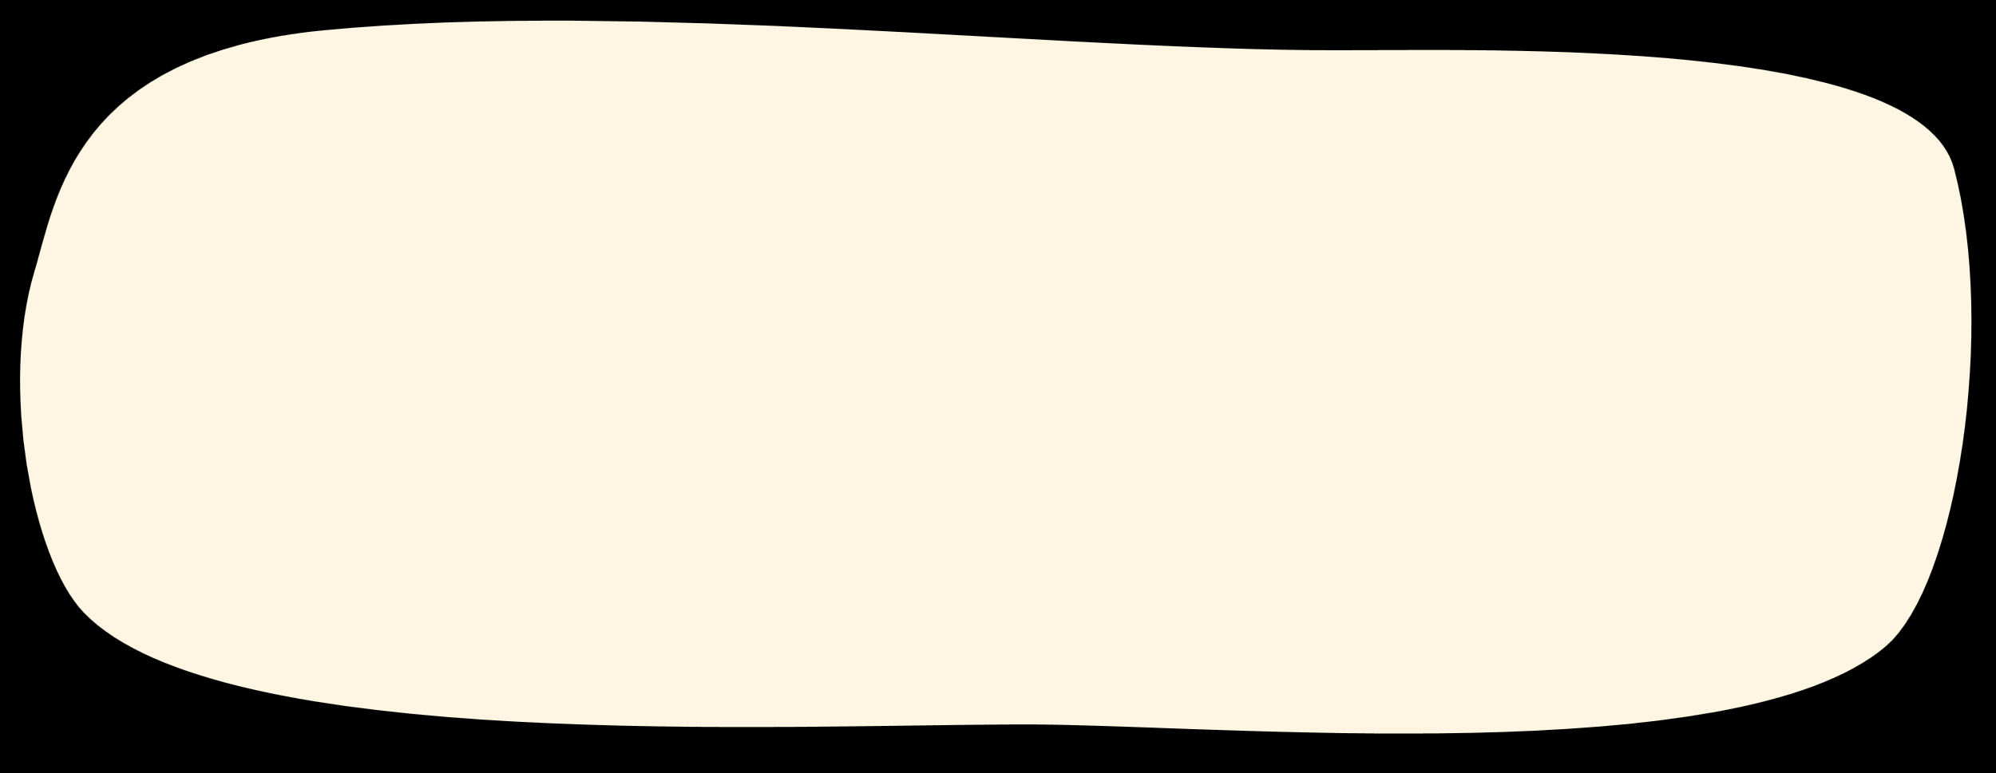
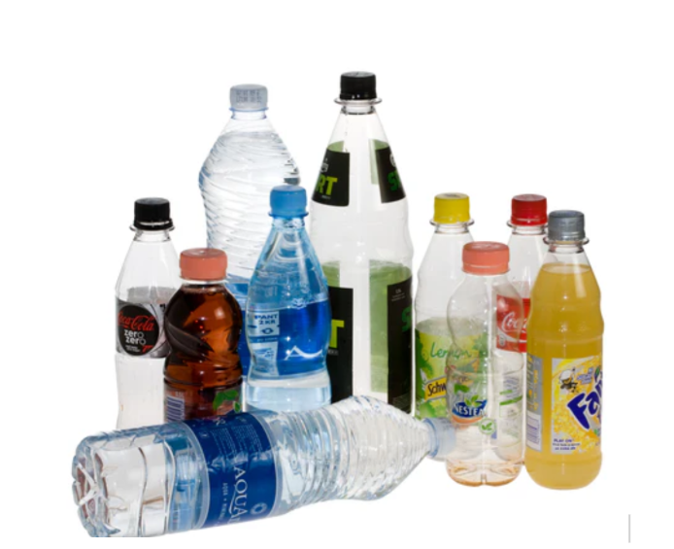
plastic bottles塑膠瓶
pl-a-st-i-c
bo-ttle-s

Slide 6
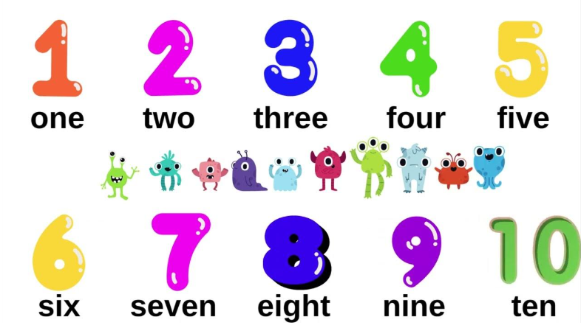
number
bottle
bottles
bottles
bottles
bottles
bottles
bottles
bottles
bottles
bottles

Slide 7
number
plastic bottle
plastic bottles
plastic bottles
plastic bottles
plastic bottles
plastic bottles
plastic bottles
plastic bottles
plastic bottles
plastic bottles

Slide 8
float in the sea
fl-oa-t 漂浮

Slide 9
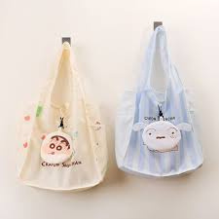
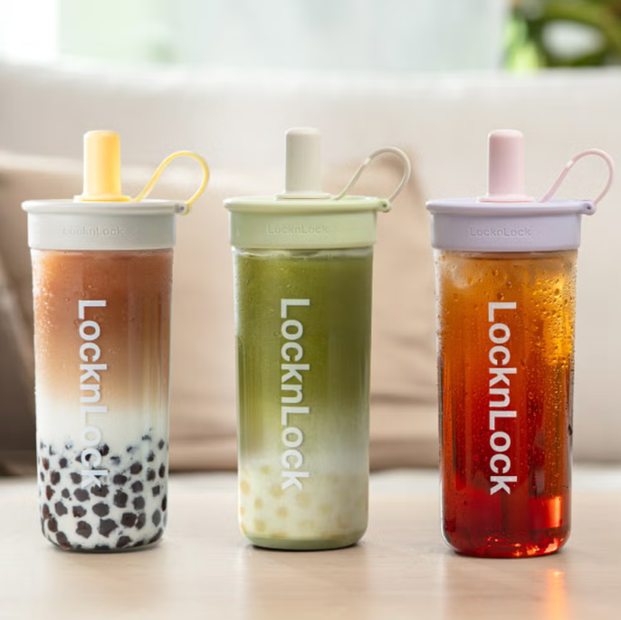
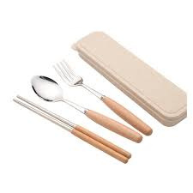
reuse 重複使用
re-use

Slide 10
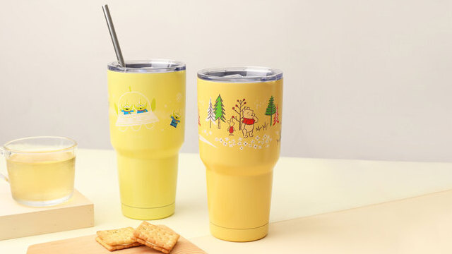
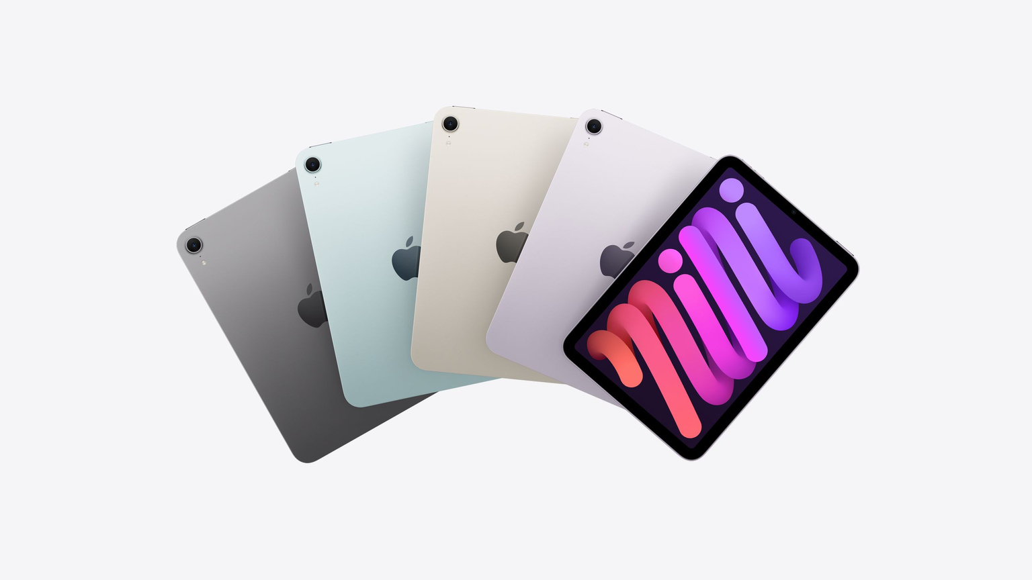
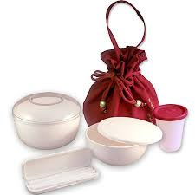
reduce 減少
re-du-ce

Slide 11
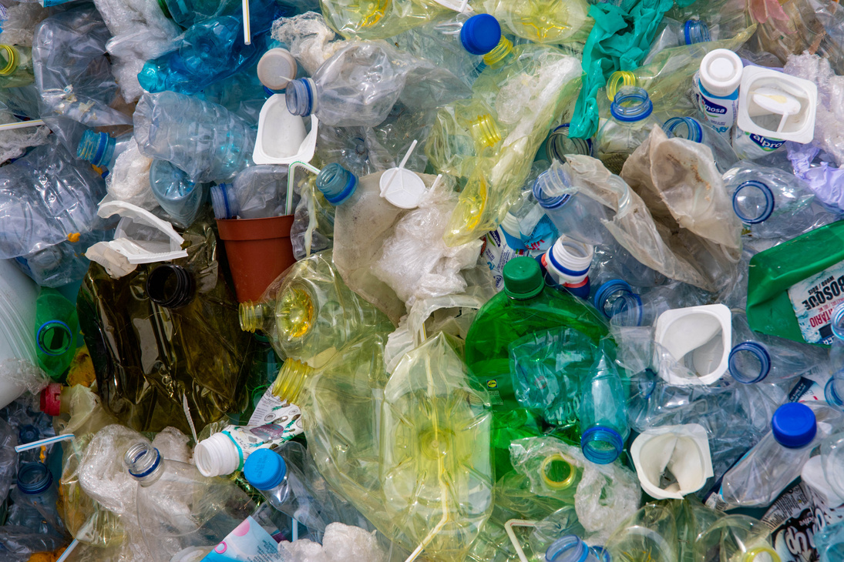
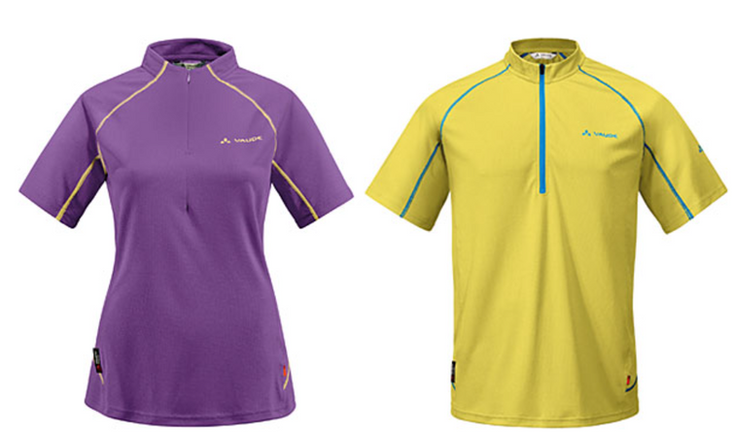
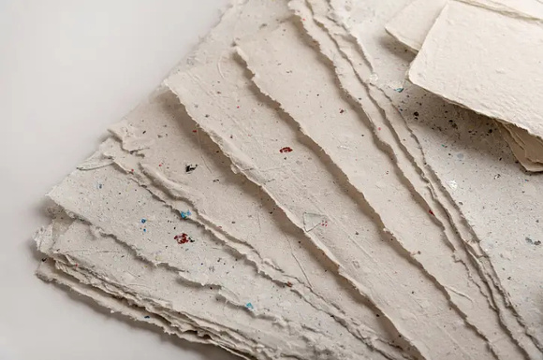
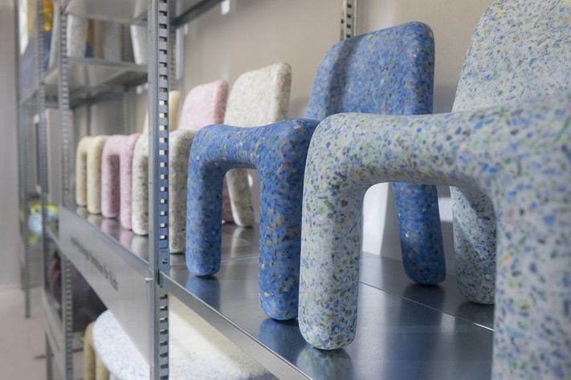
recycle 回收
re-cy-cle

Slide 12
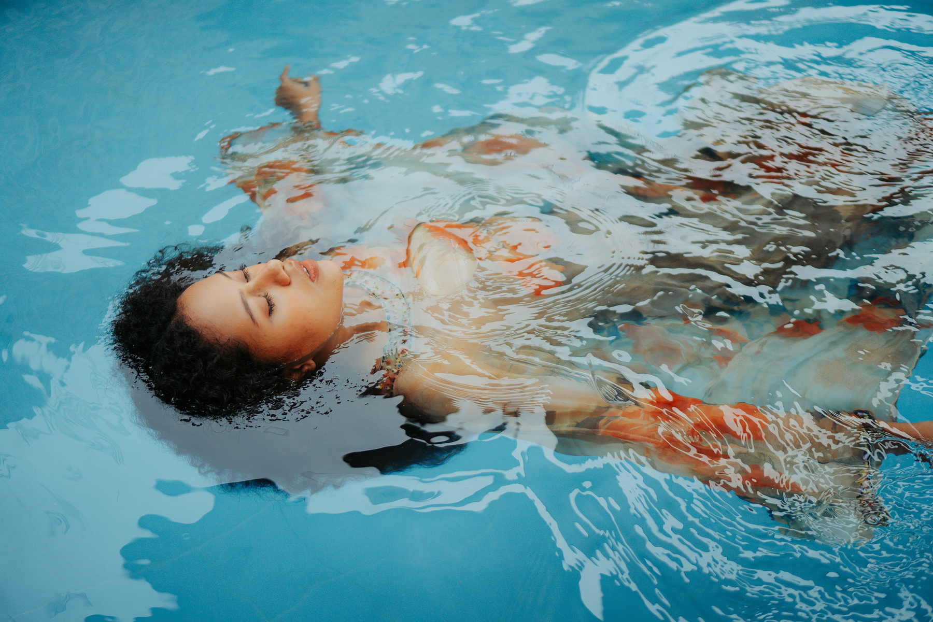
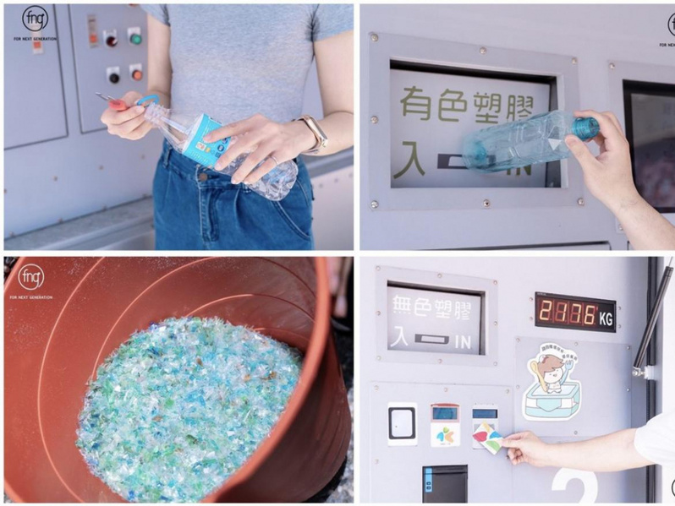
SONG
floating in the sea
reduce the plastic bottles

Slide 13


Slide 14
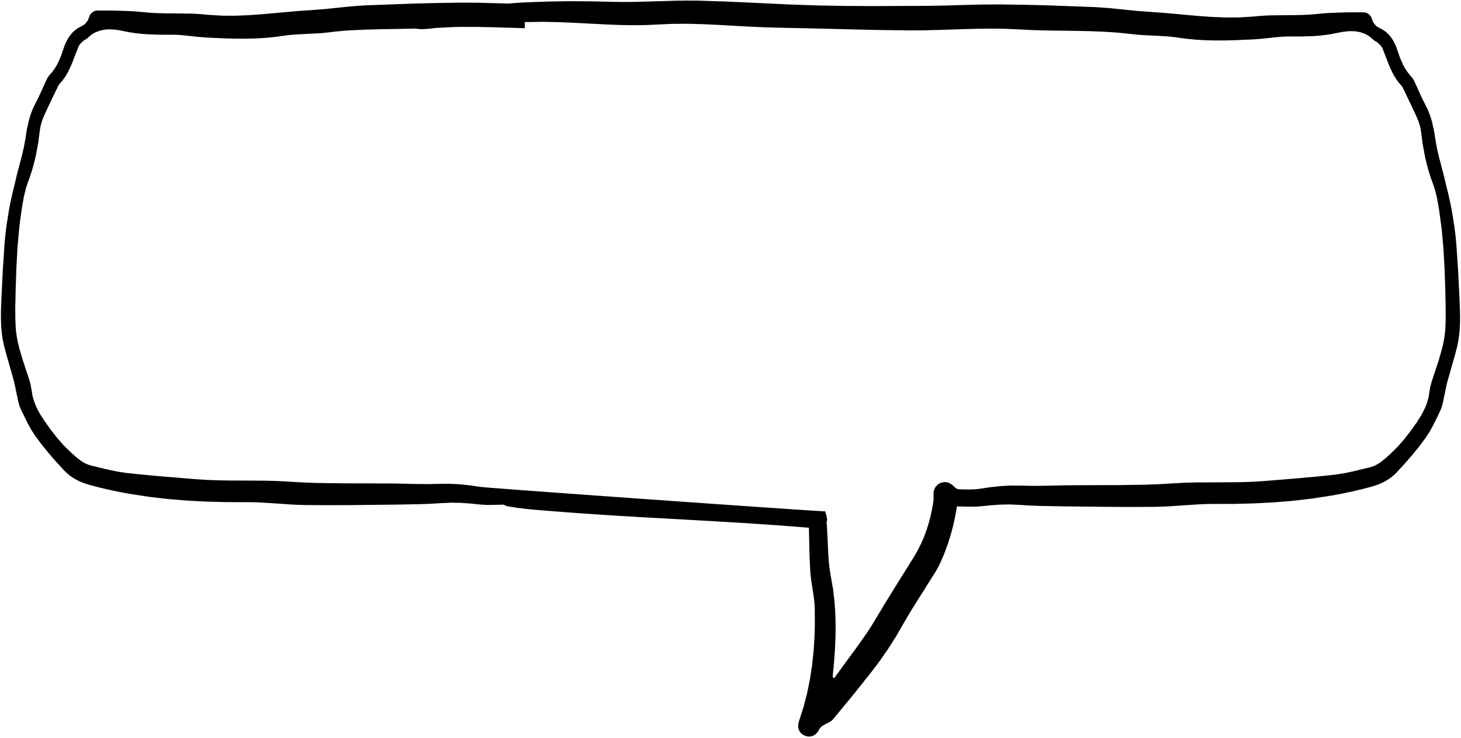
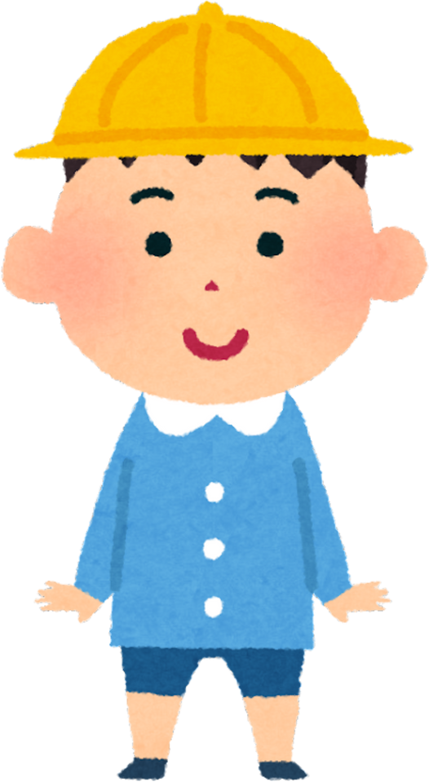
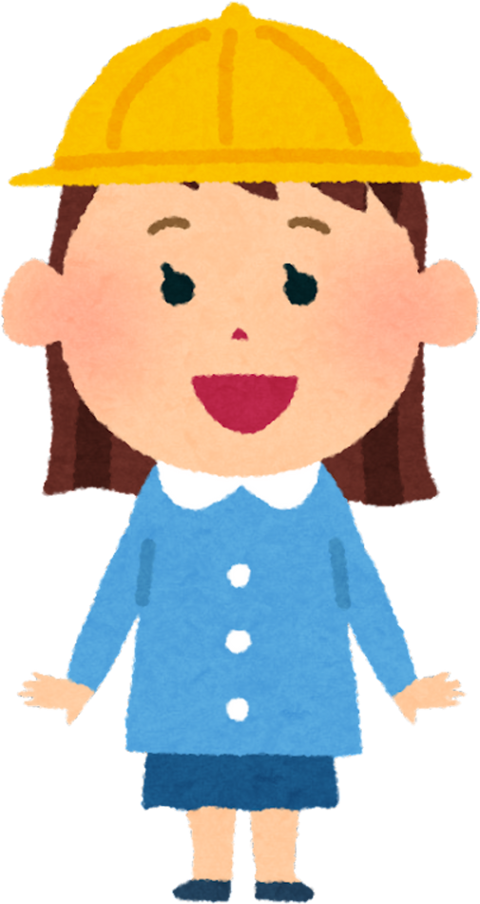
I see...
Bottles are reducing .
The space is bigger.

Slide 15



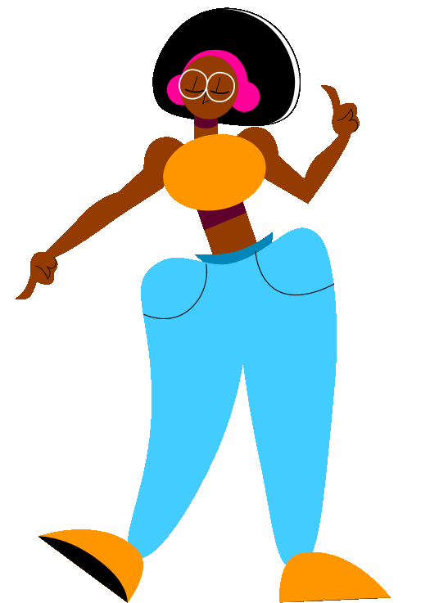

Vocabulary Game

Slide 16
Vocabulary Game

Slide 17
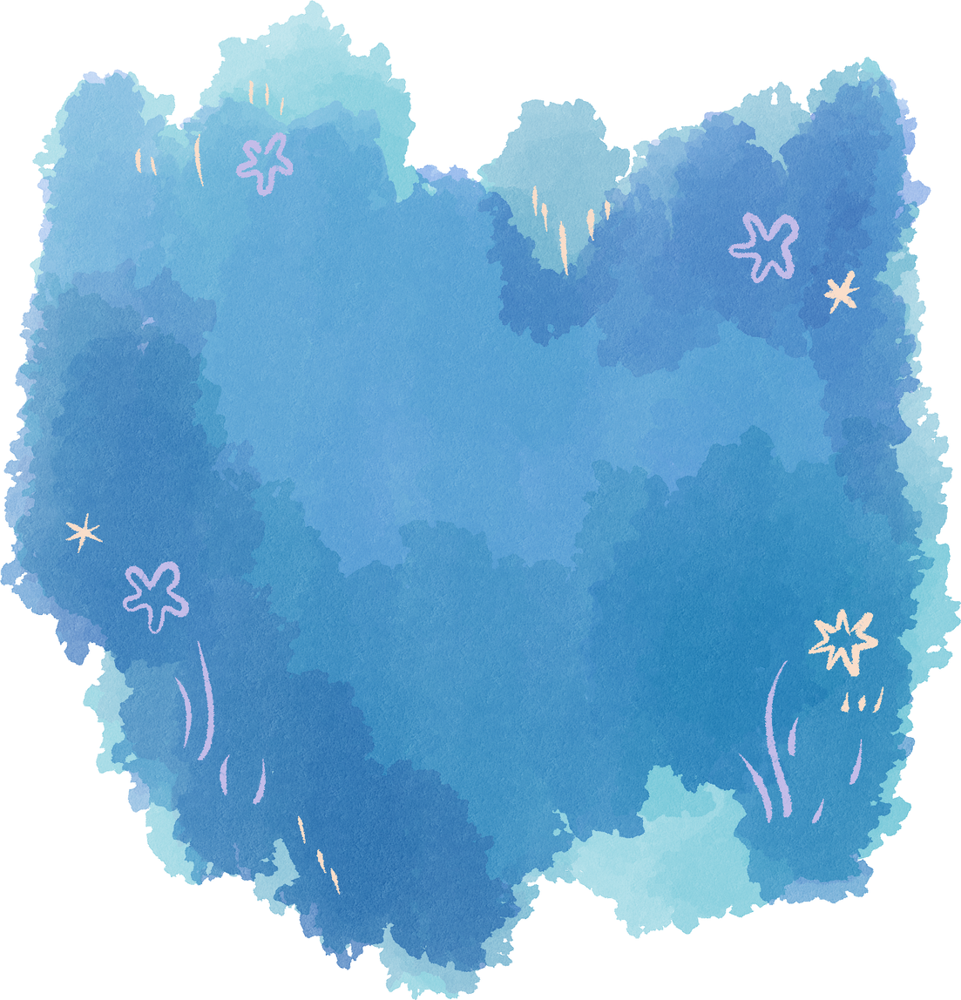
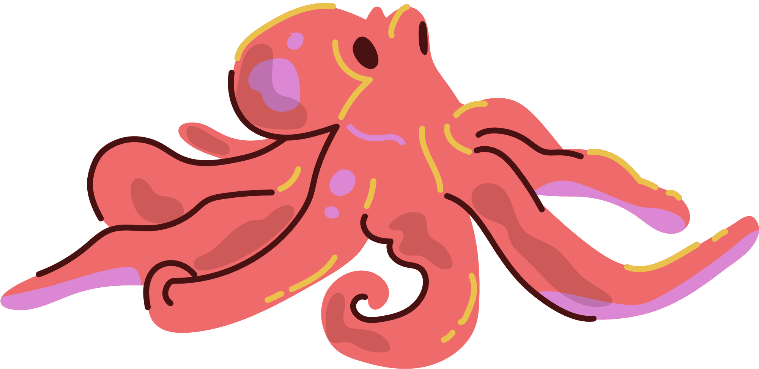
GRAMMAR

Slide 18
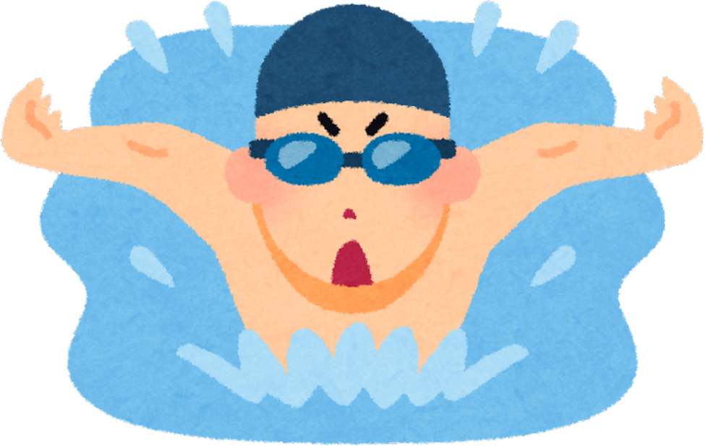
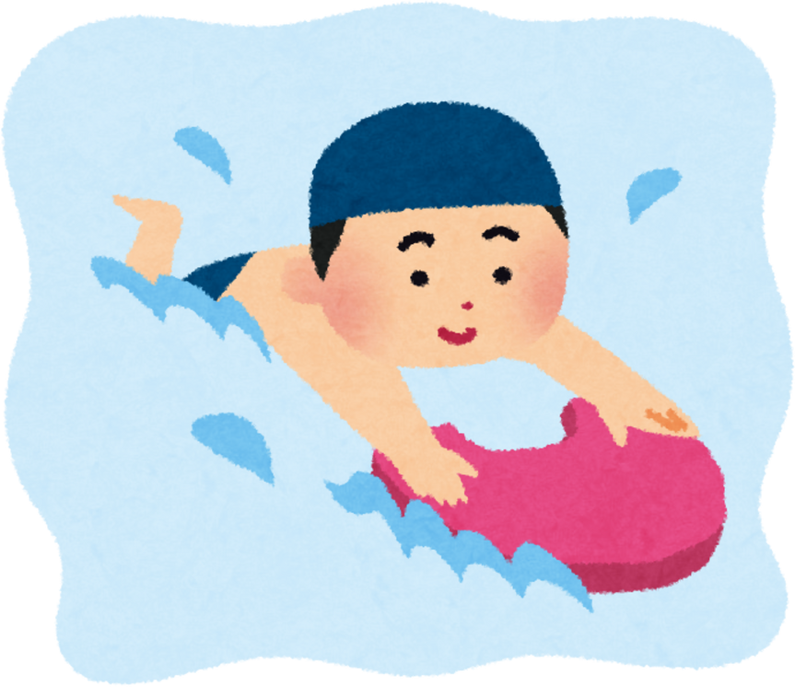
現在進行式
人＋ be動詞＋ 動詞V-ing
I am swimming.
我正在游泳
You are floating.
你正在漂浮

Slide 19
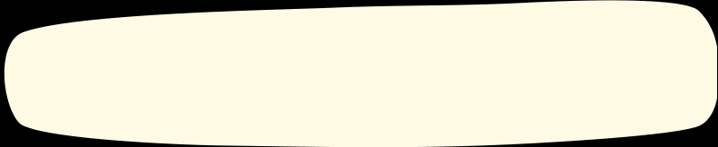
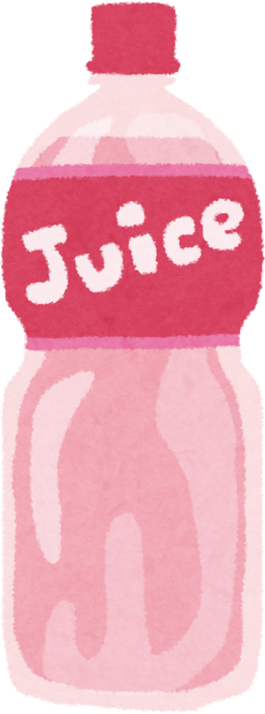
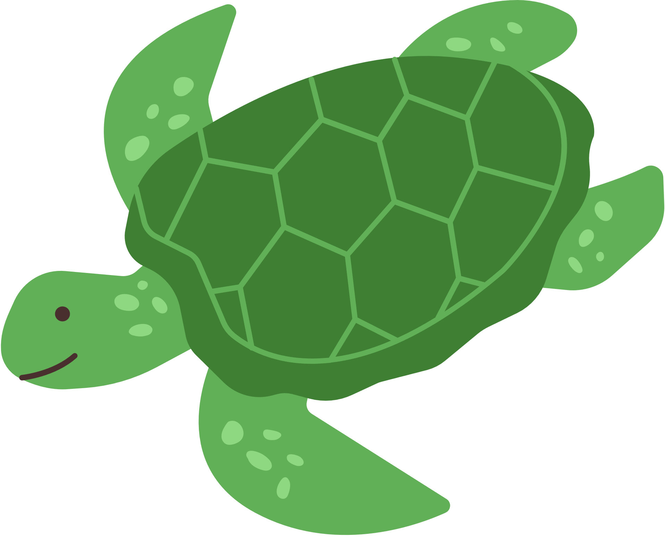
There is a _____ floating in the sea.
bottle
turtle
fish

Slide 20
bottle
There is a _____ floating in the sea.
turtle
fish

Slide 21
turtle
There is a _____ floating in the sea.
bottle
fish

Slide 22
fish
There is a _____ floating in the sea.
bottle
turtle

Slide 23
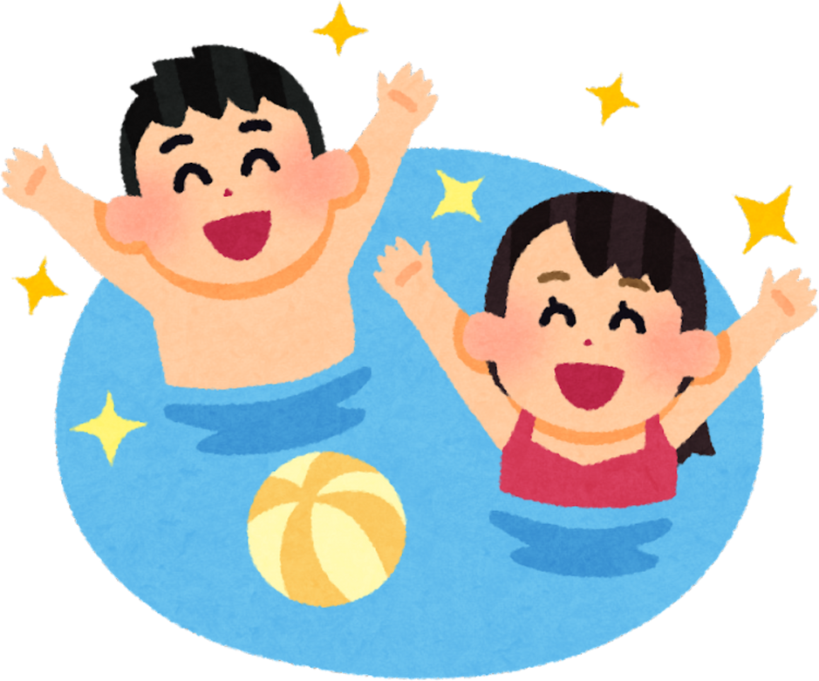
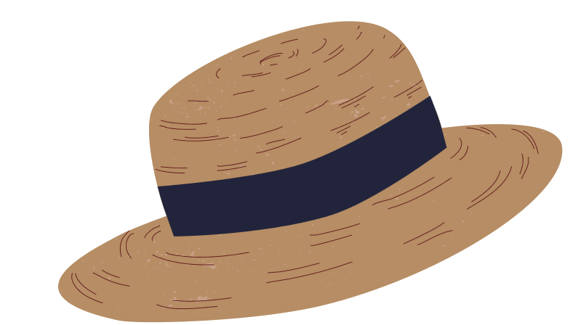

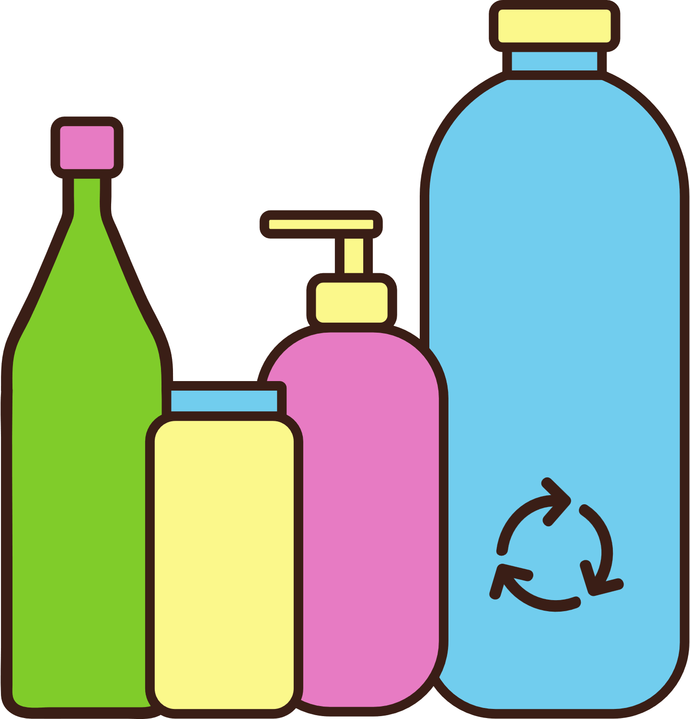


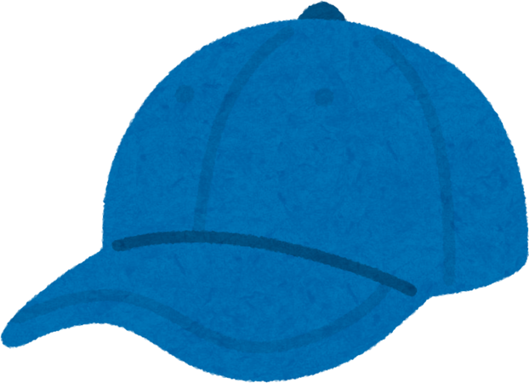
some people
There are ____ _____ floating in the sea.
some bottles
some hats

Slide 24
some hats
There are ____ _____ floating in the sea.
some bottles
some people

Slide 25
some bottles
There are ____ _____ floating in the sea.
some people
some hats

Slide 26
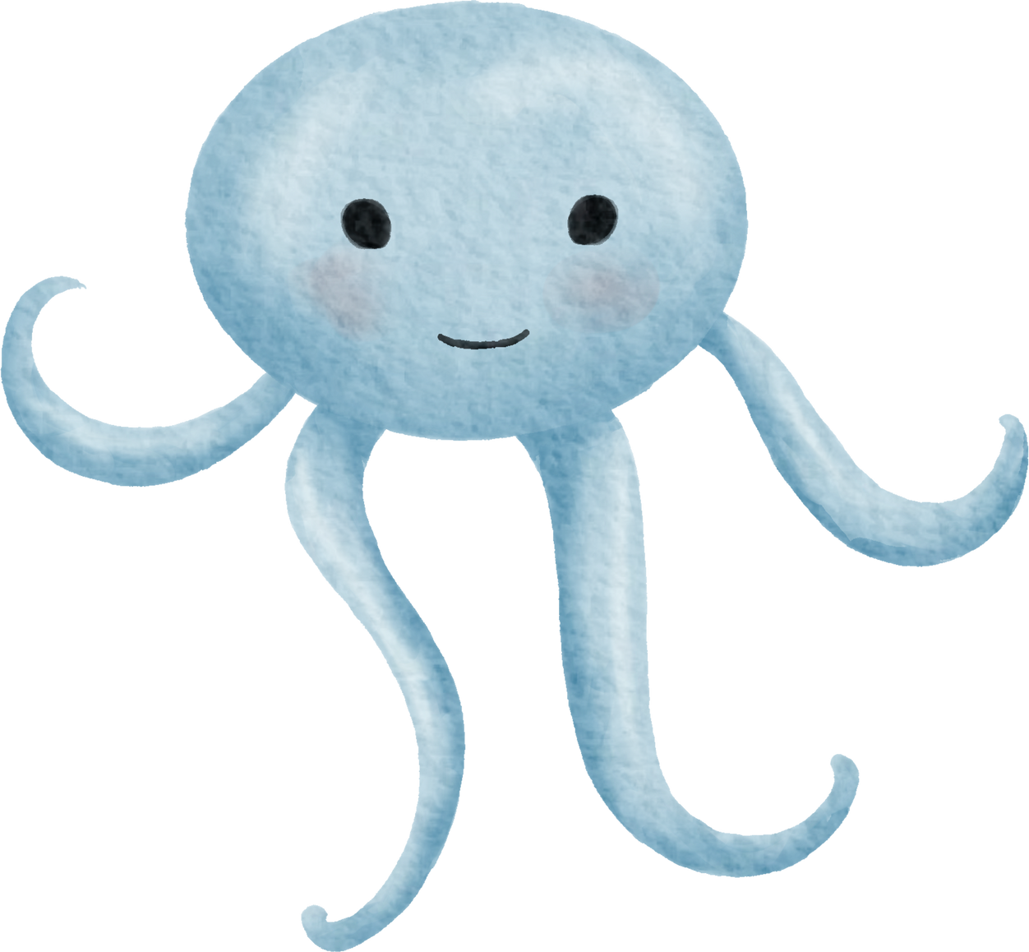
Game Time

Slide 27
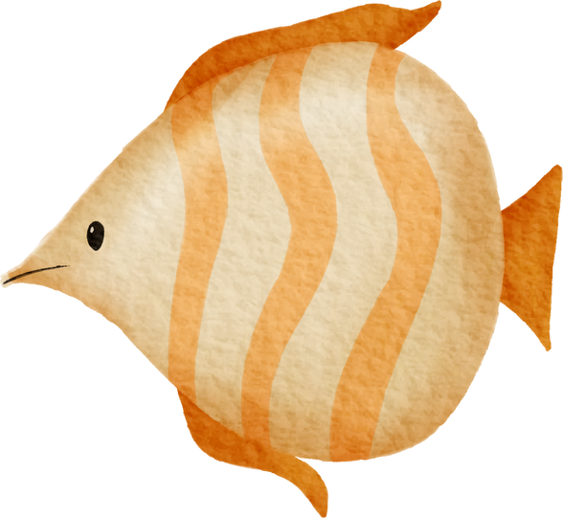
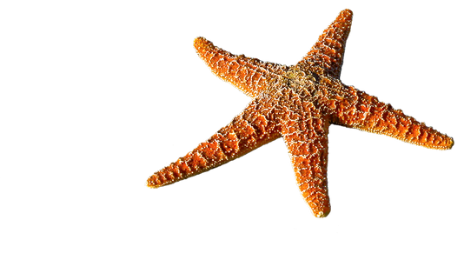
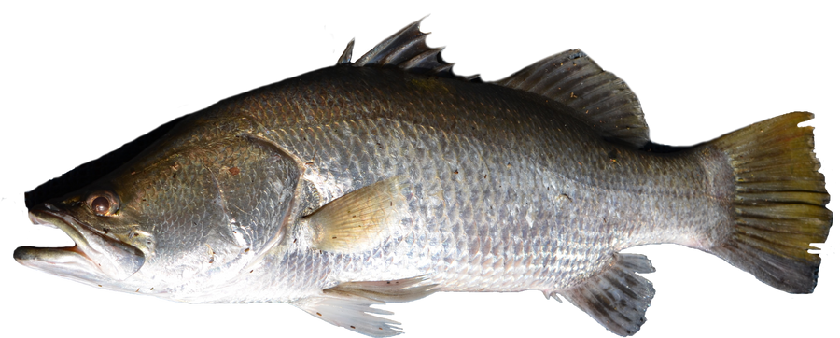
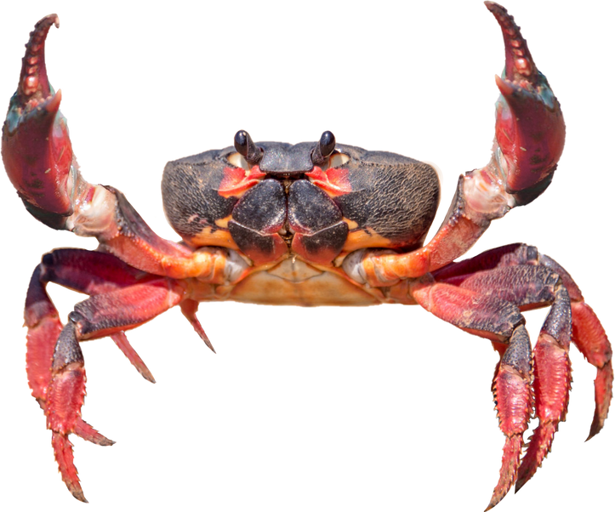
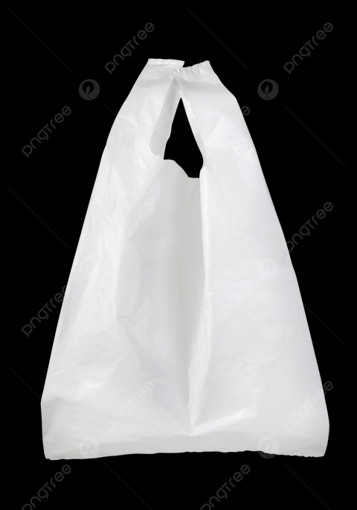
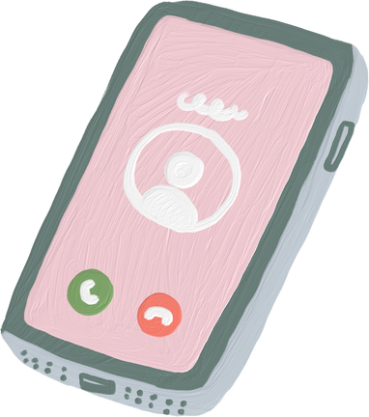
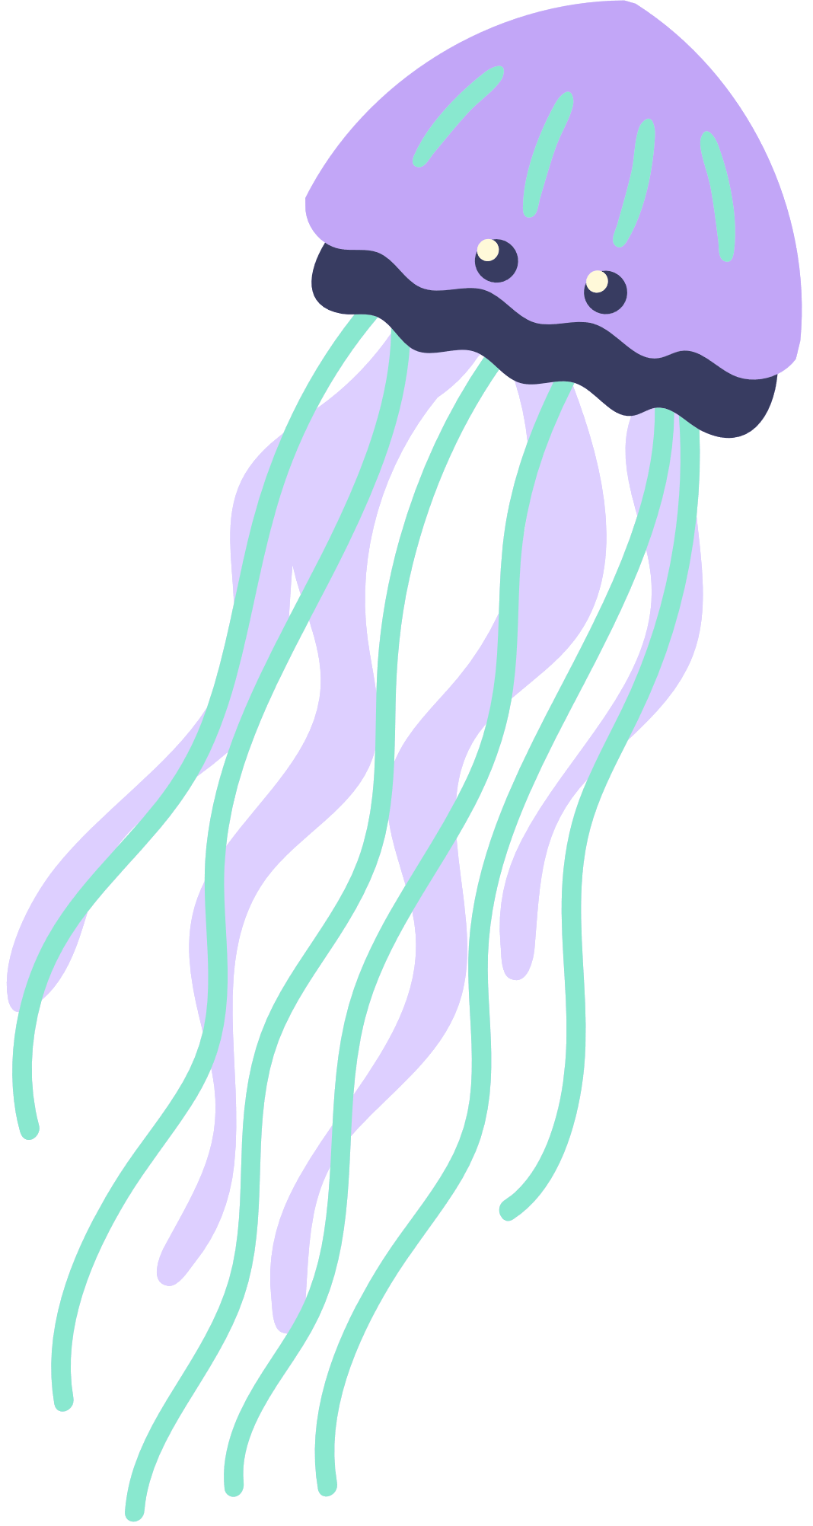
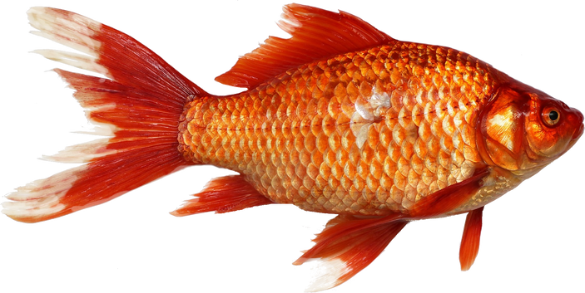
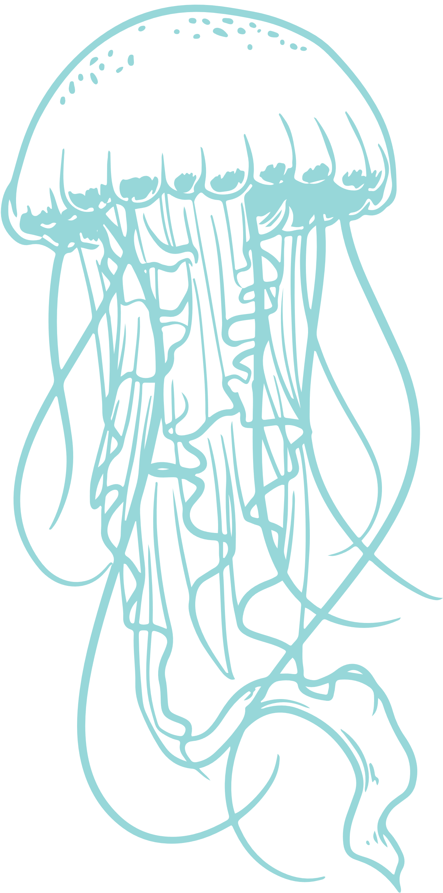
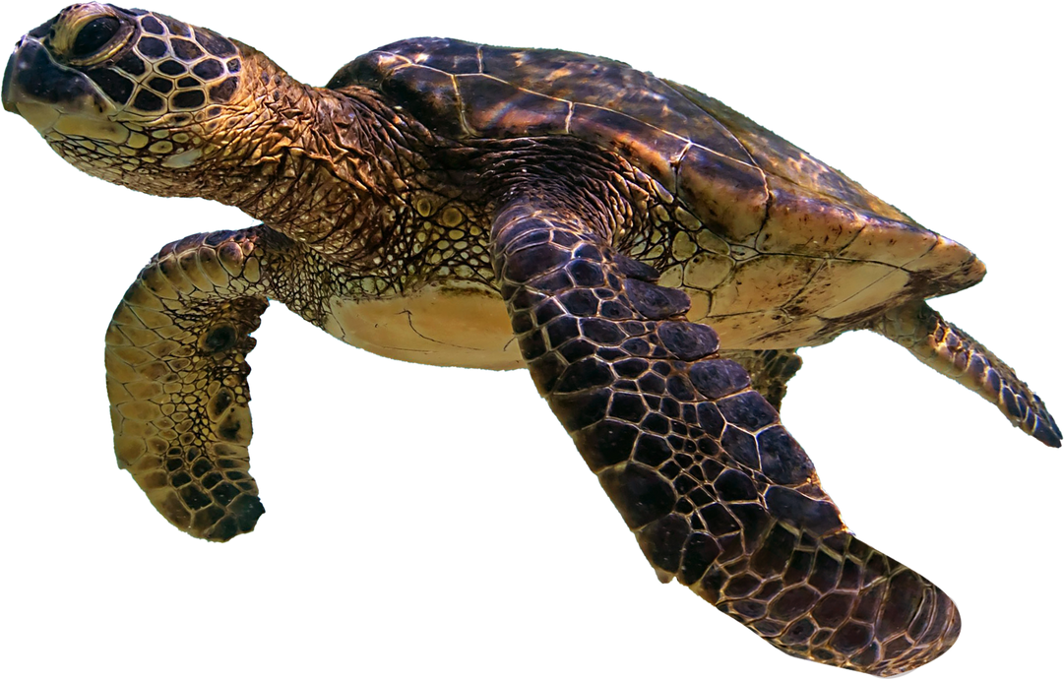







Move things that don't belong in the ocean to the trash.

Slide 28
Q1
A:What is there in the sea?
B:There are some ____ ____ in the sea.
1.paper 2.plastic bottles 3.cans

Slide 29

Q1
A:What is there in the sea?
B:There are some ____ ____ in the sea.
1.paper 2.plastic bottles 3.cans

Slide 30



Q2
What does "reuse" mean?
1
2
3

Slide 31

Q2
What does "reuse" mean?
1
2
3

Slide 32



Q3
Which one can float on the sea?
1.turtle 2.rabbit 3.cat

Slide 33

Q3
Which one can float on the sea?
1.turtle 2.rabbit 3.cat

Slide 34




Q4
How can we protect the sea?
1.Throw the trash .
2.Pick up the bottles.
3. Burn the ocean.

Slide 35
Q4
Which is a way to protect the sea?
1.Throw the trash .
2.Pick up bottles.
3. Burn the ocean.

Slide 36


Q5
Where were these photos taken?

Slide 37

Q5
Where were these photos taken?

Slide 38



You are great!

Slide 39

Thank You!

