Slide 1

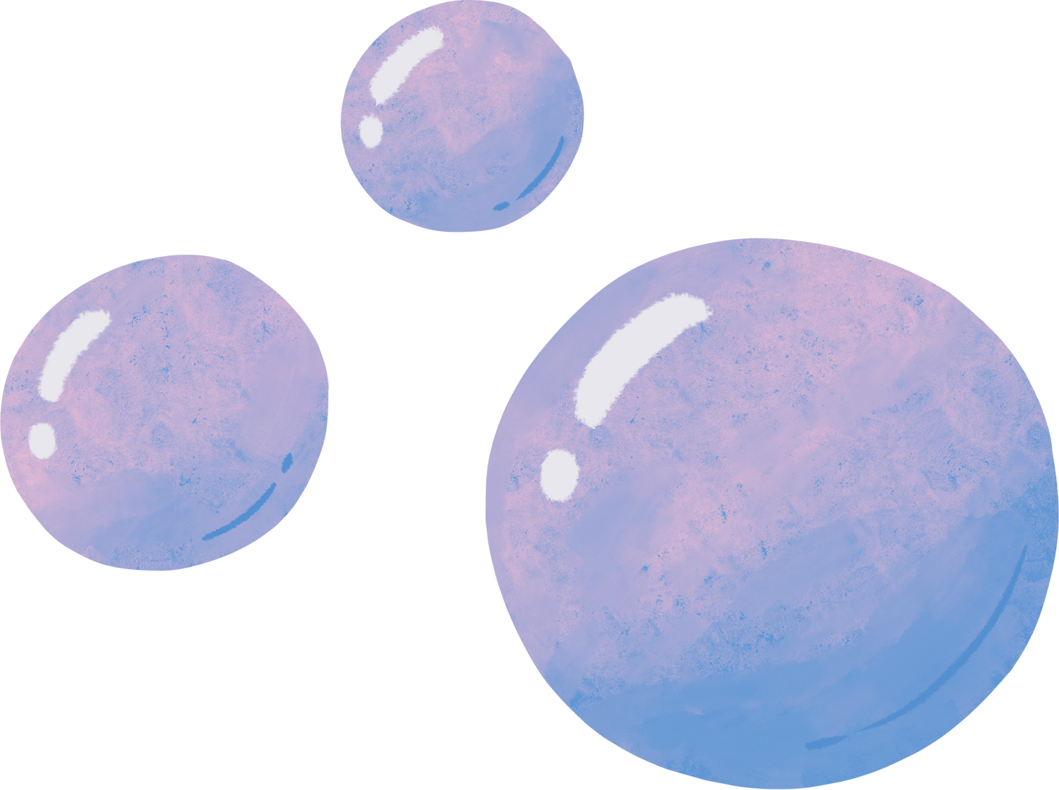

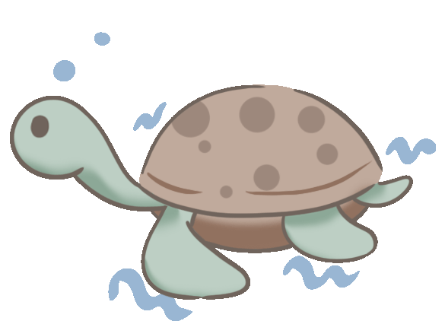
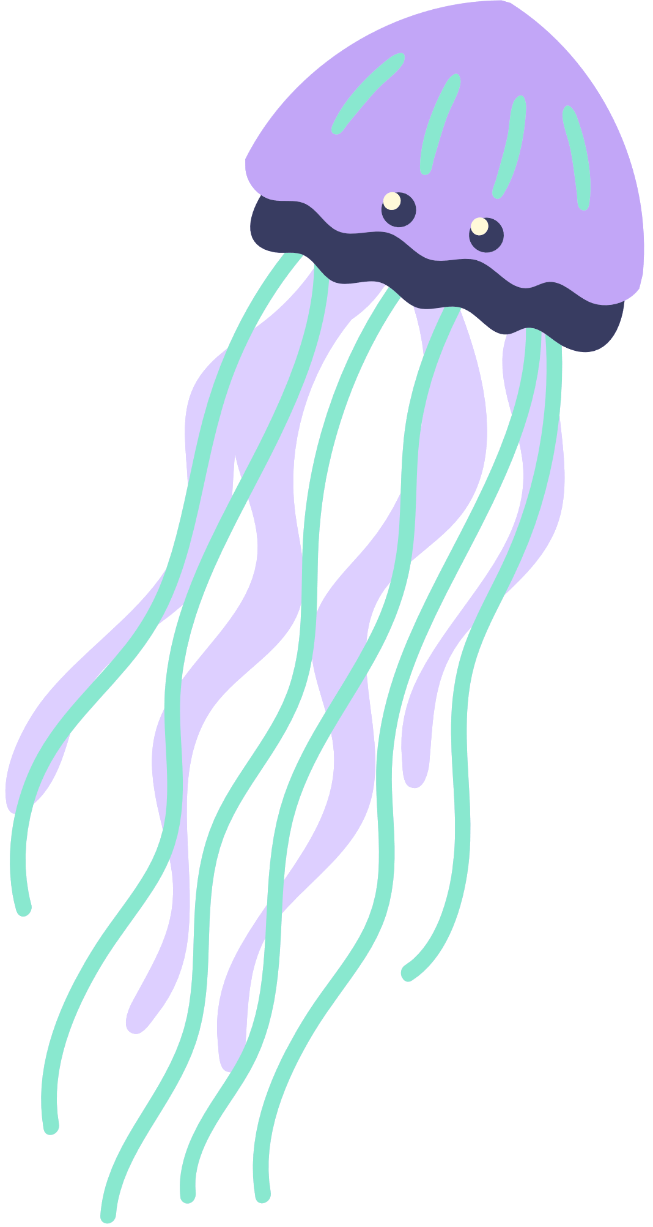


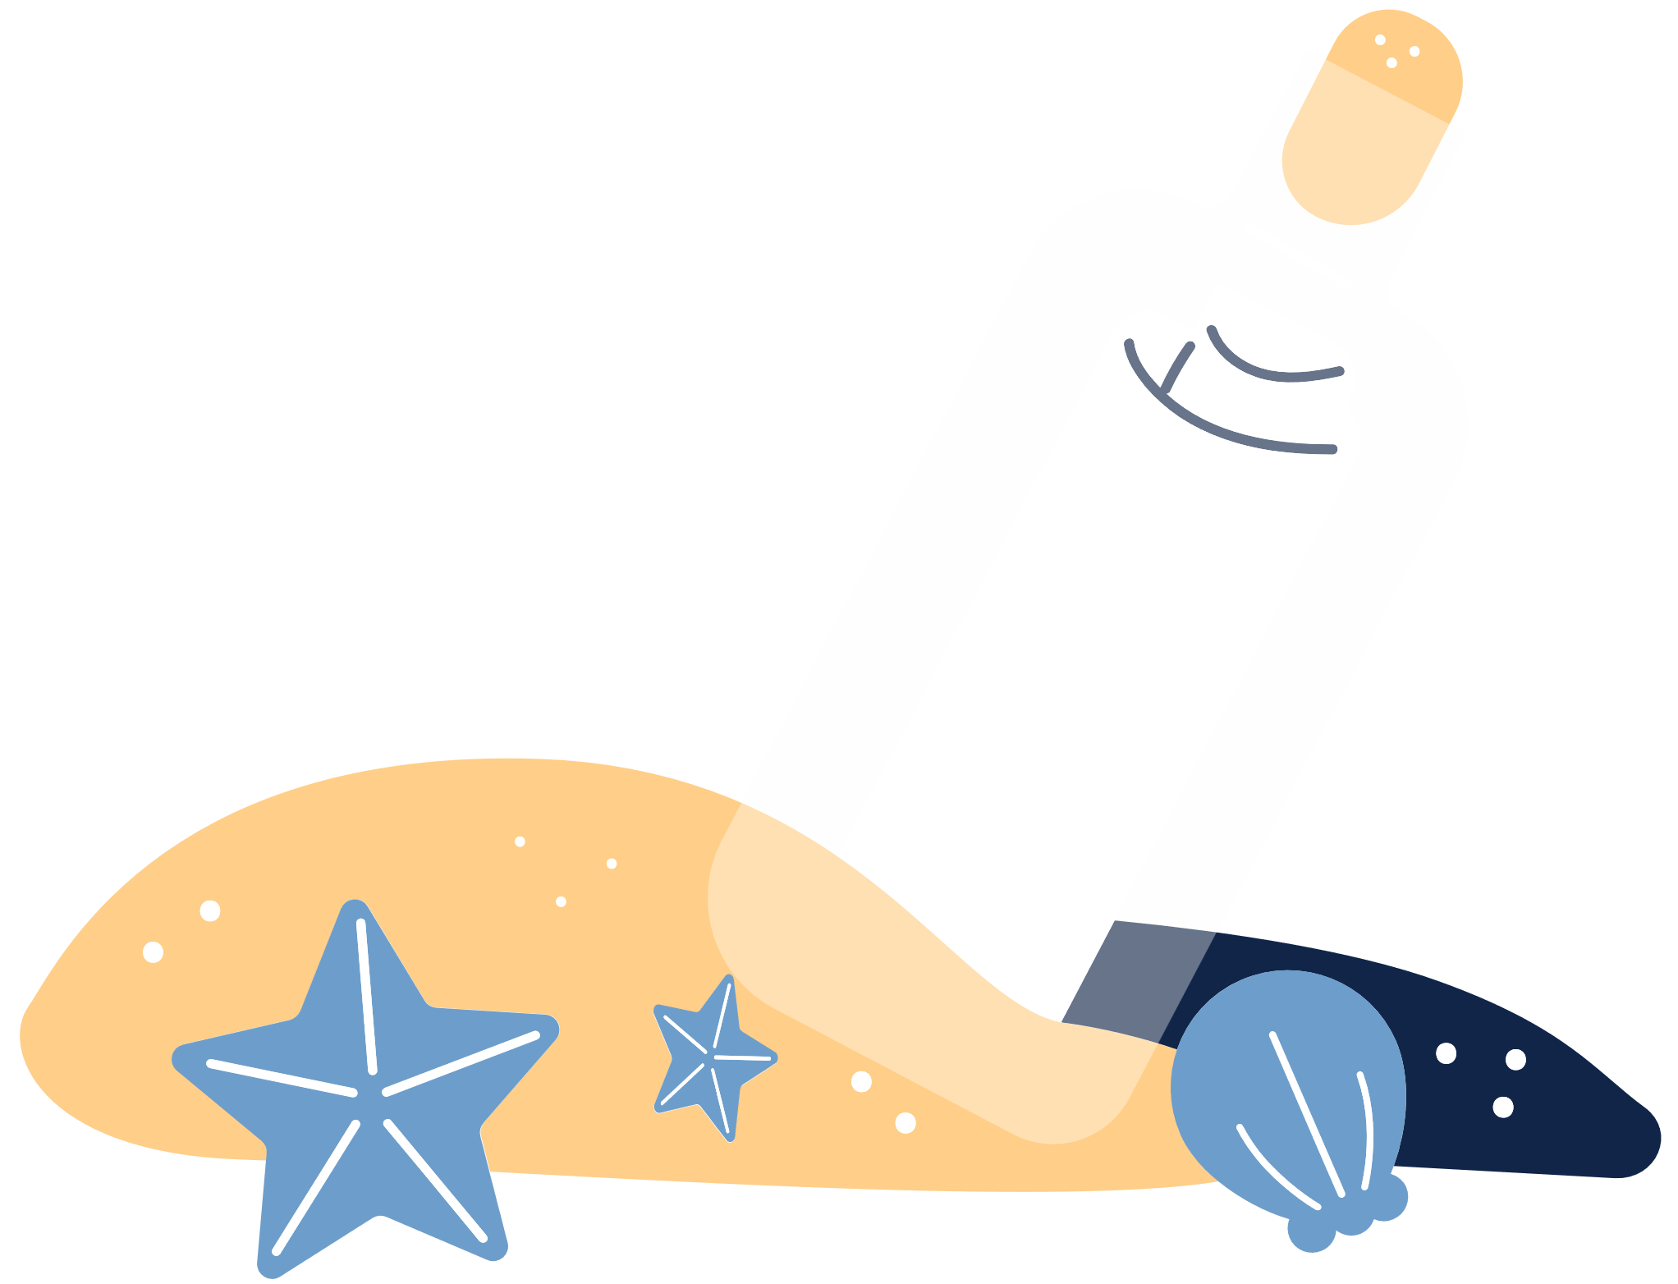

The Sea Turtle

Slide 2

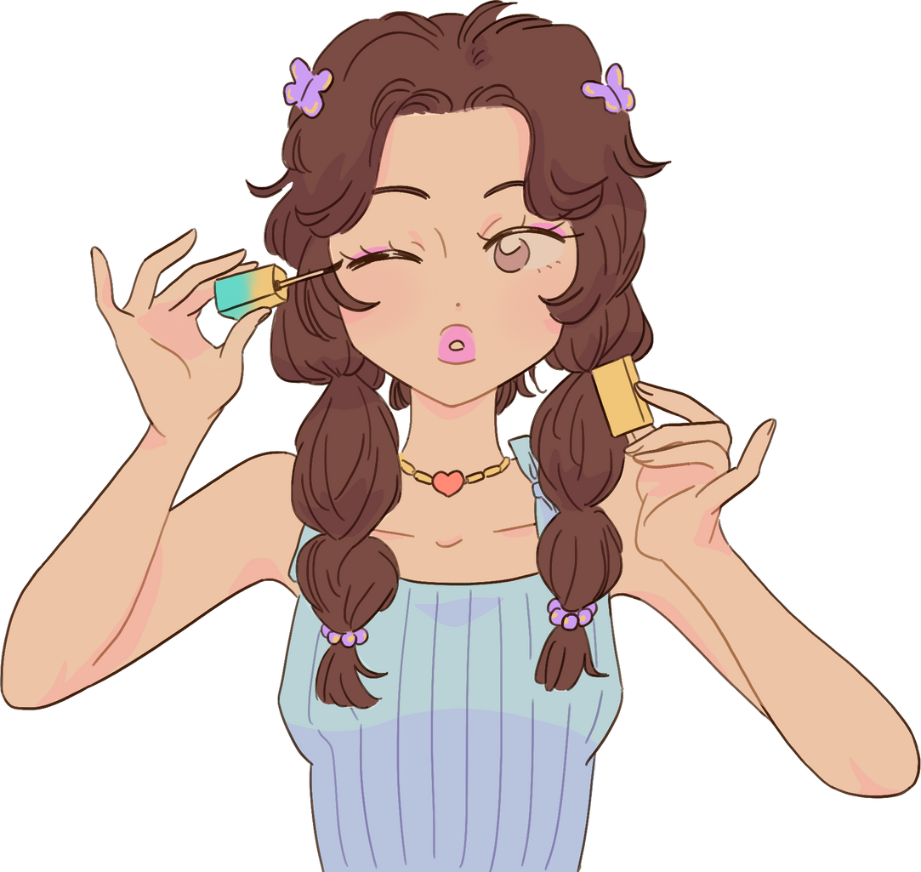
beautiful
The girl is beautiful.

Slide 3

straw
Don't throw the straw in the ocean.

Slide 4
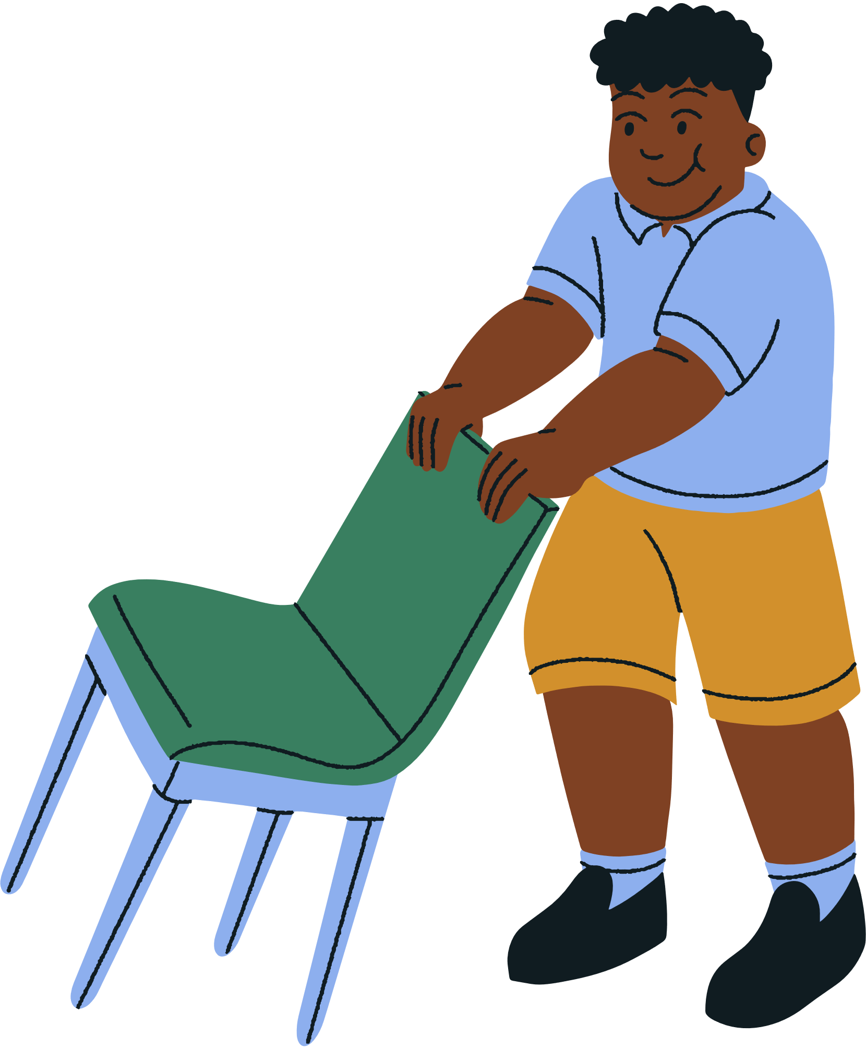
pull out
He pulls out a chair .

Slide 5

breathe
We need air to breathe.

Slide 6
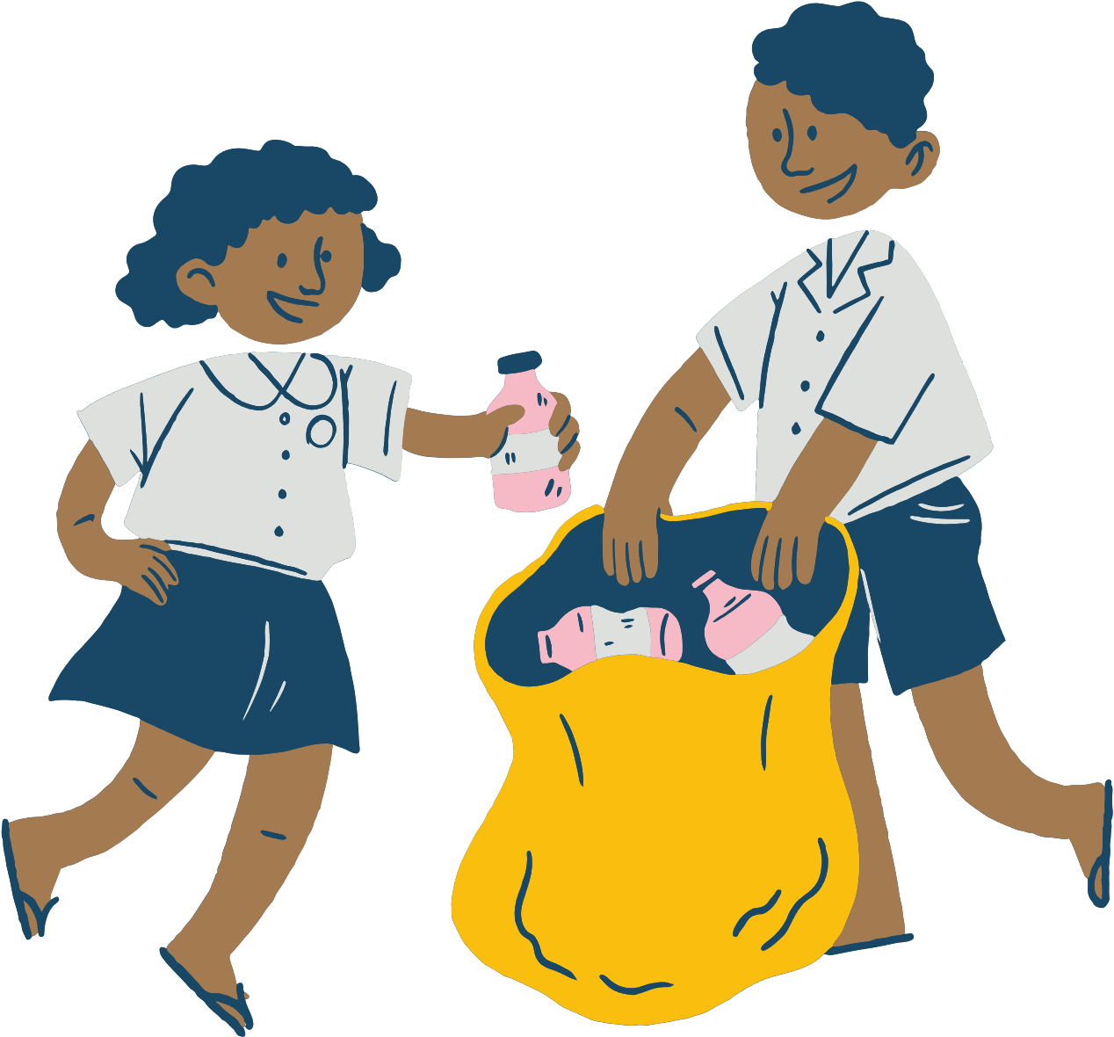
garbage
Let's pick up the garbage.

Slide 7

painful
I feel painful.

Slide 8
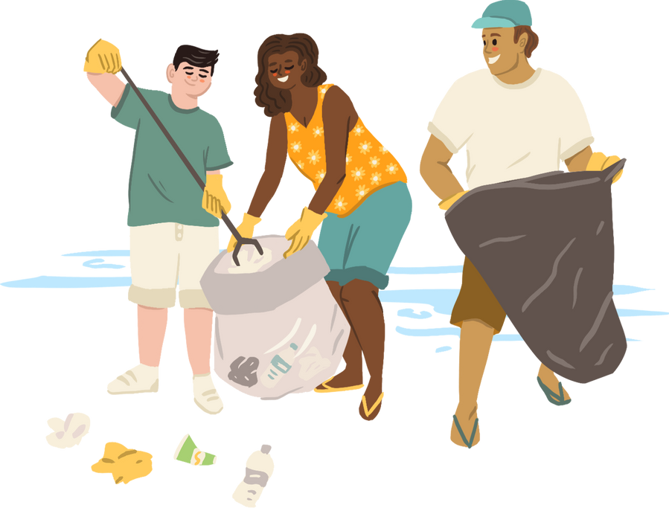
clean up
They clean up the ocean.

Slide 9
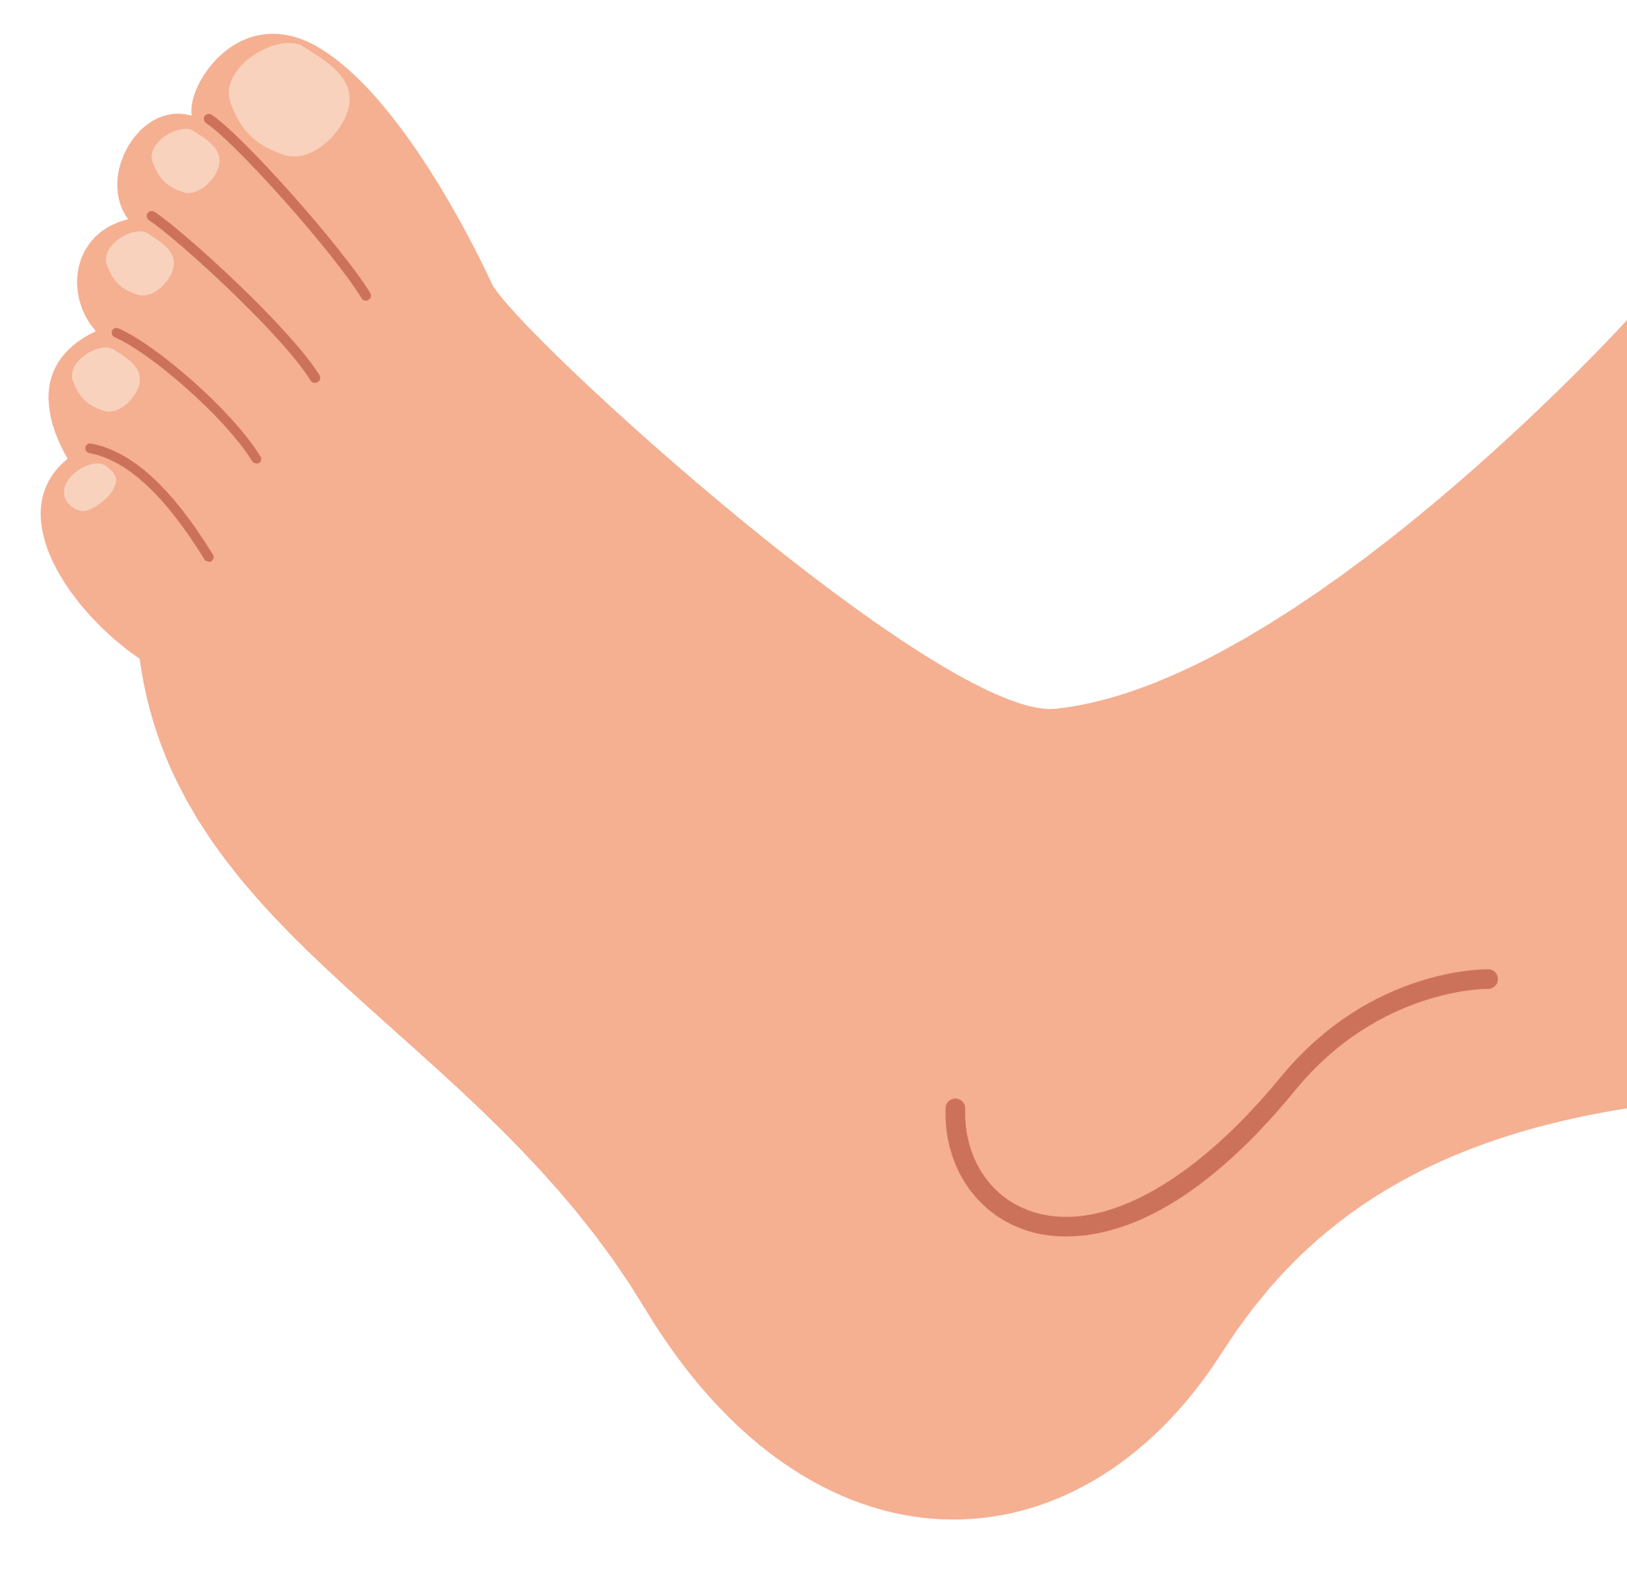


blood
Our blood is red.

Slide 10


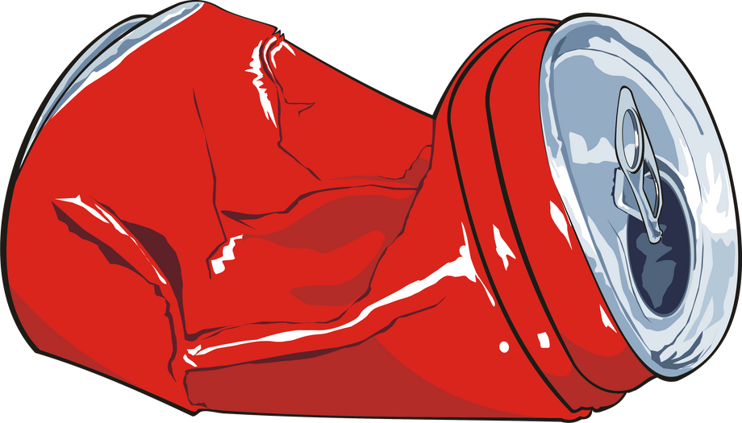

Let’s pick up the_____.
can
shell
garbage
bottle

Slide 11

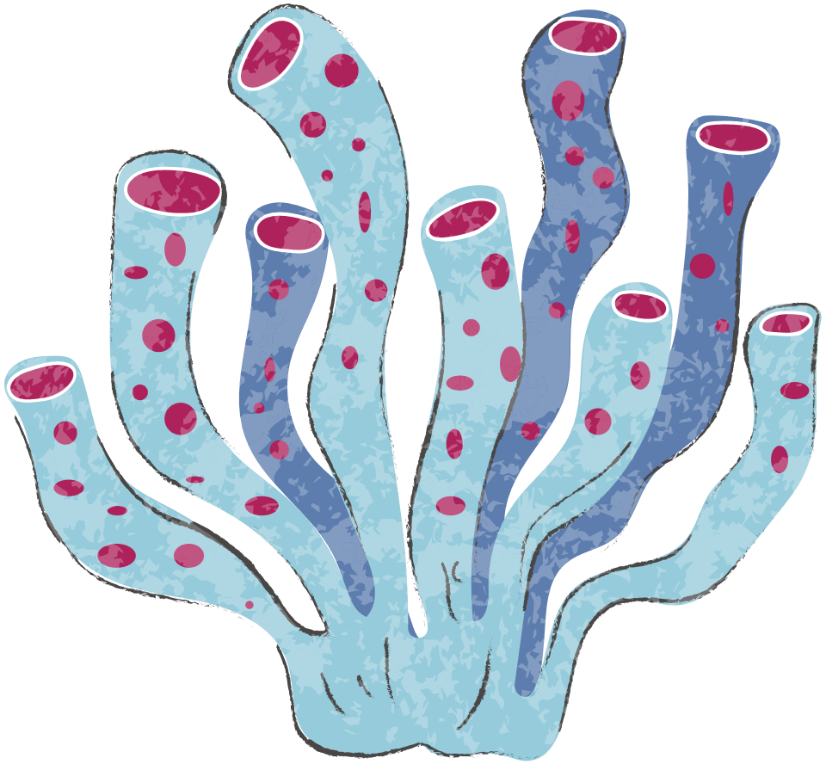
Video

Slide 12
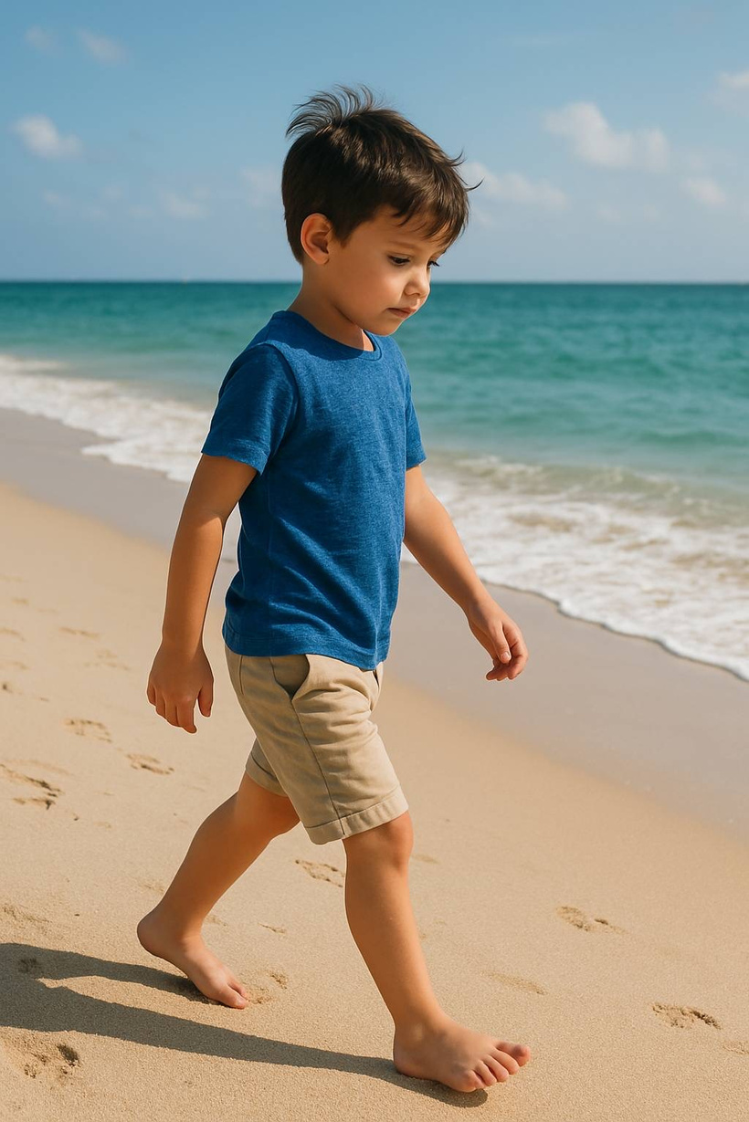
Story
One day, a boy is walking on the beach.

Slide 13
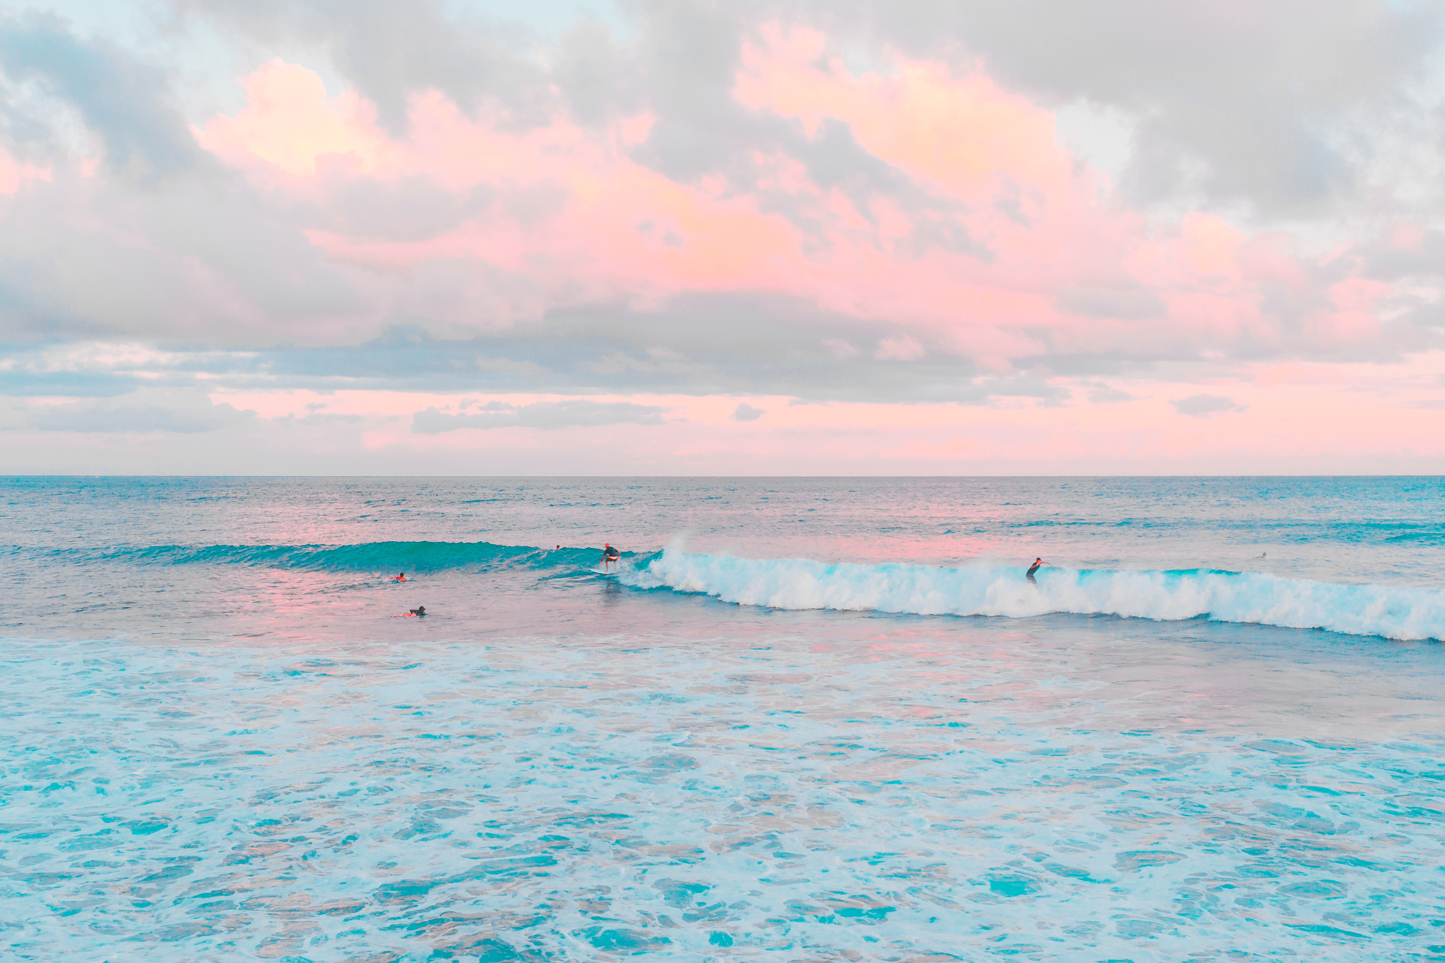
The ocean is very beautiful.

Slide 14
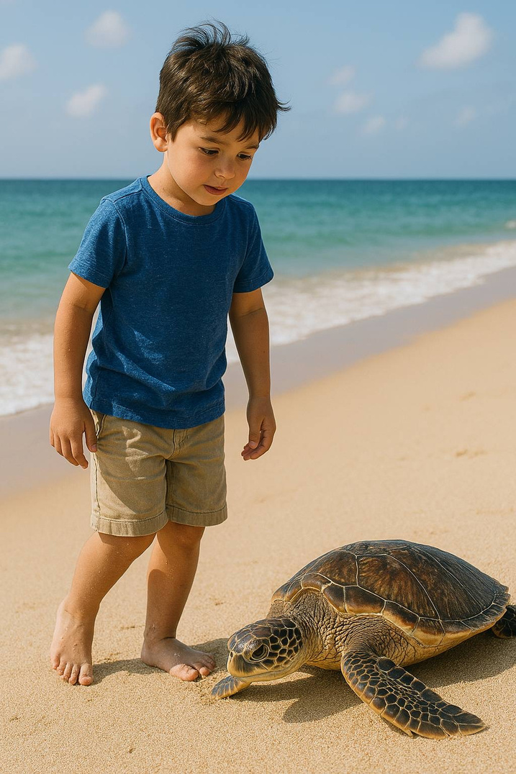
He sees a sea turtle on the beach.

Slide 15
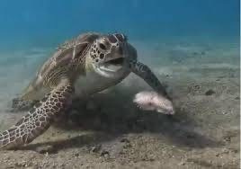
The sea turtle looks painful.

Slide 16
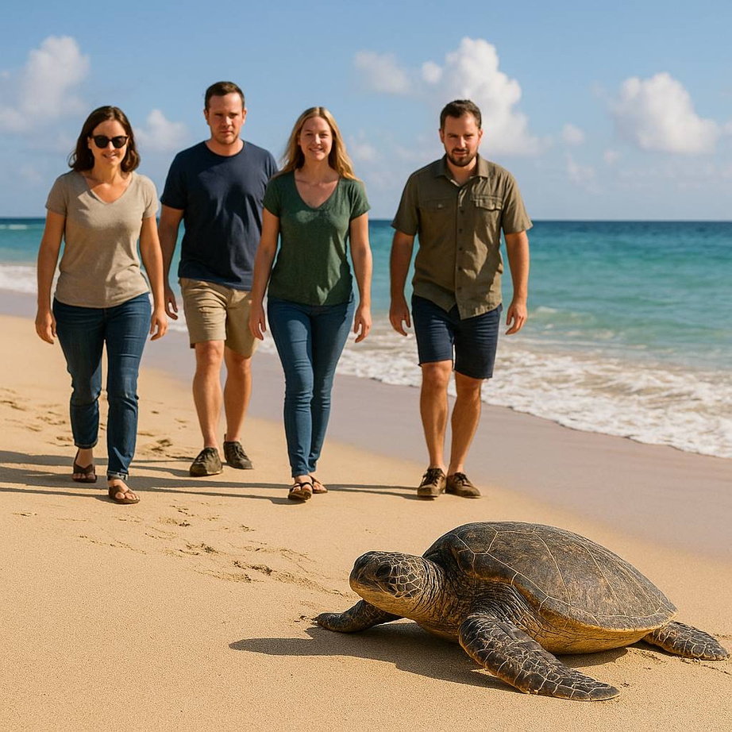
Then, some people walk to the turtle.

Slide 17
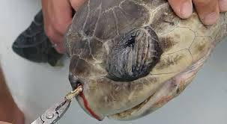
A man pulls a straw out.

Slide 18
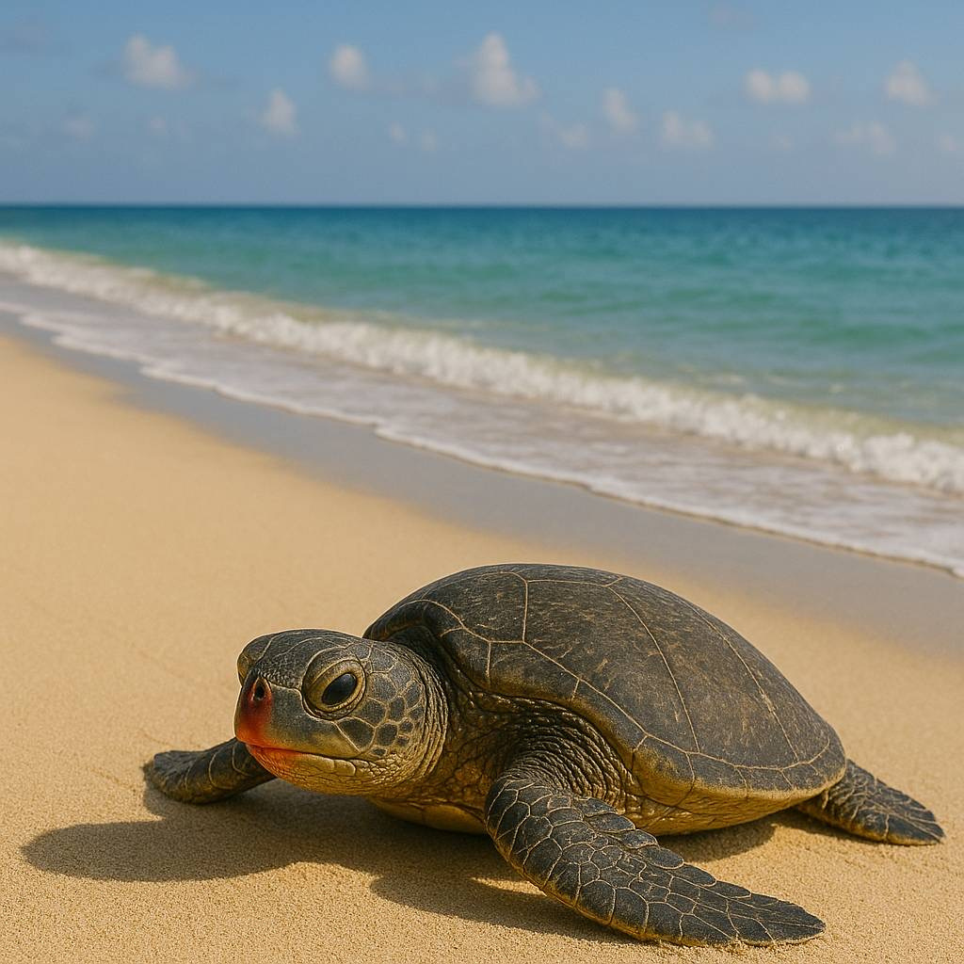
There is blood on its face.

Slide 19
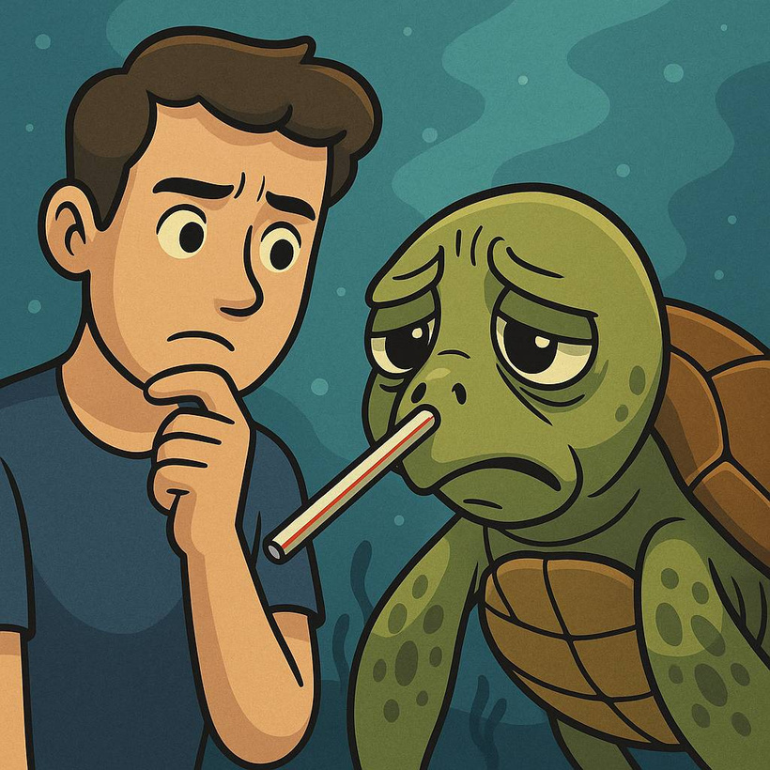
“Why the straw is in the turtle’s nose?"

Slide 20
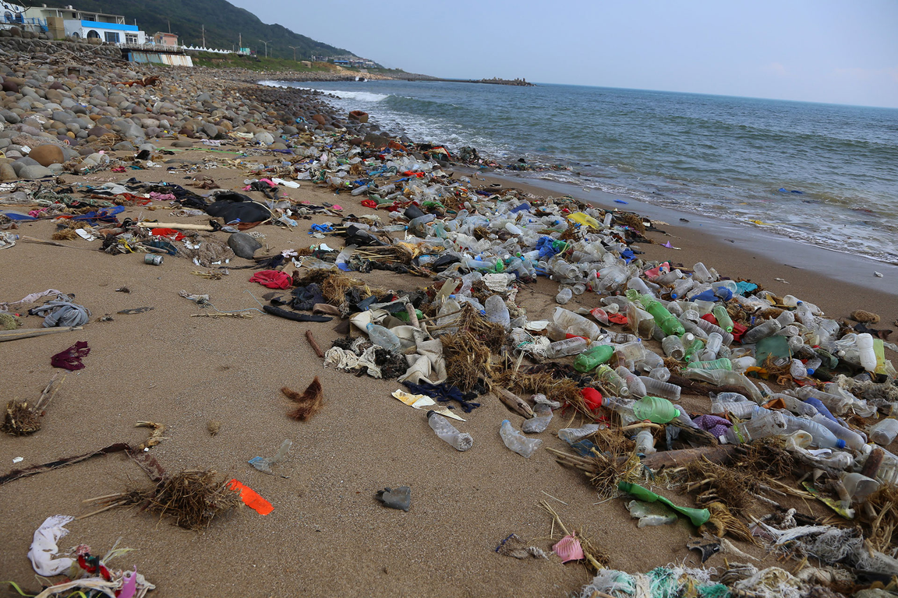
The man says, There is a lot of garbage in the ocean.

Slide 21
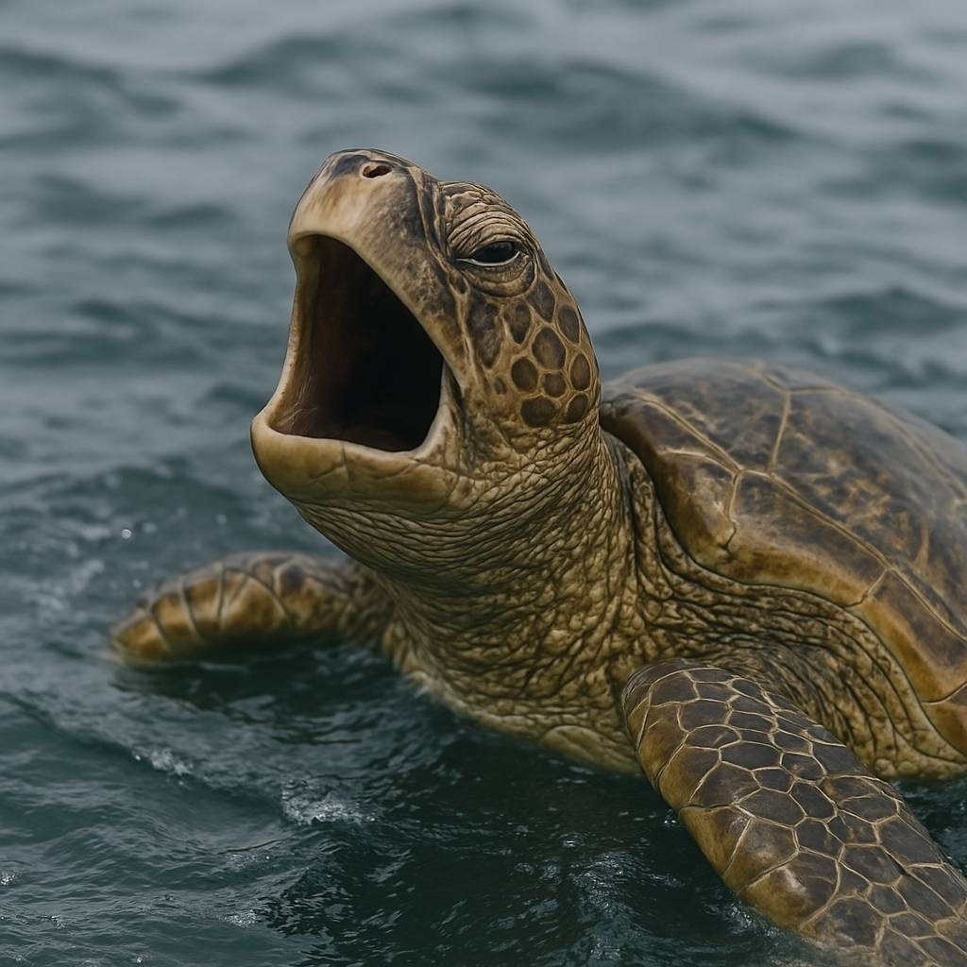
The turtle can’t breath.

Slide 22
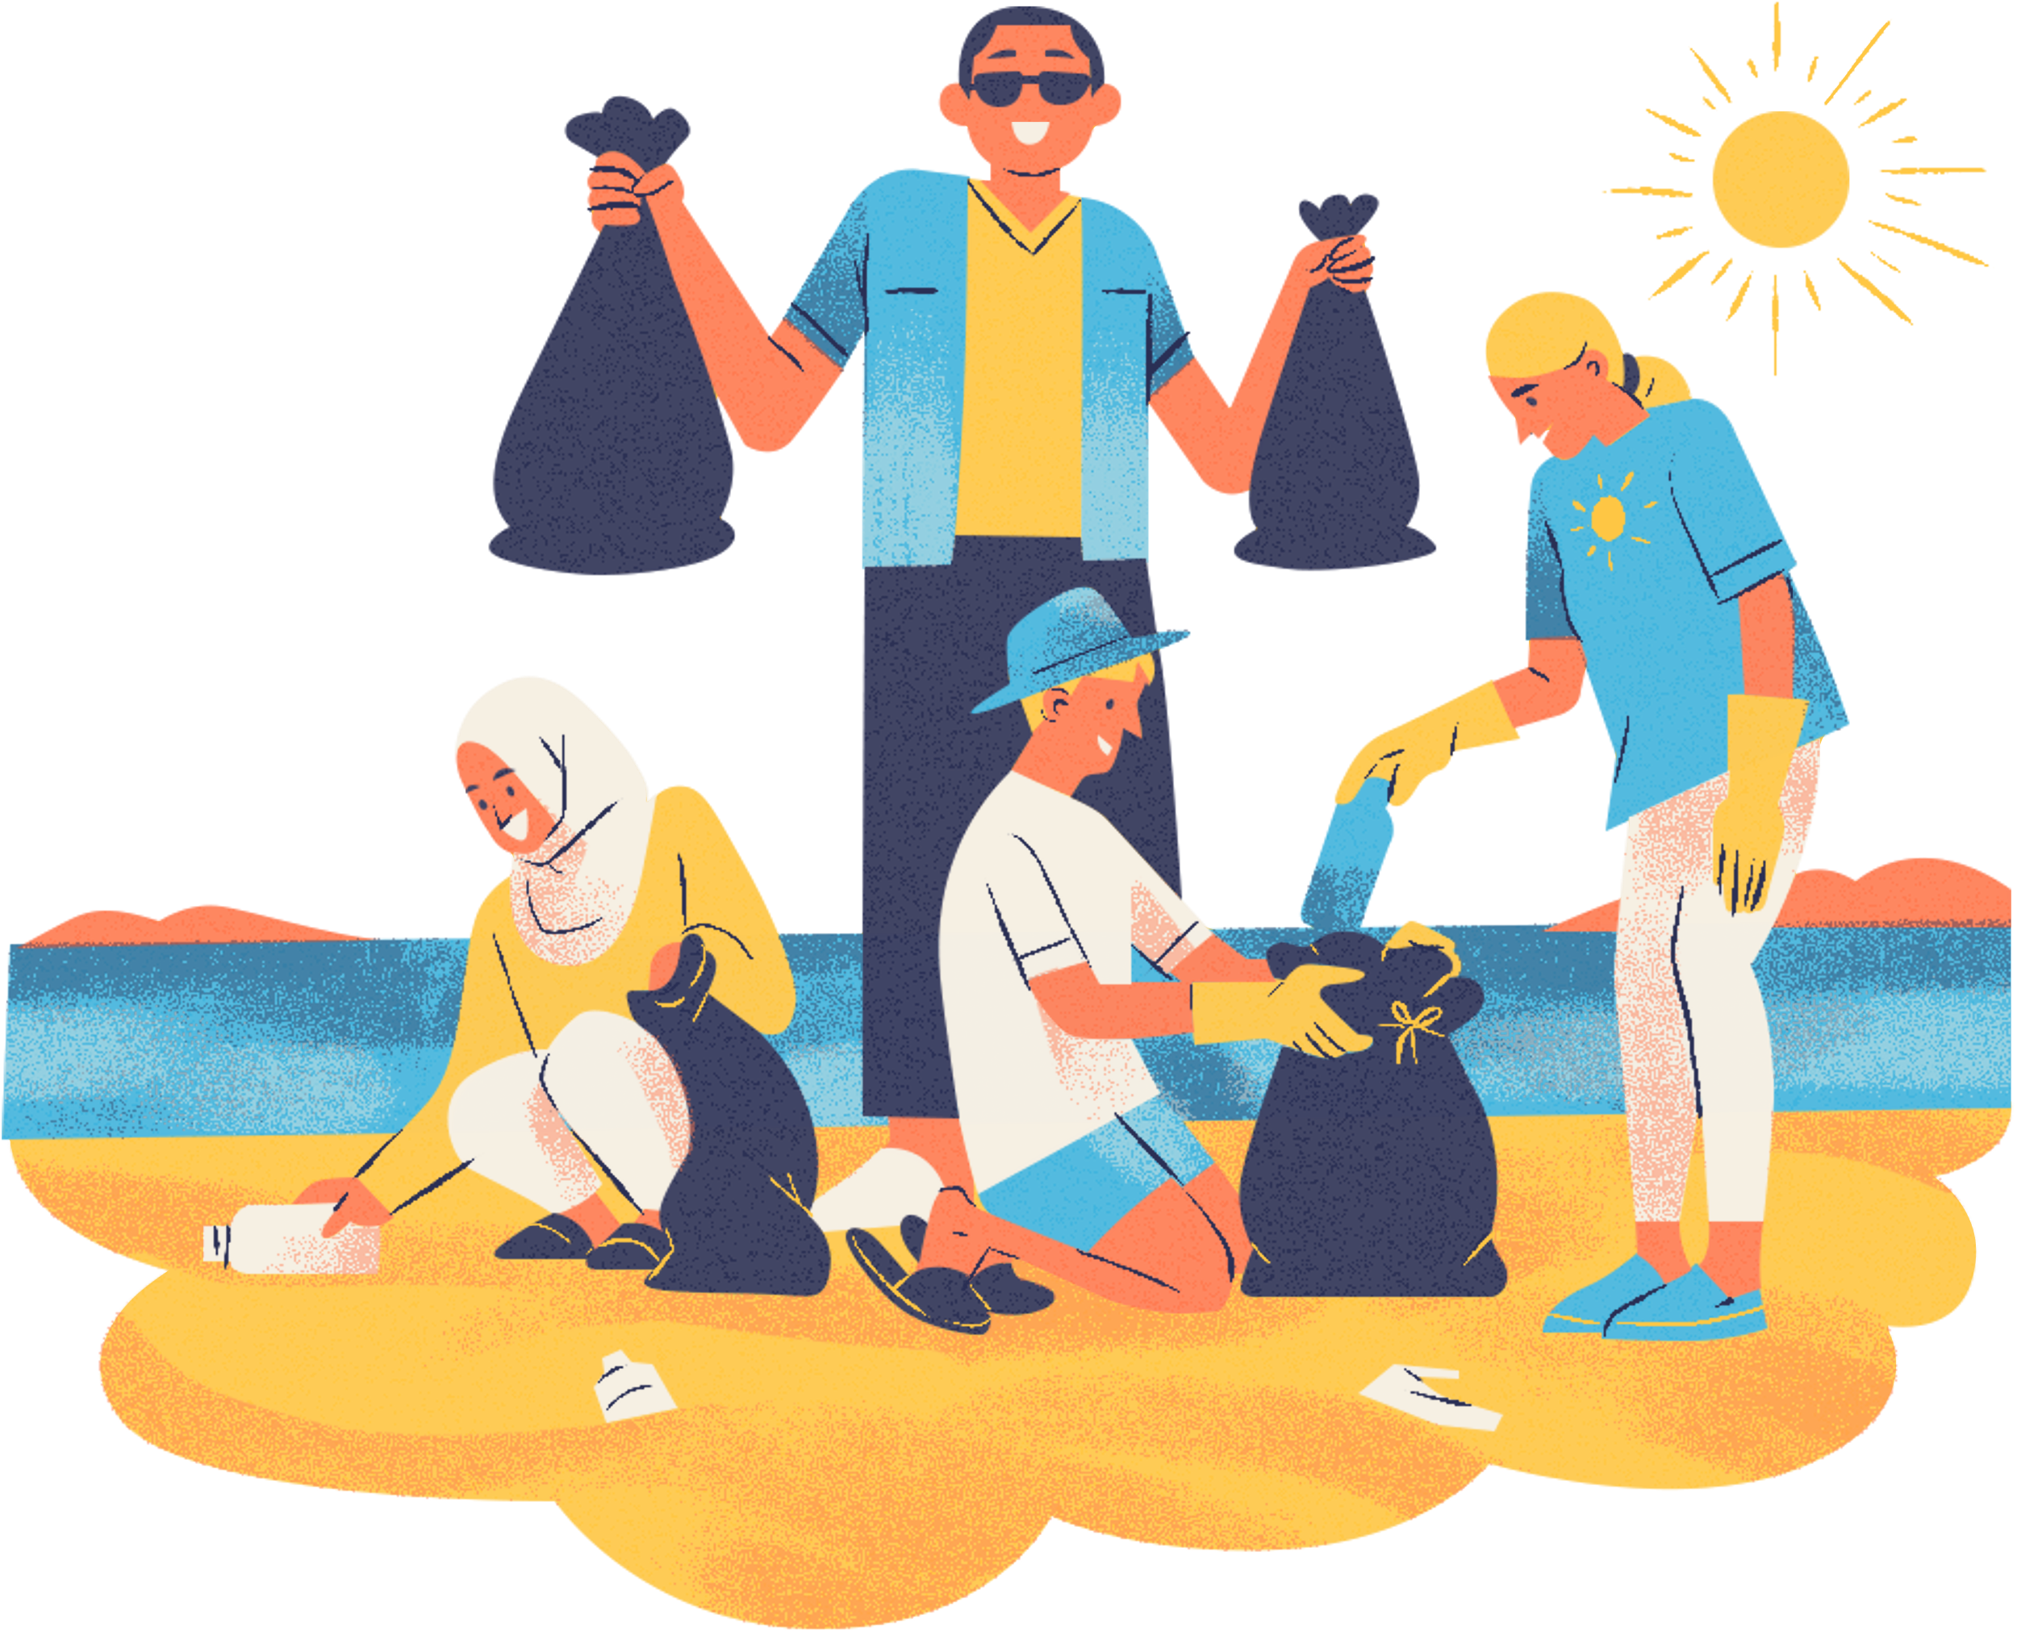
Then, the boy says to his friend , Let’s clean up the beach.

Slide 23

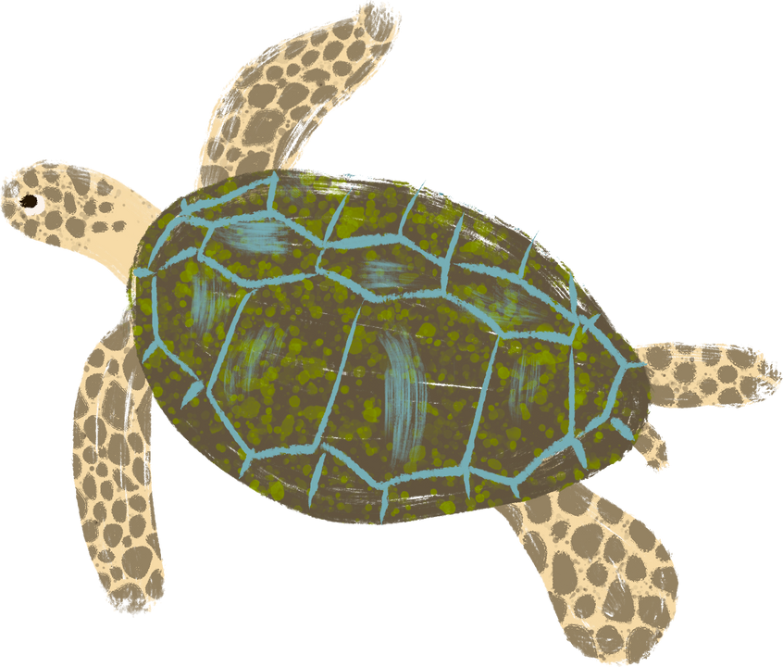
Thank you!!
Turtle says, “Thank you”.

Slide 24

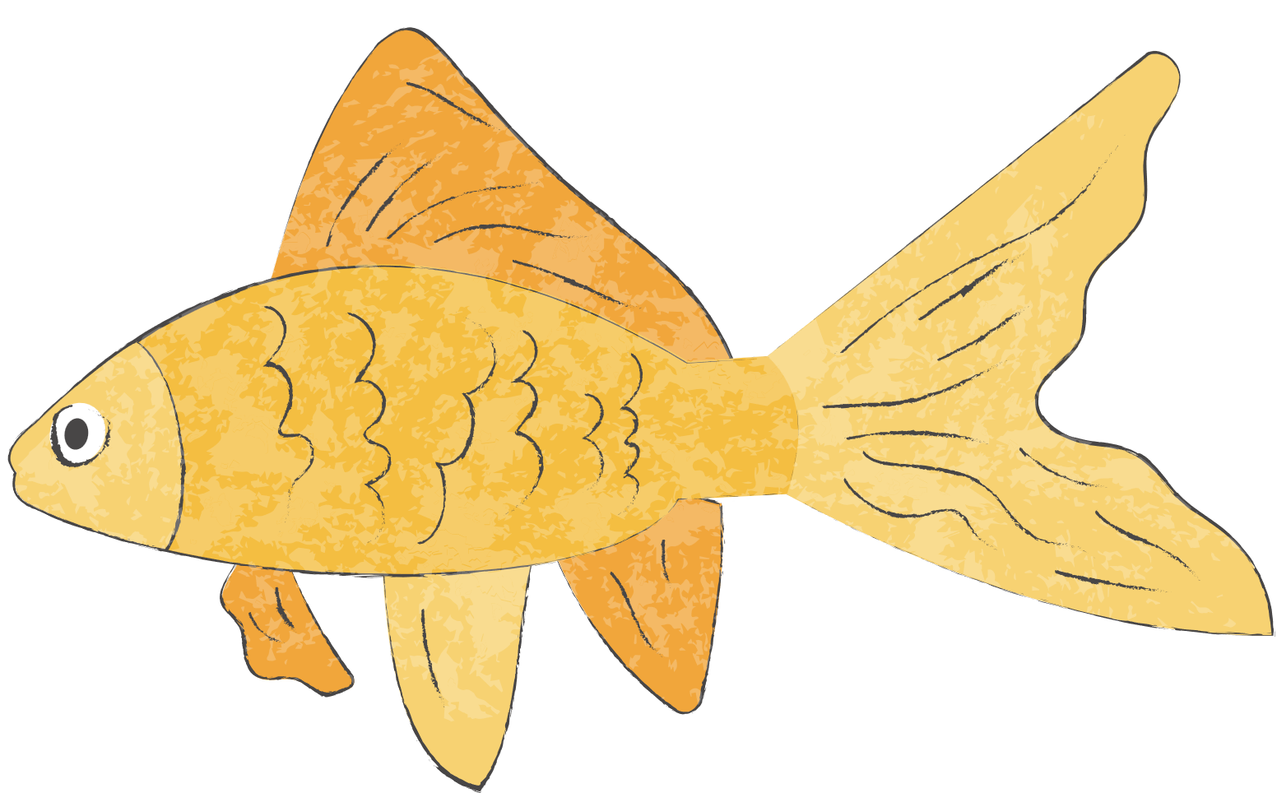

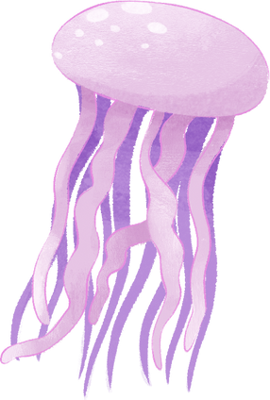
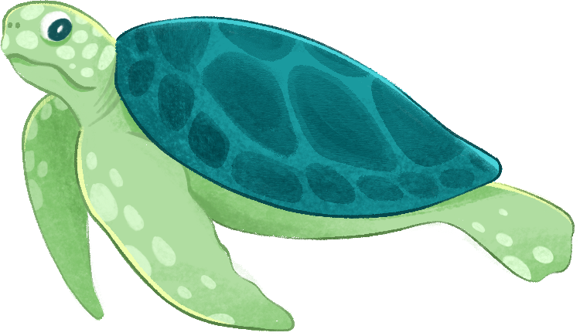
Activity
www.kahoot.it

Slide 25
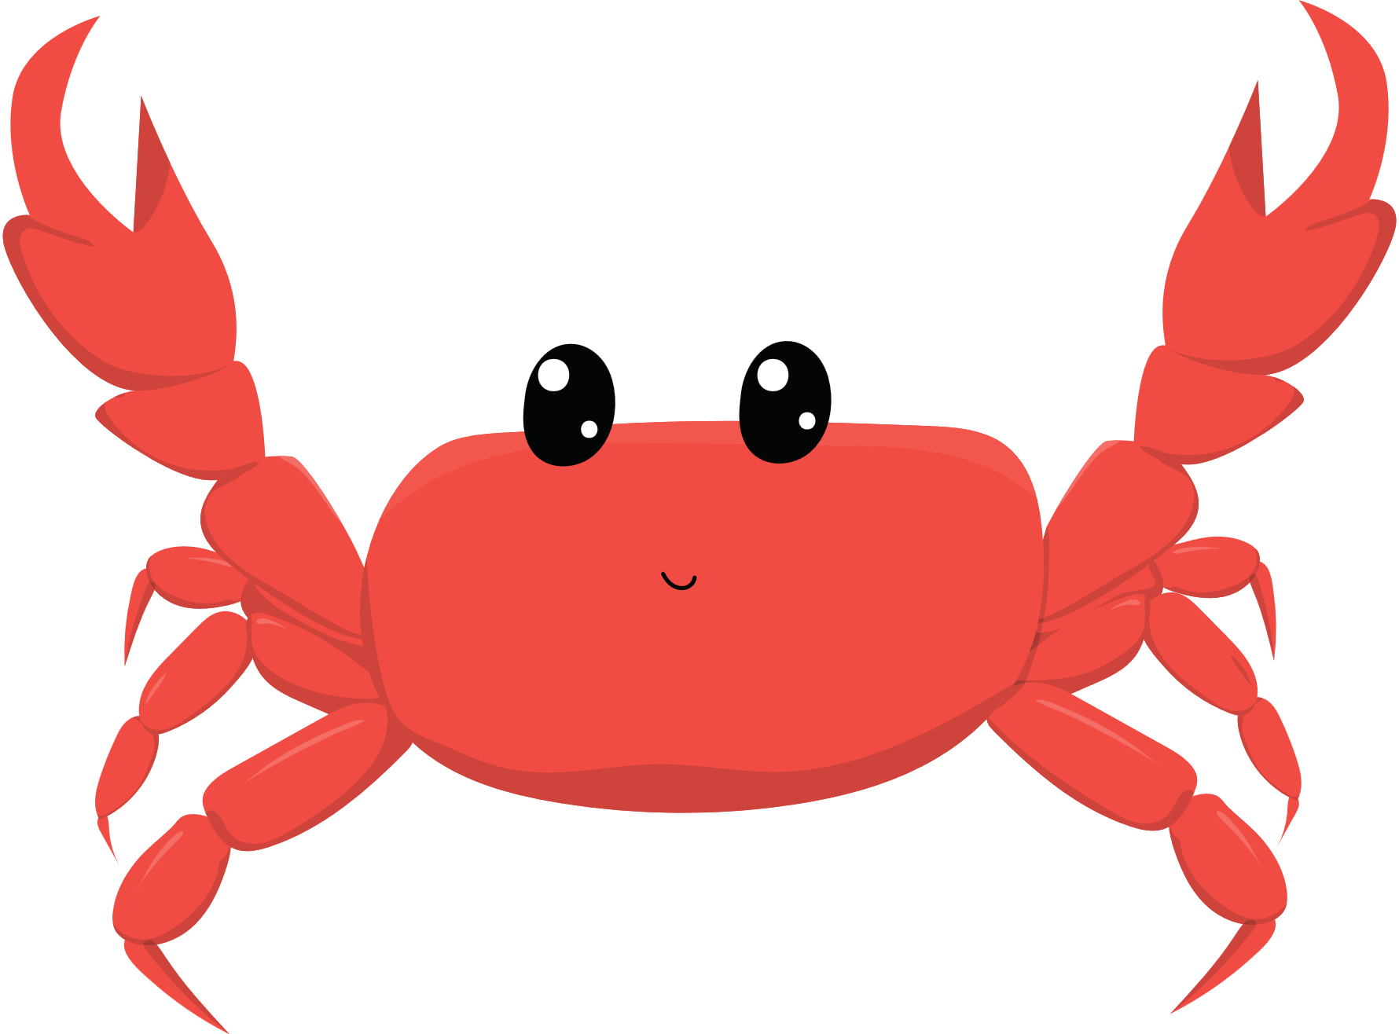
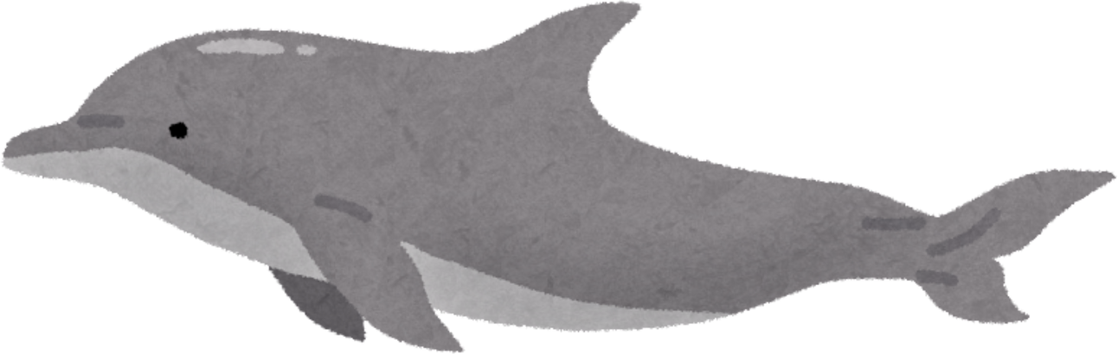
See you!!

