Slide 1
Down in the Deep Blue Sea
深海好朋友
小老師：陳寀妍

Slide 2
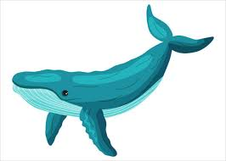
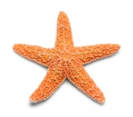


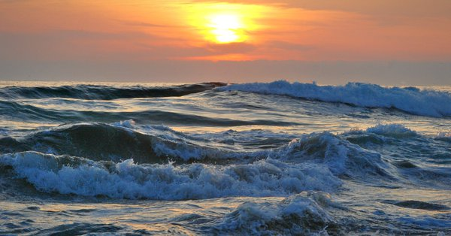
Warm-up

Slide 3
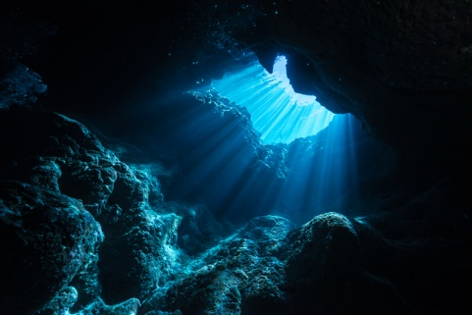
單 字
deep

Slide 4
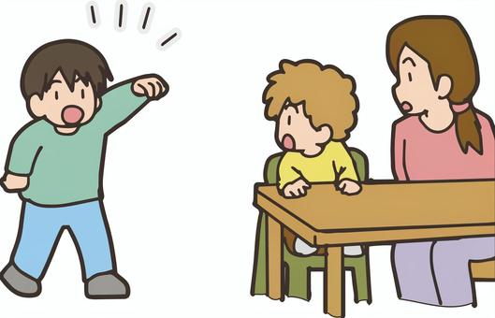
單 字
come

Slide 5
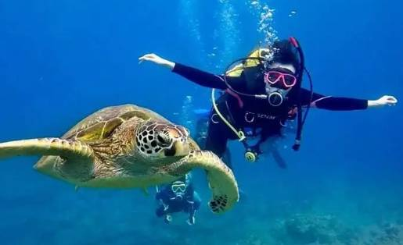
單 字
take a dive

Slide 6

單 字
see

Slide 7
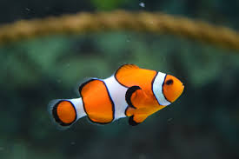
單 字
fish

Slide 8
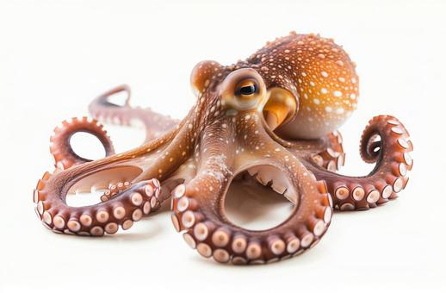
單 字
‘octopus

Slide 9

單 字
baby shark

Slide 10

單 字
jelly
fish

Slide 11
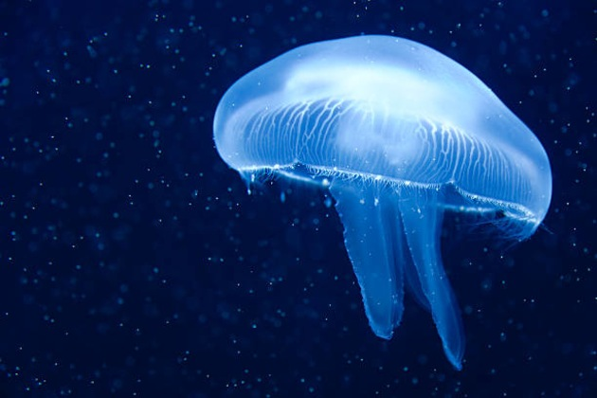
單 字
jelly fish

Slide 12
猜猜看 ，將單字說出來和拼出來
t_k_ a d_v_
Ans：take a dive

Slide 13
猜猜看 ，將單字說出來和拼出來
j_l_y f_s_
Ans： jelly fish

Slide 14
猜猜看 ，將單字說出來和拼出來
b_by sh_ _k
Ans： baby shark

Slide 15

Kahoot! Game time
https://kahoot.com

Slide 16
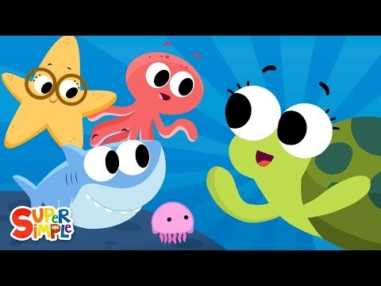
Down in the deep blue sea song
We’ll (will) see a _____________ in the deep blue sea.
swimming fish

Slide 17
Down in the deep blue sea song
We’ll (will) see a _____________ in the deep blue sea.
great big whale

Slide 18
Down in the deep blue sea song
We’ll (will) see a _____________ in the deep blue sea.
baby shark

Slide 19
Down in the deep blue sea song
We’ll (will) see a _____________ in the deep blue sea.
jelly fish

Slide 20
Down in the deep blue sea song
We’ll (will) see a _____________ in the deep blue sea.
starfish

Slide 21

Down in the deep blue sea song
We’ll (will) see an _____________ in the deep blue sea.
octopus

Slide 22
未來式 Will+V (複習)
We′ll (will) see a swimming fish in the deep blue sea.
You′ll (will) see a swimming fish in the deep blue sea.
They′ll (will) see a swimming fish in the deep blue sea.
He′ll (will) see a swimming fish in the deep blue sea.
She′ll (will) see a swimming fish in the deep blue sea.
I′ll (will) see a swimming fish in the deep blue sea.

Slide 23
上週未來式Will 的文法說明
用法 | 說明 | 句型 | 例句
未來式 | 1.臨時決定、承諾 2.已經有計畫好的未來 | 1. S +will +原V 2. S+am/are/is +going to+原V | 1.They’ll(will) help you now . 2.I am going to visit grandma.

Slide 24
未來式 Will+V 疑問句/回答
We′ll (will) see a swimming fish in the deep blue sea.
Will you see a swimming fish in the deep blue sea?
Yes, I will.
No, I will not (won′t).

Slide 25
未來式 Will+not (Won′t)+ V 否定句
We′ll (will) see a swimming fish in the deep blue sea.
We will not (won′t) see a swimming fish in the deep blue sea.
You′ll (will) see a swimming fish in the deep blue sea.
You will not (won′t) see a swimming fish in the deep blue sea.
They′ll (will) see a swimming fish in the deep blue sea.
They will not (won′t) see a swimming fish in the deep blue sea.

Slide 26
未來式 Will+not (Won′t)+ V 否定句
I′ll (will) see a swimming fish in the deep blue sea.
I will not (won′t) see a swimming fish in the deep blue sea.
S/he′ll (will) see a swimming fish in the deep blue sea.
S/he will not (won′t) see a swimming fish in the deep blue sea.

Slide 27
上週Be+Ving 表示未來式(計畫)的文法說明
用法 | 說明 | 句型 | 例句
現在進行式 | 表示正在進行或已經安排好的計畫 | S + am/is/are + V-ing | I'm going down under the sea.

Slide 28
上週Be+Ving 表示未來式(計畫)的疑問句/簡答
We′re (are) seeing a swimming fish in the deep blue sea.
Are you seeing a swimming fish in the deep blue sea?
Yes, we are.
No, we are not (aren′t).

Slide 29
上週Be+Ving 表示未來式(計畫)的否定句
We′re(are) seeing a swimming fish in the deep blue sea.
We are not (aren′t) seeing a swimming fish in the deep blue sea.
You′re(are) seeing a swimming fish in the deep blue sea.
You are not (aren′t) seeing a swimming fish in the deep blue sea.
They′re (are) seeing a swimming fish in the deep blue sea.
They are not (aren′t) seeing a swimming fish in the deep blue sea.

Slide 30
上週Be+Ving 表示未來式(計畫)的否定句
I′m(am) seeing a swimming fish in the deep blue sea.
I′m(am) not seeing a swimming fish in the deep blue sea.
S/he′s (is) seeing a swimming fish in the deep blue sea.
S/he is not (isn′t) seeing a swimming fish in the deep blue sea.

Slide 31
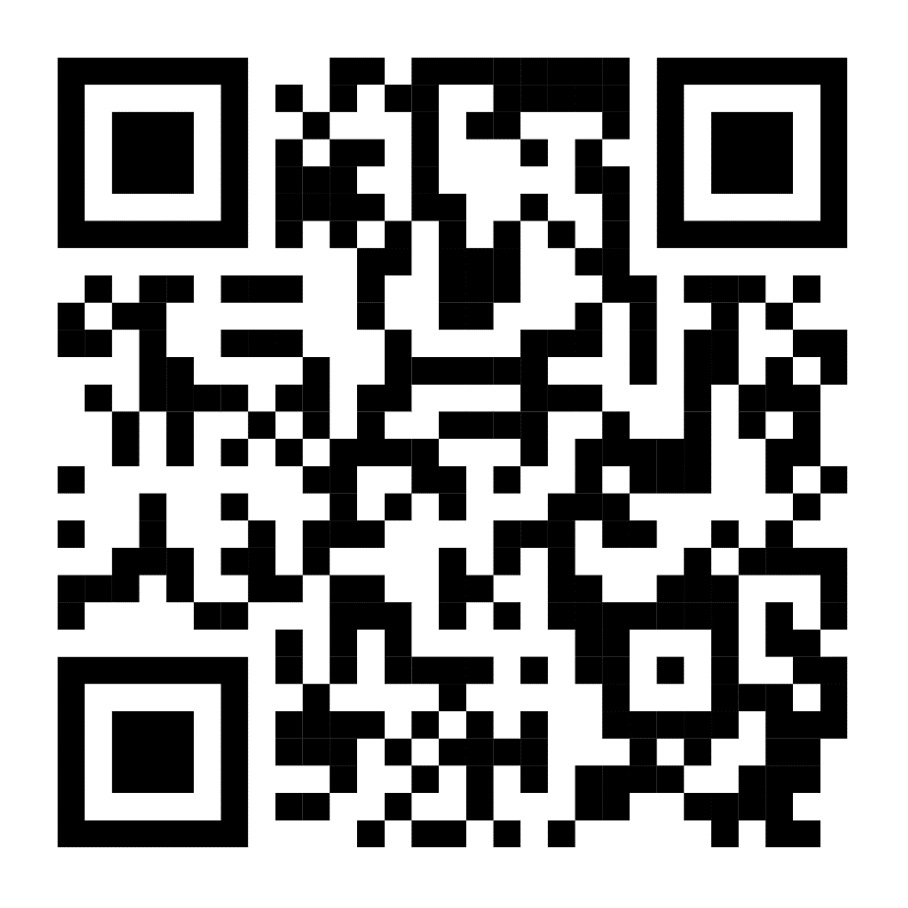
Blooket Game time

