Slide 1
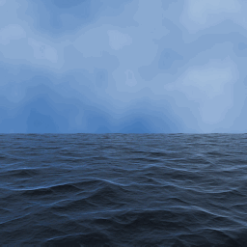


The ocean is lots of water.
It is big and blue!
What is the ocean?
ocean

Slide 2
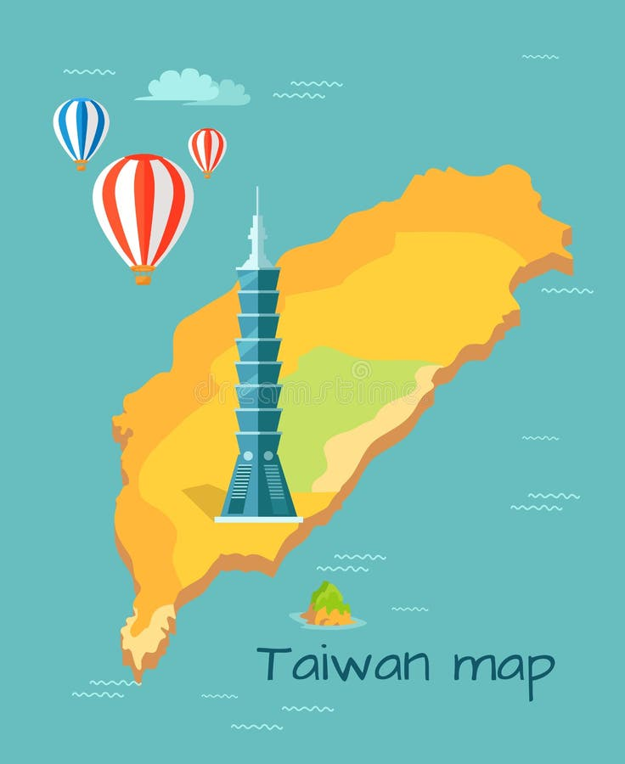
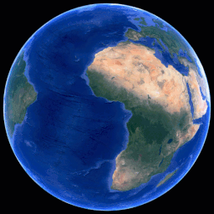
All around the world!
Look at Taiwan!
Where is the ocean?
ocean
ocean
ocean

Slide 3
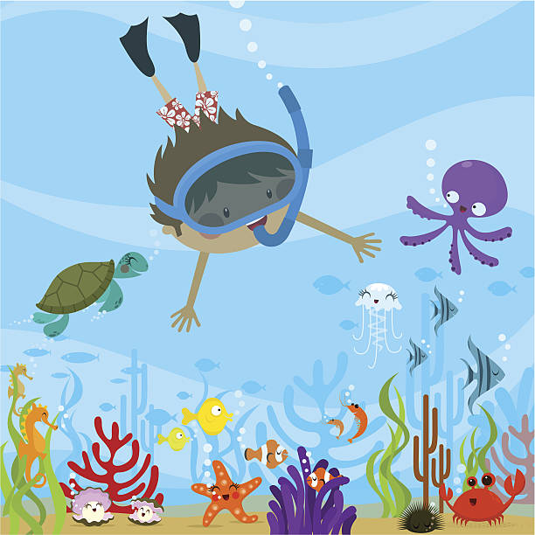
Ocean Words:
ocean

Slide 4

Ocean Words:
water

Slide 5
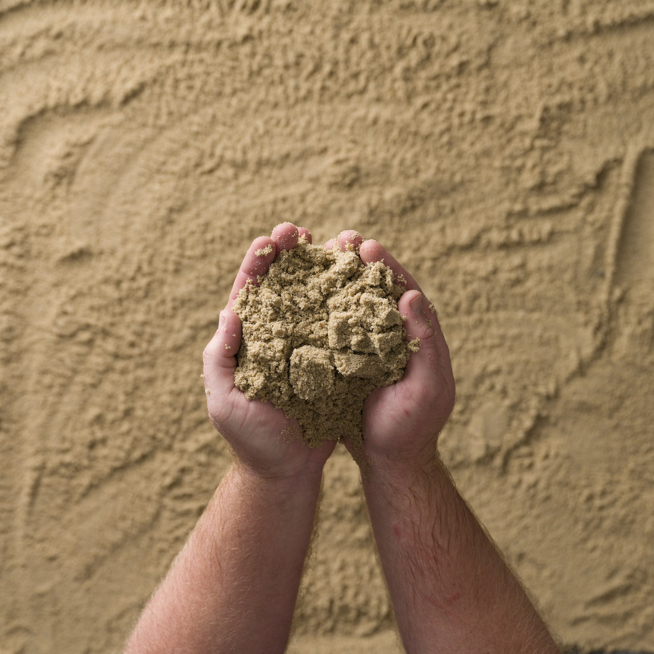
Ocean Words:
sand

Slide 6
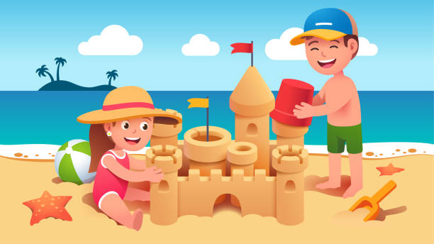
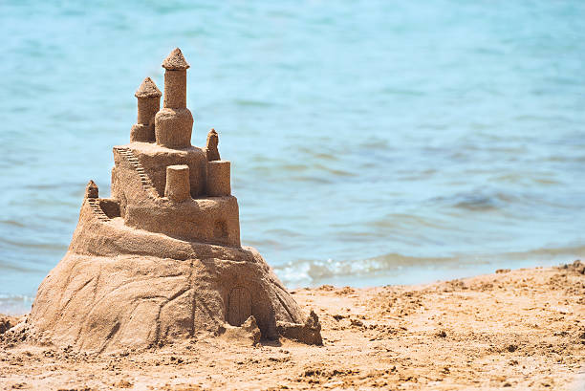
Ocean Words:
sandcastle

Slide 7
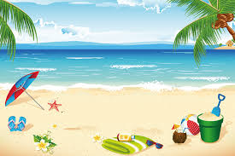
Ocean Words:
beach

Slide 8
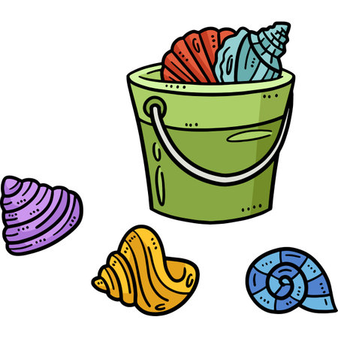
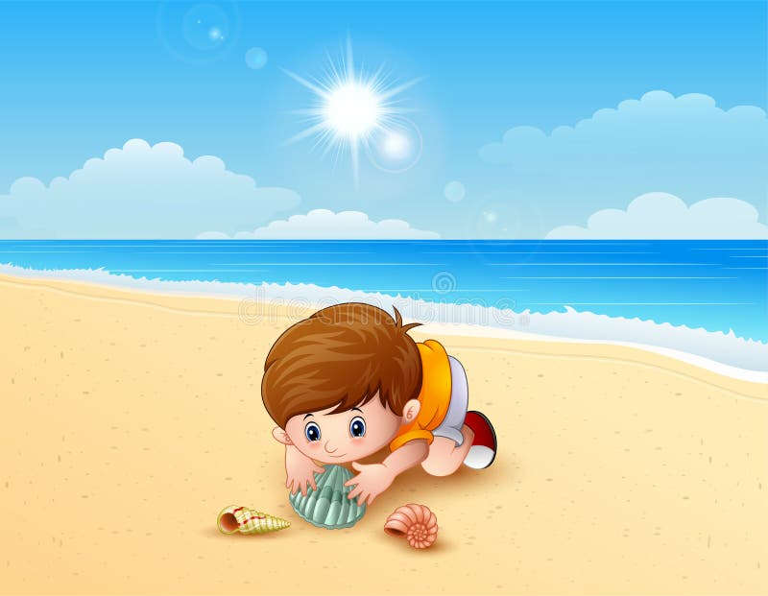
Ocean Words:
shells

Slide 9
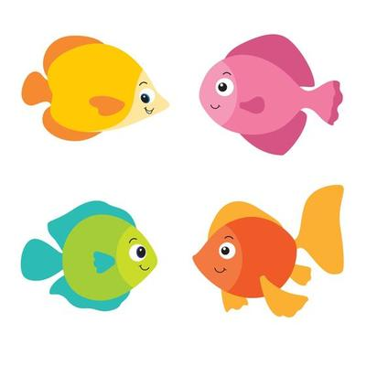
Ocean Words:
fish

Slide 10
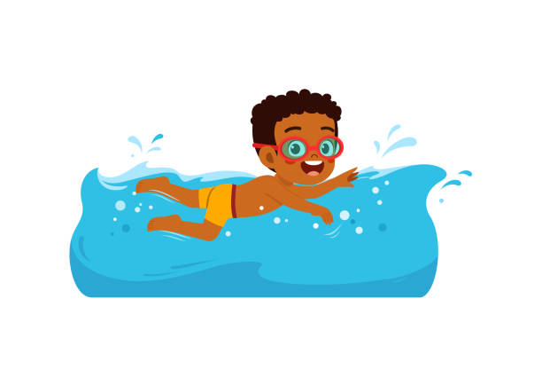
Ocean Words:
swim

Slide 11

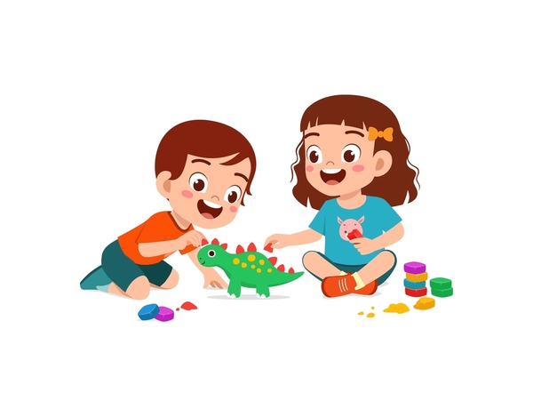
Ocean Words:
play

Slide 12
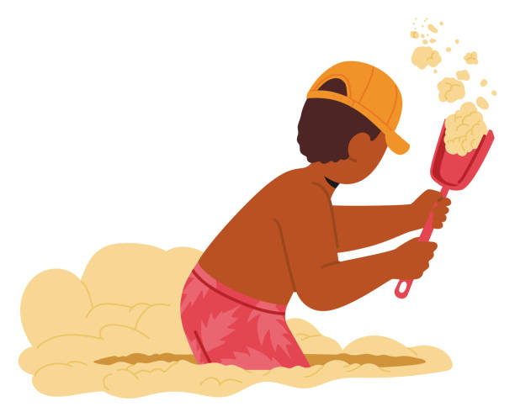
Ocean Words:
dig

Slide 13
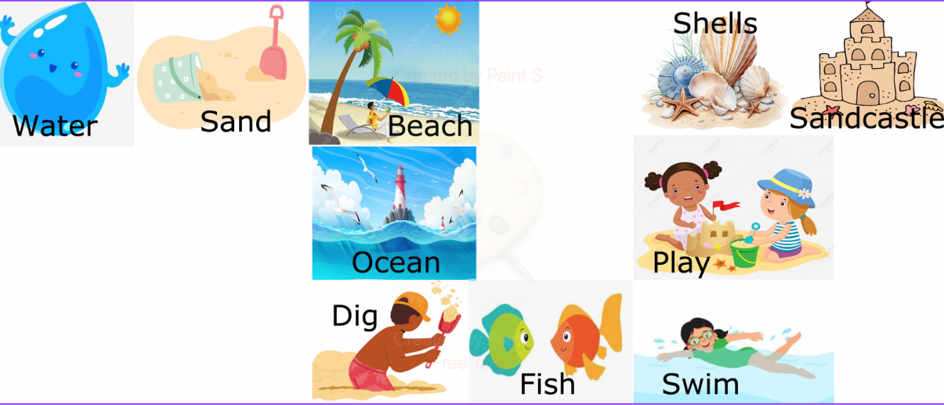




https://wheelofnames.com/xqb-e2f
Ocean words hopscotch game:

Slide 14
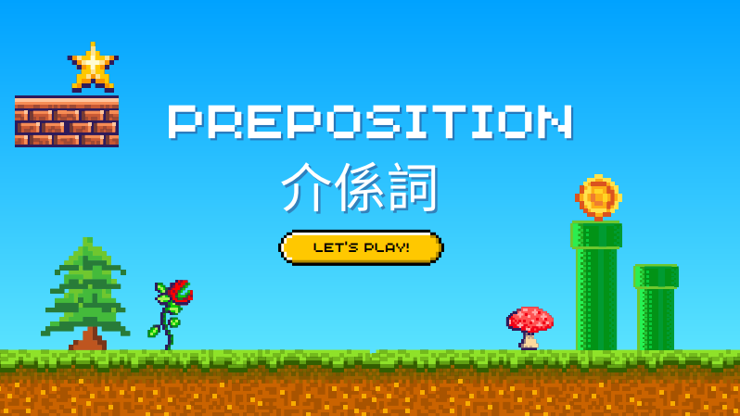


Slide 15
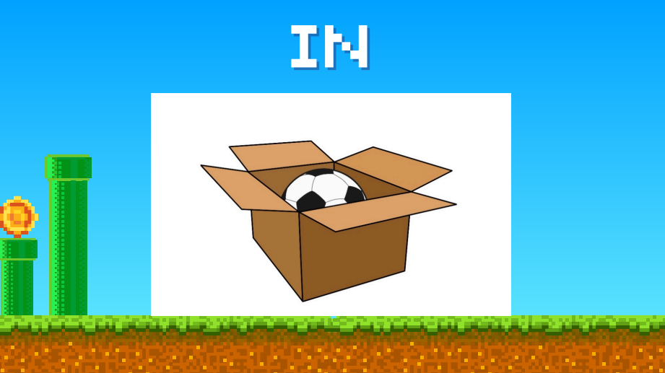


Slide 16
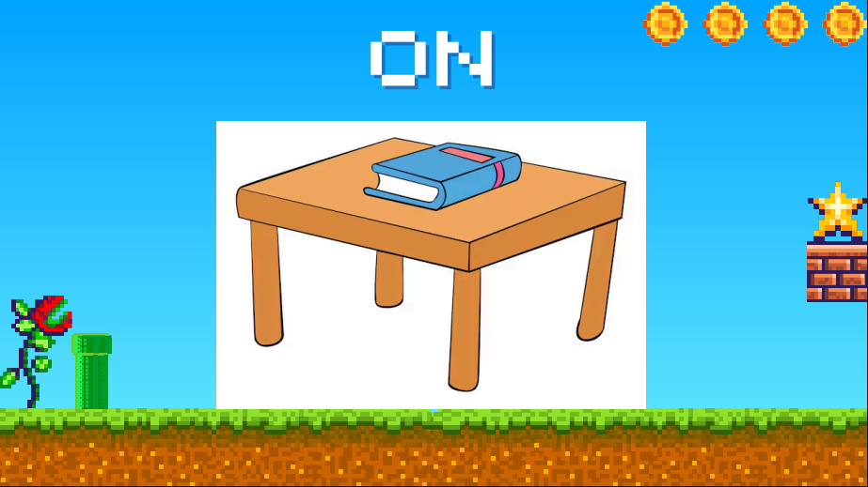

Slide 17
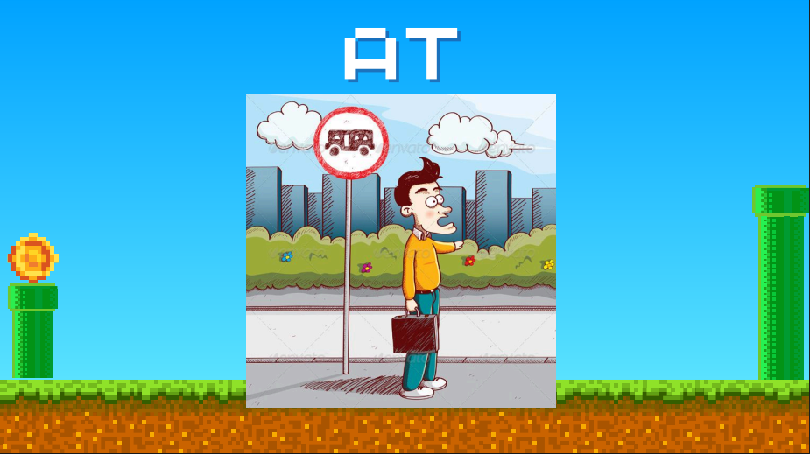

Slide 18
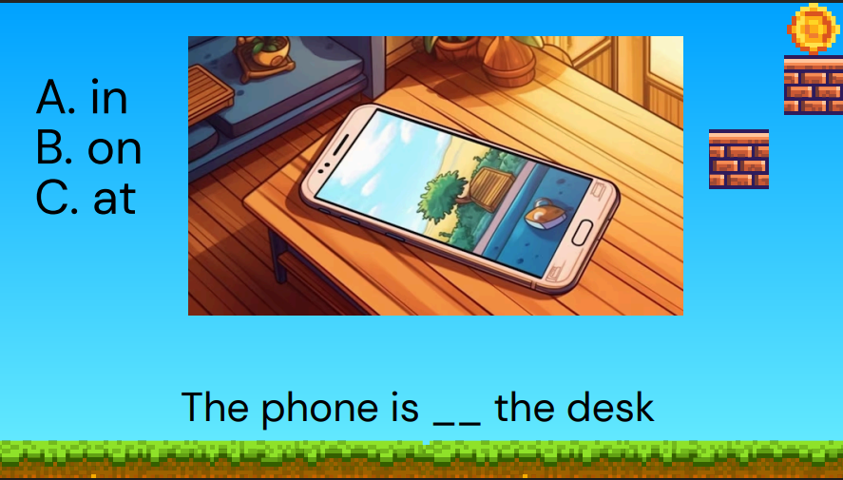

on

Slide 19
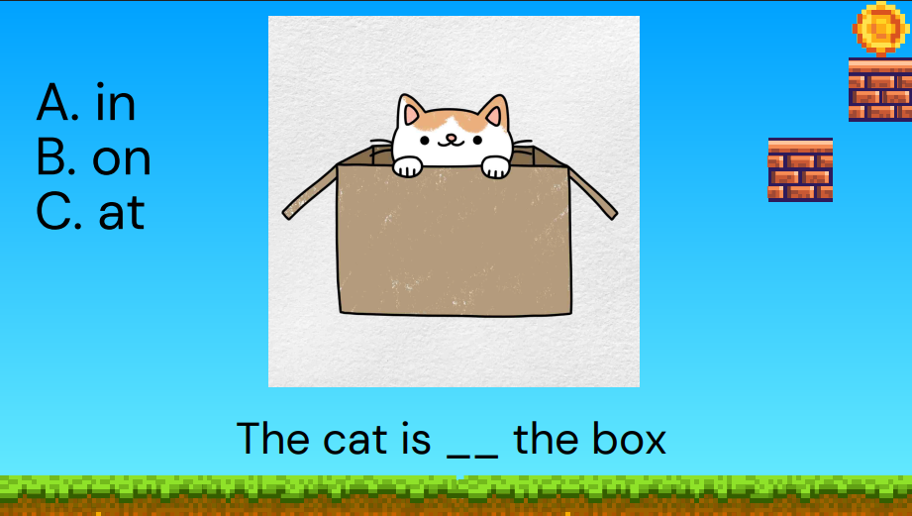
in

Slide 20
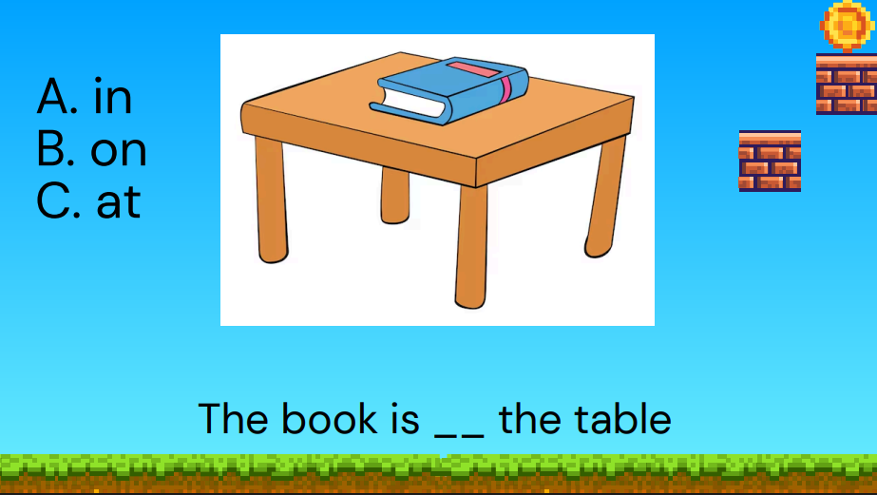
on

Slide 21
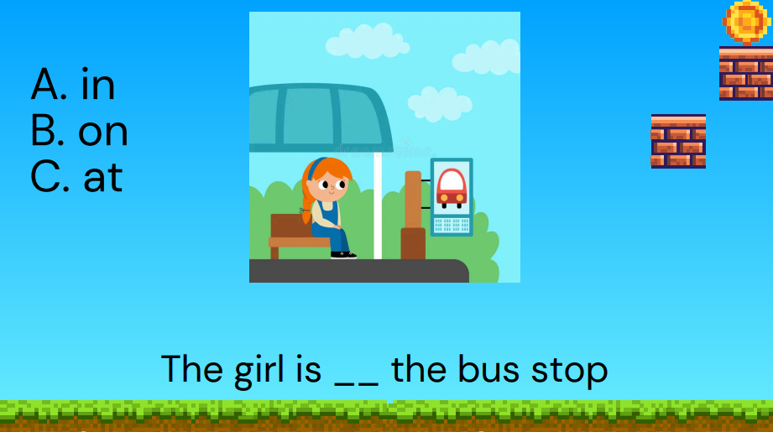
at

Slide 22

Ocean Song:
at the ocean we can…
swim in the water
see fish in the ocean
play on the beach
dig in the sand
look for shells
all day long!
all day long!
all day long!
all day long!
all day long!
all day long!
x3
x3
x3
x3
x3

Slide 23
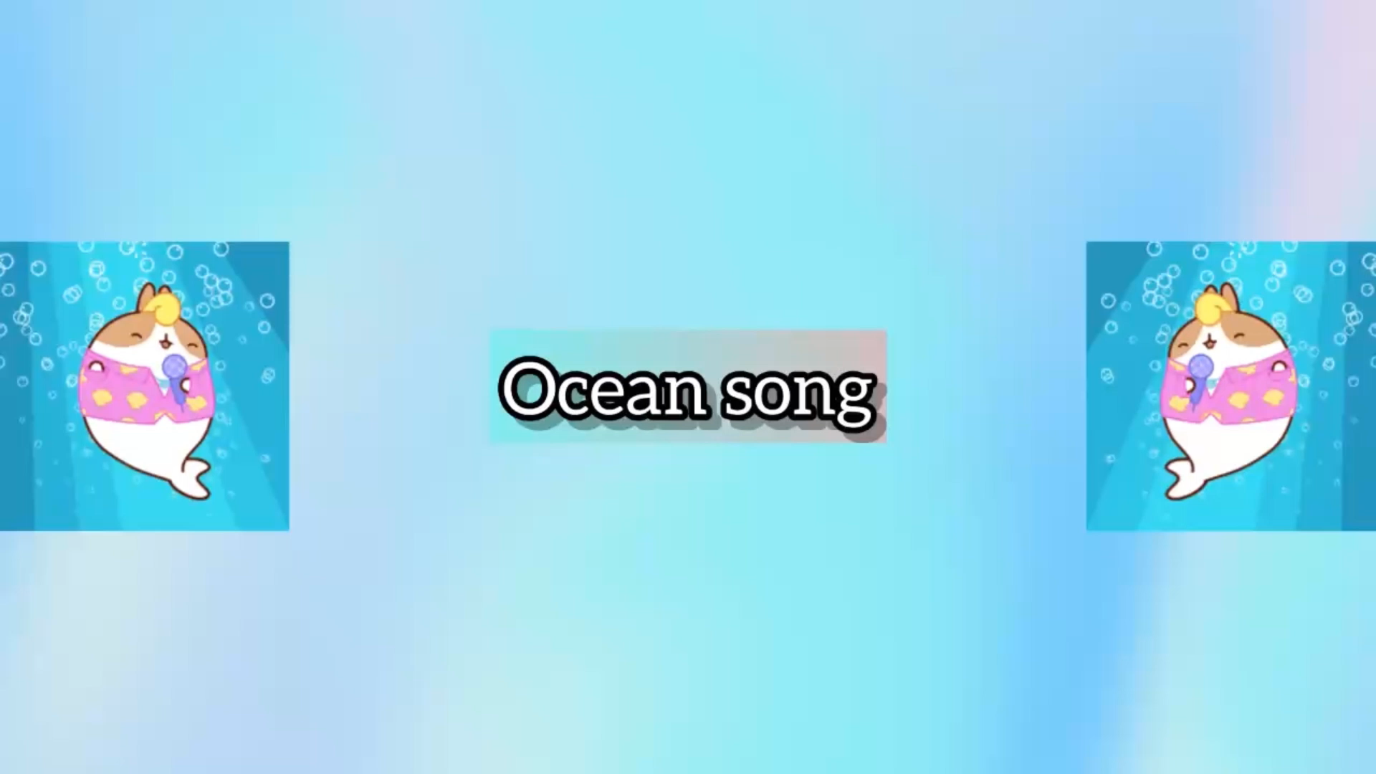

Slide 24
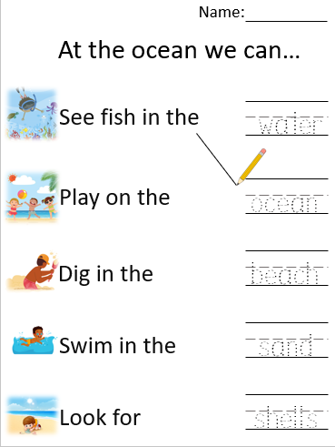
Try
writing
and
matching!
water
ocean
beach
sand

Slide 25
answers

